Slide 1
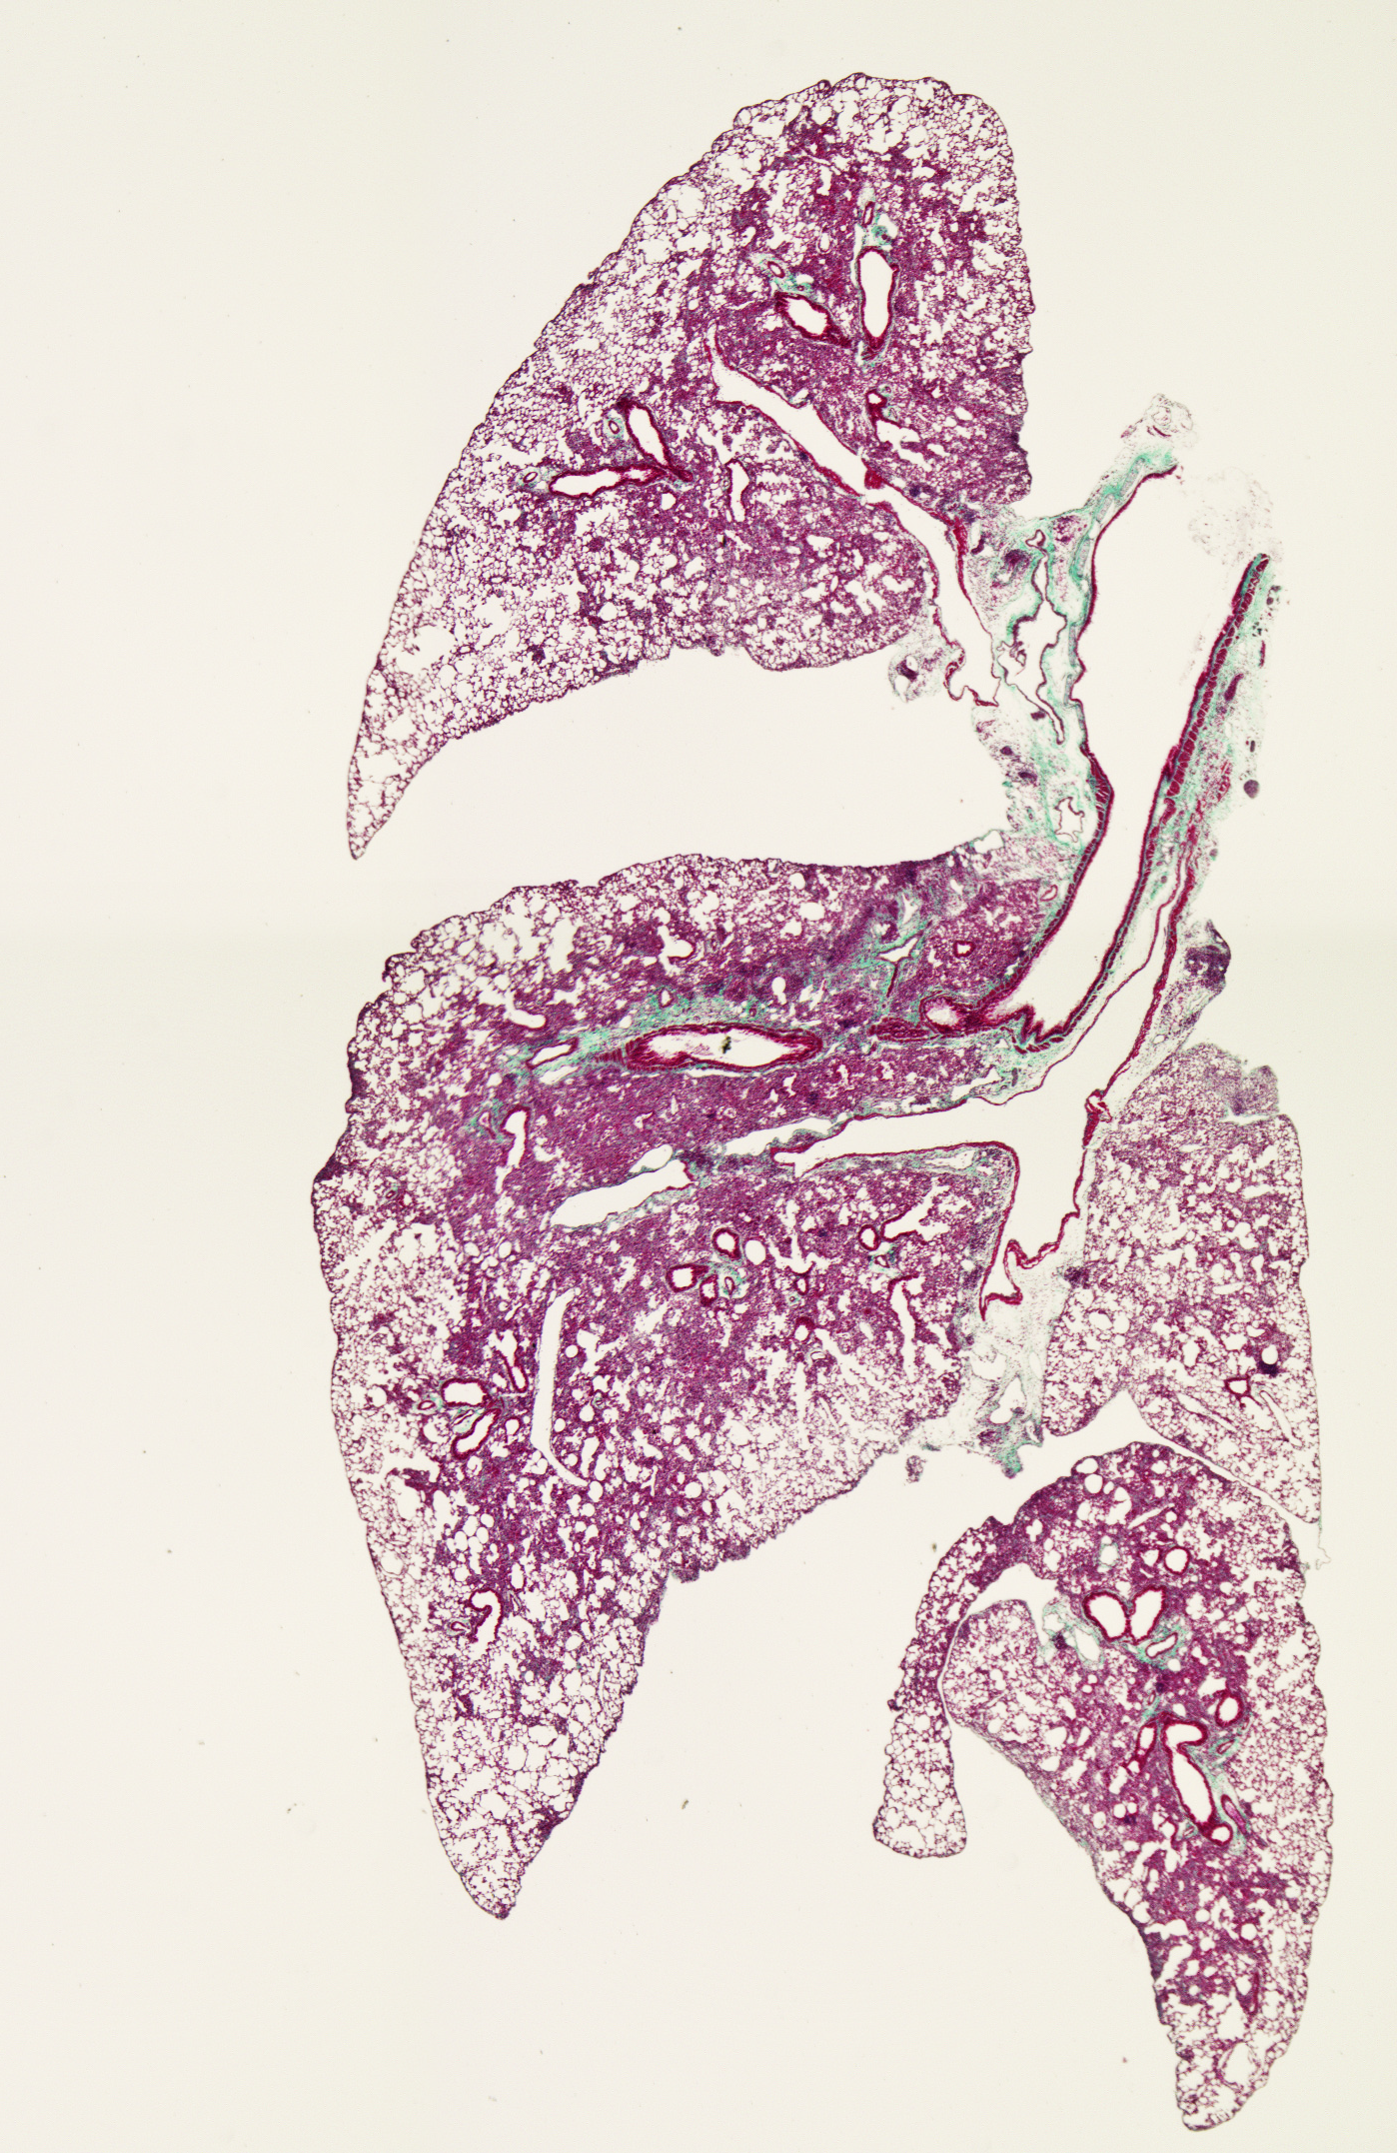
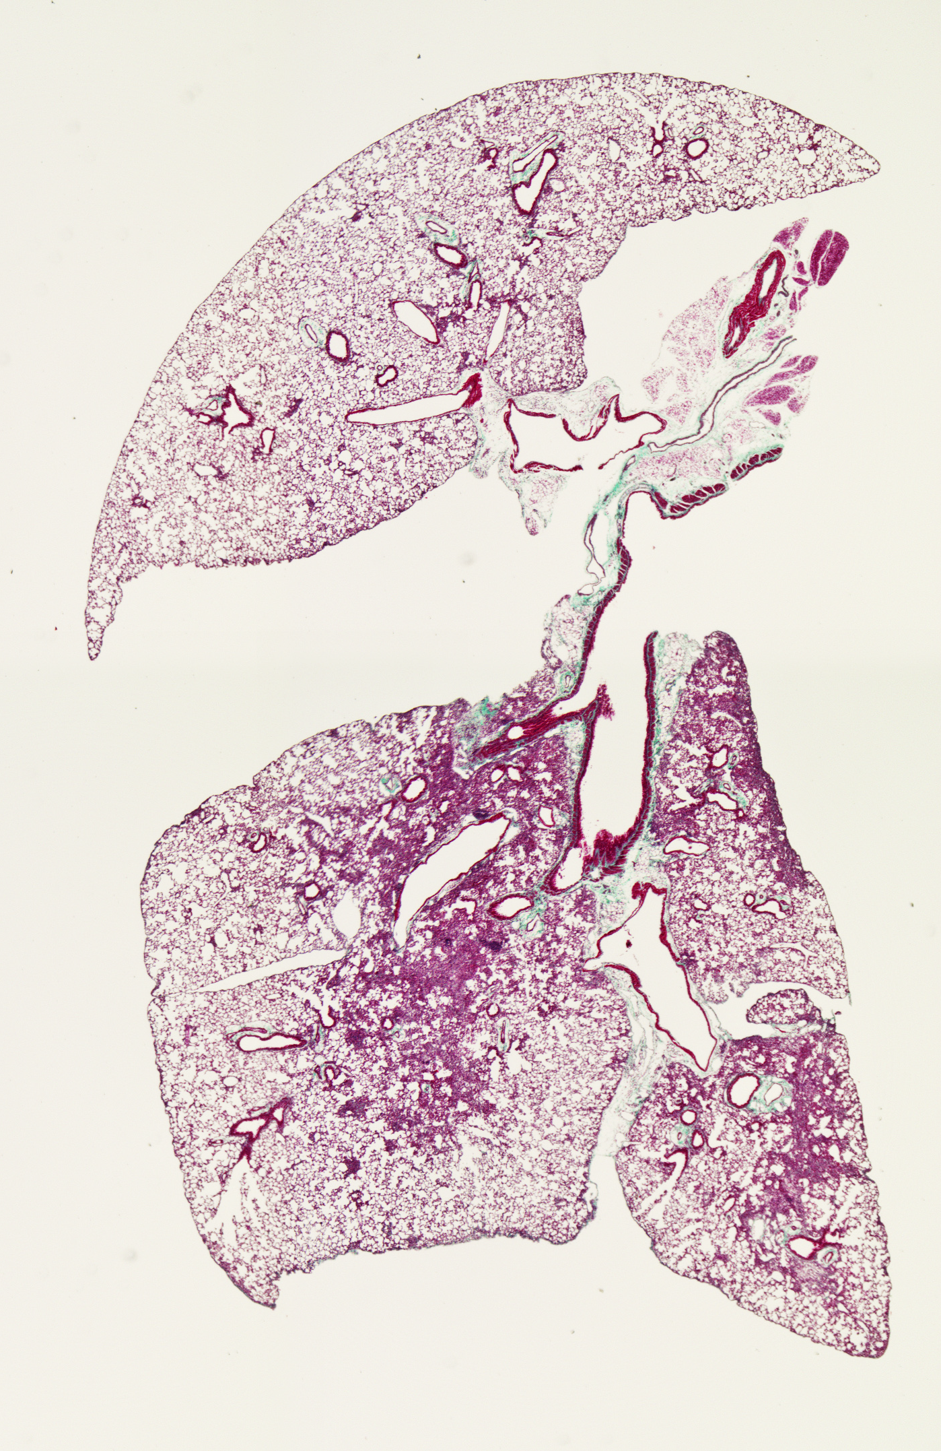
CD45⁻/ALDH^{dim} i.v.
CD45⁻/ALDH^{br} i.v.
With BLM
Additional file 7:
CD45⁻/ALDH^{br} cell therapy ameliorates BLM-induced pulmonary fibrosis
Masson’s trichrome staining of lung tissue sections obtained on day 14 from BLM-treated mice transferred with CD45⁻/ALDH^{dim} and CD45⁻/ALDH^{br} cells.

