Slide 1
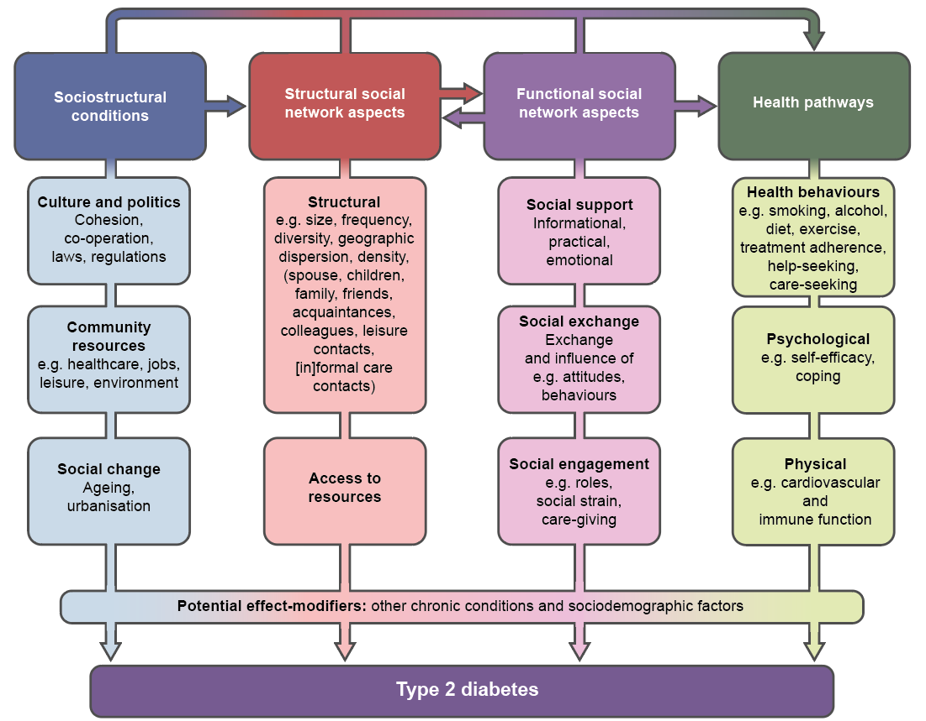
Theoretical model of social networks and type 2 diabetes
Schram et al (2021) Diabetologia DOI 10.1007/s00125-021-05496-2
©The Authors 2021. Distributed under the terms of the CC BY 4.0 Attribution License (http://creativecommons.org/licenses/by/4.0/)

Slide 2
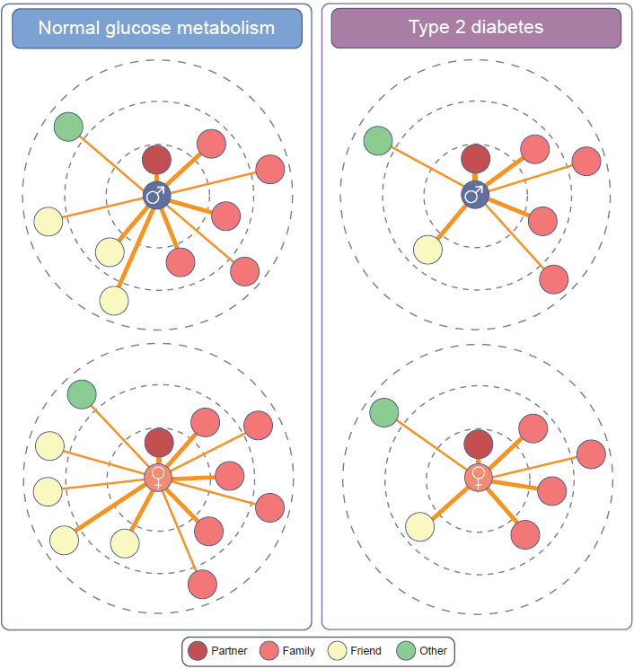
Structural social network characteristics in diabetes
Schram et al (2021) Diabetologia DOI 10.1007/s00125-021-05496-2
©Adapted from Brinkhues et al (2017), BMC Public Health, under the terms of the CC BY 4.0 Attribution License (http://creativecommons.org/licenses/by/4.0/)

