Slide 1
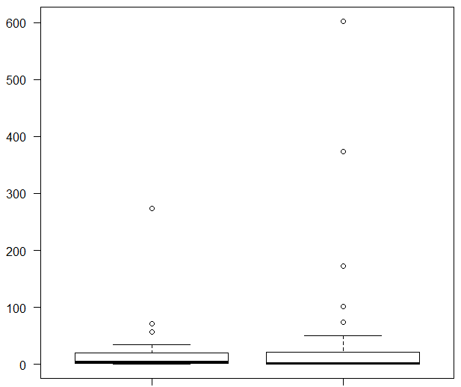
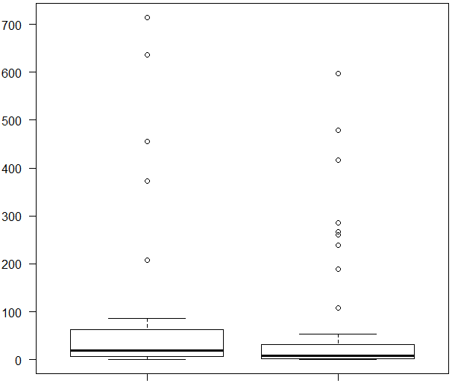
Supplementary Figure 2.
a
IFN-γ
b
IL-10
p = 0.677
p = 0.115
Relative expression
Relative expression
LOX-1-L
n = 31
LOX-1-H
n = 57
LOX-1-L
n = 31
LOX-1-H
n = 57
Stromal LOX-1 status
Stromal LOX-1 status

