Slide 1
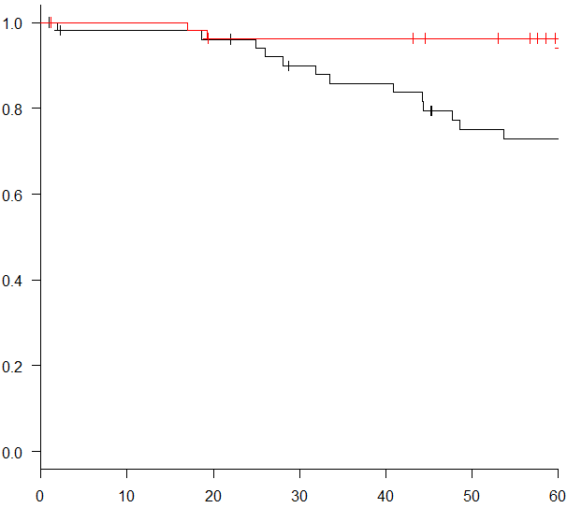
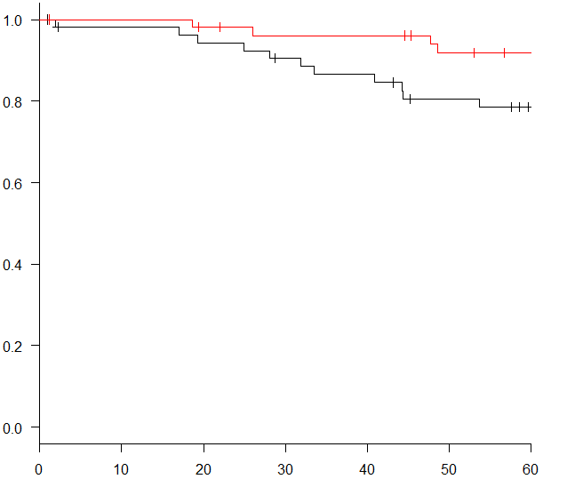
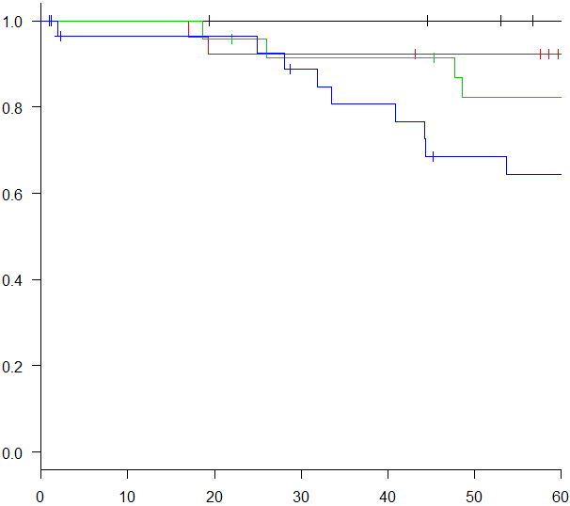
Supplementary
Figure 1.
a
b
CD8⁺ CTL-H (n = 53)
Stromal LOX-1-H
(n = 55)
Stromal LOX-1-L
(n = 53)
Overall Survival
CD8⁺ CTL-L (n = 55)
Overall Survival
p = 0.006
p = 0.015
Months after surgery
Months after surgery
c
Stromal LOX-1-H/CD8⁺ CTL-H (n = 29)
Stromal LOX-1-H/CD8⁺ CTL-L (n = 26)
Stromal LOX-1-L/CD8⁺ CTL-H (n = 24)
Stromal LOX-1-L/CD8⁺ CTL-L (n = 29)
Overall Survival
p = 0.002
Months after surgery

