Slide 1
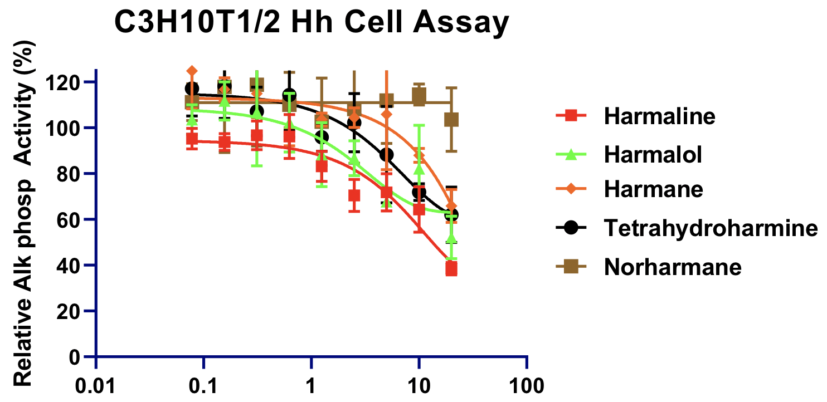
Supp Fig 1
Harmaline
Harmalol
Harmane
THH
Norharmane
Inhibition_{Max}
40%
50%
70%
60%
—
Compound (µM)
Supplementary Fig. 1. Activities of selected β-carbolines in C3H10T1/2 Hh cell assay. C3H10T1/2 were induced with ShhN protein and β-carbolines added at the indicated concentrations. After 5 days, the effects on alkaline phosphatase (AP) activity were measured at 405 nm using pNPP. As full dose response curves were not achieved for these 5 inhibitors, a 3-parameter curve fit was done. Inset is the maximal inhibition observed (Inhibition_{Max}) at the highest compound concentration tested (20 µM). THH = tetrahydroharmine.

