Slide 1
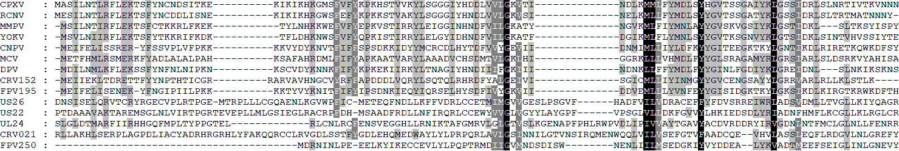
A31
CPXV, Cowpox virus|CAD90699.1;
RCNV, Raccoonpox virus|AKJ93781.1;
MMPV, Murmansk poxvirus|AST09343.1;
YOKV, Yokapox virus|AEN03725.1;
CNPV, Canarypox virus|AAR83615.1;
MCV Molluscum contagiosum virus|AZT86323.1;
DPV, Deerpox virus|ABI99114.1;
CRV152, Nile crocodilepox virus|YP_784342.1;
FPV195, Fowlpox virus|NP_039158.1;
US26, Human betaherpesvirus 5|ABV71516.1;
US22, Human betaherpesvirus 5|ACZ79906.1;
UL24, Human betaherpesvirus 5|CAA35423.1;
CRV021, Nile crocodilepox virus|YP_784211.1;
FPV250, Fowlpox virus|NP_039213.1
Fig.S1A

Slide 2
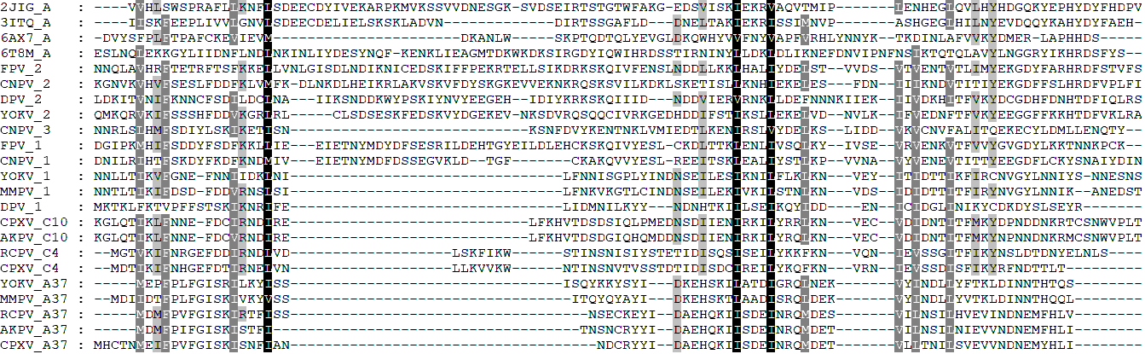
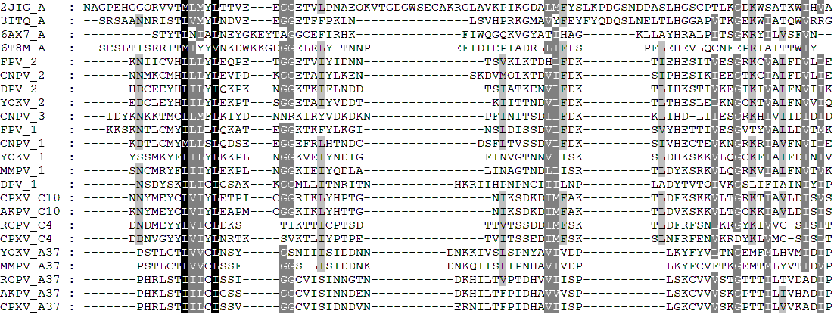
A37
FPV_2, Fowlpox virus|QRM13537.1
CNPV_2, Canarypox virus|NP_955237.1
DPV_2, Deerpox virus|YP_227384.1
YOKV_2, Yokapox virus|YP_004821354.1
CNPV_3, Canarypox virus|NP_955046.1
FPV_1, Fowlpox virus|QRM13553.1
CNPV_1, Canarypox virus|NP_955061.1
DPV_1, Deerpox virus|YP_227512.1
YOKV_1, Yokapox virus|YP_004821363.1
MMPV_1, Murmansk poxvirus|YP_009408204.1
CPXV_C10, Cowpox virus|CAD90594.1
AKPV_C10, Alaskapox virus|QED21164.1
RCPV_C4, Raccoonpox virus|YP_009143333.1
CPXV_C4, Cowpox virus|CAA64101.1
YOKV_A37, Yokapox virus|YP_004821496.1
MMPV_A37, Murmansk poxvirus|YP_009408336.1
RCPV_A37, Raccoonpox virus|YP_009143466.1
AKPV_A37, Alaskapox virus|QED21188.1
CPXV_A37, Cowpox virus|CAD90705.1
Fig. S1B

Slide 3
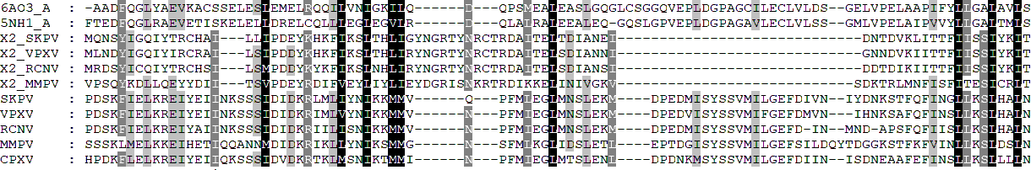
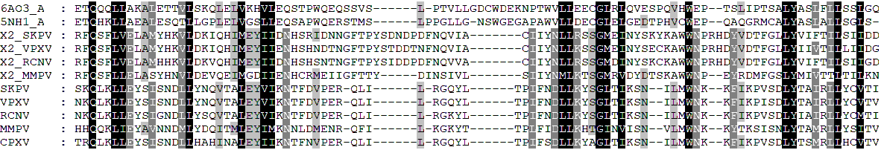
A47
X2_SKPV, Skunkpox virus|AOP31653.1
X2_VPXV, Volepox virus|AOP31864.1
X2_RCNV, Raccoonpox_virus|AKJ93804.
X2_MMPV, Murmansk poxvirus|AST09366.1
SKPV, Skunkpox virus|AOP31647.1
VPXV, Volepox virus|AOP31858.1
RCNV, Raccoonpox_virus|AKJ93798.1
MMPV,Murmansk poxvirus|AST09360.1
CPXV, Cowpox virus|CAD90717.1
Fig. S1C

