Slide 1
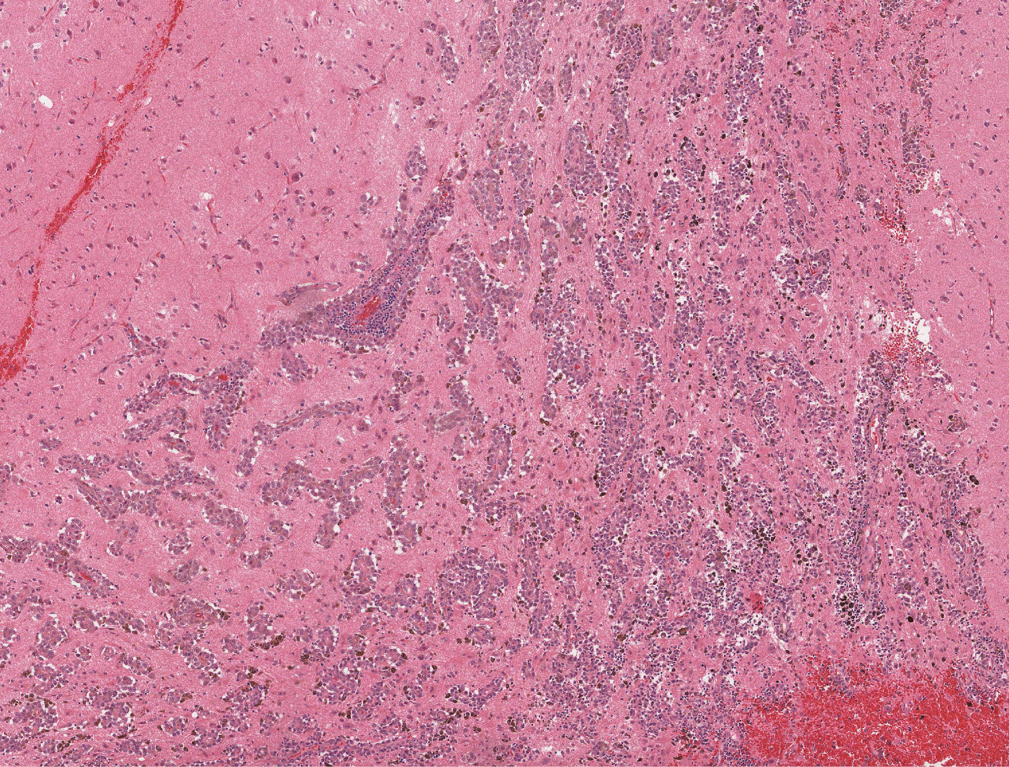
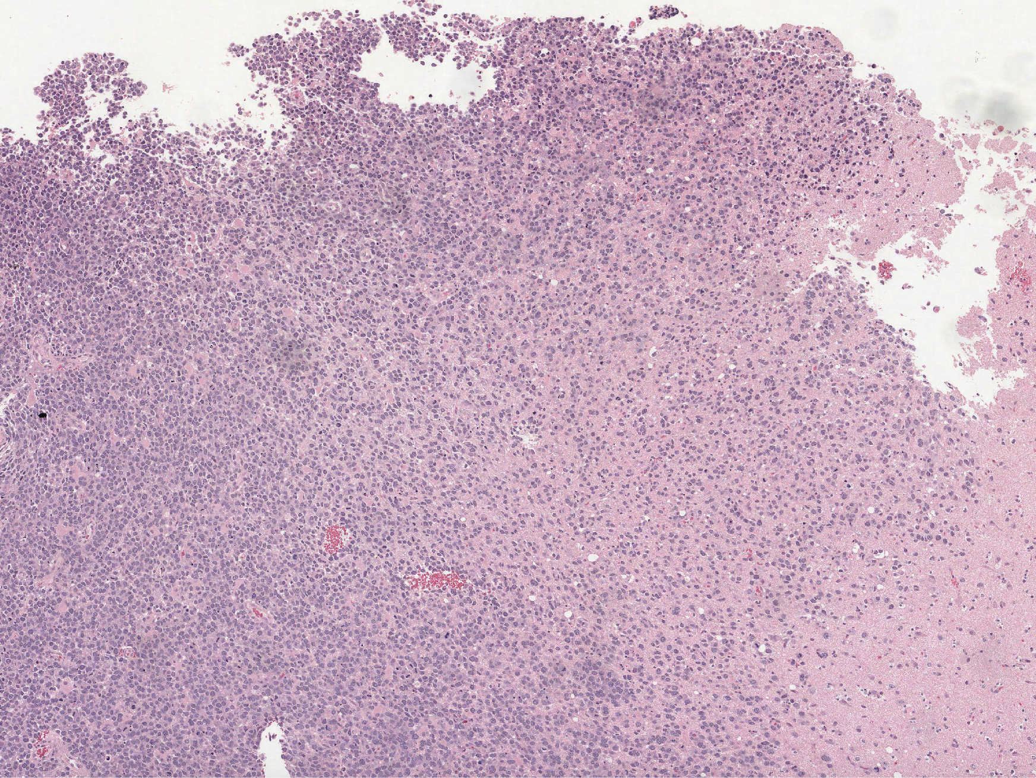
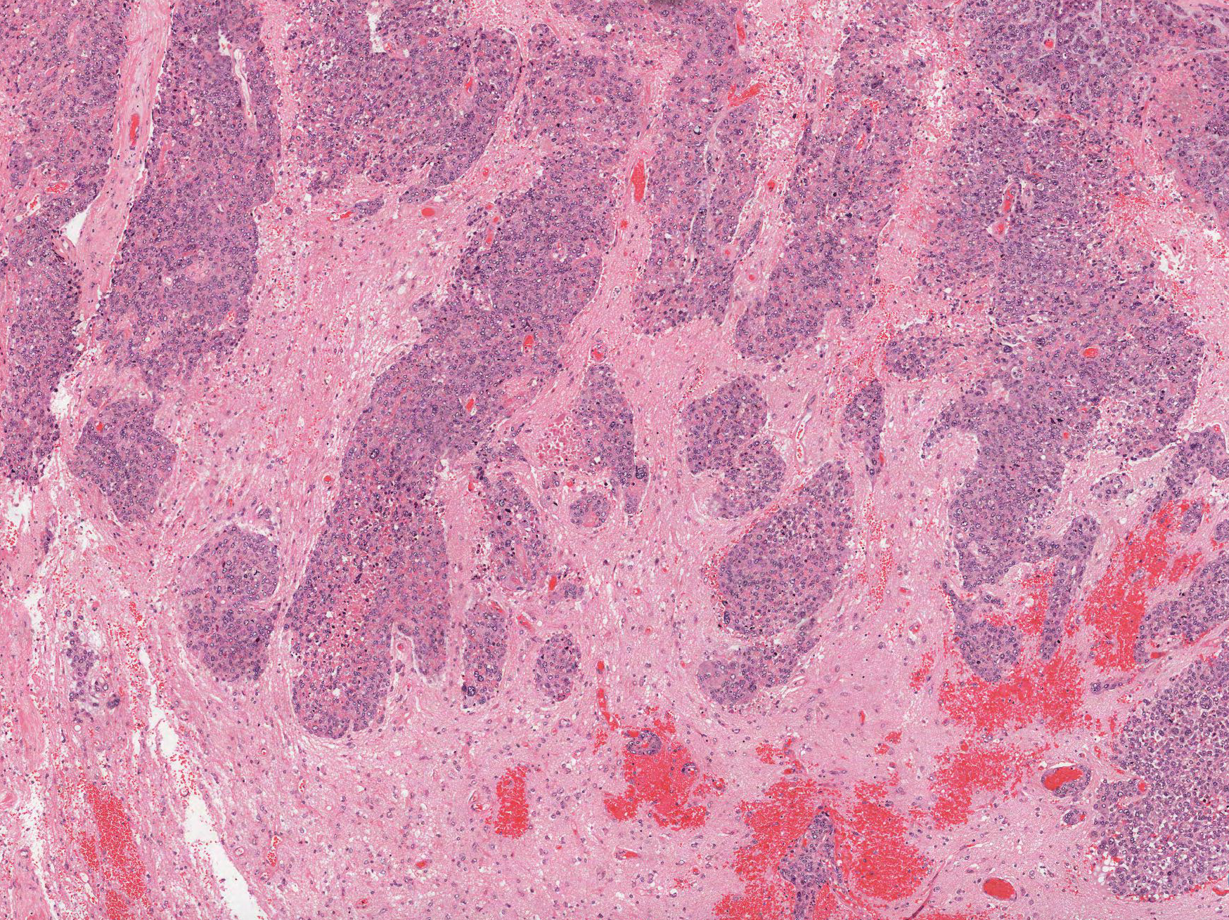
A
B
100
Angiocooptive
80
60
Number of
Specimens
40
20
0
Angio-
cooptive
Diffuse
Lobular
C
Angiocooptive (A; N=15)
A vs. D: P = 0.1844
HR: 1.741
95% CI: 0.7005-4.327
A vs. L: P = 0.1949
HR: 1.558
95% CI: 0.6995-3.471
D vs. L: P = 0.0465
HR: 1.947
95% CI: 0.8137-4.652
100
Diffuse (D; N=17)
Diffuse
75
Lobular (L; N=72)
50
Overall Survival (%)
25
0
0
1
2
3
Years Post-Surgery
D
100
A vs. D: P = 0.1573
HR: NA
A vs. L: P = 0.3334
HR: NA
D vs. L: P = 0.0382
HR: 3.501
95% CI: 0.4699-26.08
75
Local RFS (%)
50
25
Angiocooptive (A; N=6)
Diffuse (D; N=10)
Lobular
0
Lobular (L; N=47)
0
1
2
3
Years Post-Surgery
E
100
Angiocooptive (A; N=10)
A vs. D: P = 0.3103
HR: 1.428
95% CI: 0.5479-3.723
A vs. L: P = 0.1694
HR: 1.585
95% CI: 0.7729-3.249
D vs. L: P = 0.4267
HR: 1.167
95% CI: 0.586-2.324
Diffuse (D; N=15)
75
Lobular (L; N=65)
LM-Free Survival (%)
50
25
0
0
1
2
3
Years Post-Surgery
Dankner et al., Supplementary Figure S4

Slide 2
Supplementary Figure S4. Breakdown of highly invasive (HI) specimens by different histopathological types of invasion. A, Representative H&E images that depict angiocooptive, diffuse and lobular invasion. The angiocooptive pattern refers to cancer cells situated along blood vessels, diffuse infiltration involves single-cell migration of cancer cells into the brain and lobular invasion consists of small clusters of cancer cells invading the brain collectively. Scale bar 500 µM. B, Type of invasion pattern observed in HI specimens classified by primary tumor type of origin. C, Kaplan-Meier curve plotting overall survival of HI specimens stratified by invasion type, calculated from time of neurosurgical resection. D, Kaplan-Meier curve plotting local recurrence-free survival (RFS) of HI specimens stratified by invasion type, which had undergone macroscopic gross total resections confirmed by post-operative MRI and were not themselves locally recurrent lesions. P-value, HR and 95% CI calculated by log-rank (Mantel-Cox) test. E, Kaplan-Meier curve plotting leptomeningeal metastasis-free (LM-free) survival of HI specimens stratified by invasion type, calculated from the time of the patient’s first neurosurgical resection. P-value, HR and 95% confidence interval (CI) calculated by log-rank (Mantel-Cox) test.

