Slide 1
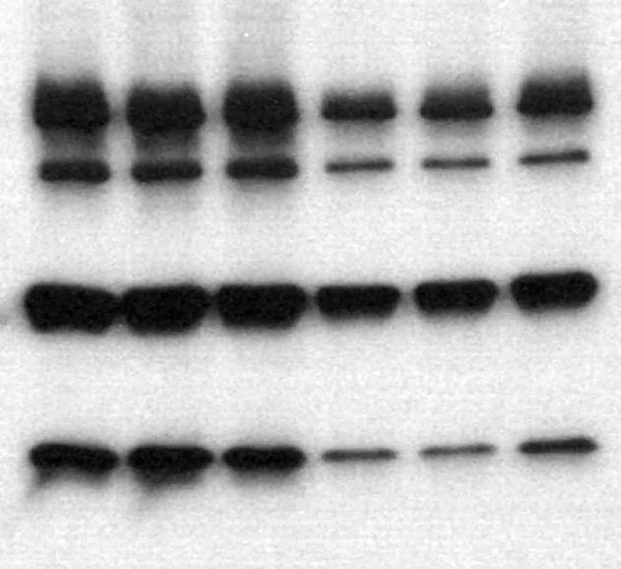
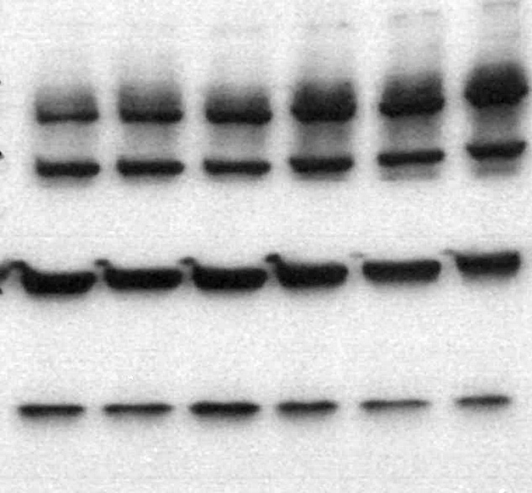
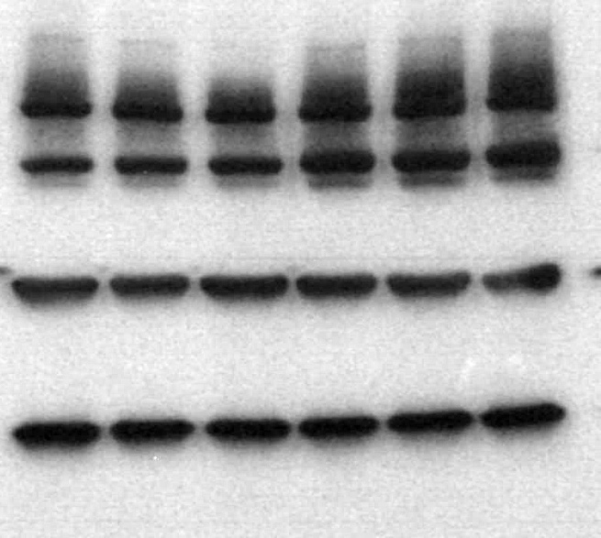
A
B
SK-N-SH
T-PARP
C-PARP
SK-N-SH
β tubulin
T-Caspase 3
QGP-1
C-Caspase 3
T-PARP
C-PARP
QGP-1
β tubulin
BON-1
T-Caspase 3
C-Caspase 3
T-PARP
C-PARP
BON-1
β tubulin
T-Caspase 3
C-Caspase 3
Ctrl
FL
dEx1
Ctrl
FL
dEx1
48 hrs
No serum
72 hrs
No serum
Supplementary Figure S2.

Slide 2
Supplementary Figure S2. MAML3 overexpression has no effect on proliferation or apoptotic signaling. SK-N-SH, QGP-1 and BON-1 transfected with FL or dEx1 MAML3 and showed A) no increase in proliferation by BrdU assay when grown in full serum media for 72 hours and B) no increase in total or cleaved PARP or Caspase 3 when grown in serum free media for 48 or 72 hours. No cleaved caspase 3 was seen at all. The % of cleaved PARP was calculated after normalizing to beta tubulin and no significant differences were found at either time point for any cell line. Experiment performed N=3 with representative blots shown. T-PARP= total PARP; C-PARP=cleaved PARP; T-Caspase 3=total Caspase 3; C-Caspase 3=cleaved Caspase 3

