Slide 1
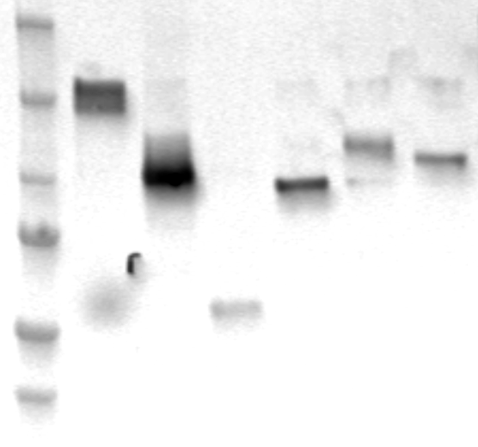
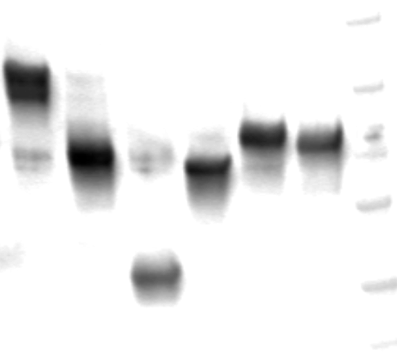
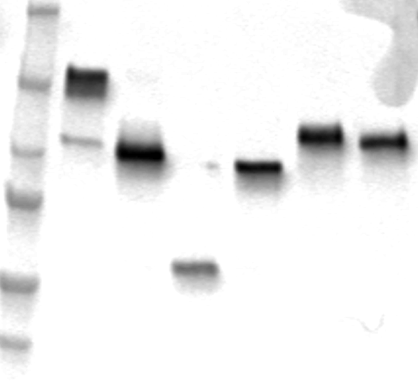
A.
FL MAML3 domain constructs
FL ∆S
FL ∆N∆S
FL ∆Q
FL ∆C 364
FL ∆C 772
FL
250
150
SK-N-SH
100
75
50
250
150
QGP-1
100
75
50
250
150
BON-1
100
75
50
Supplemental Figure S6A.

Slide 2
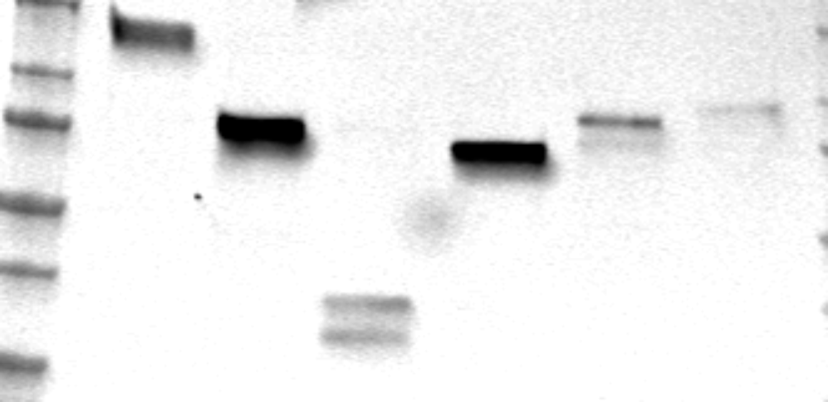
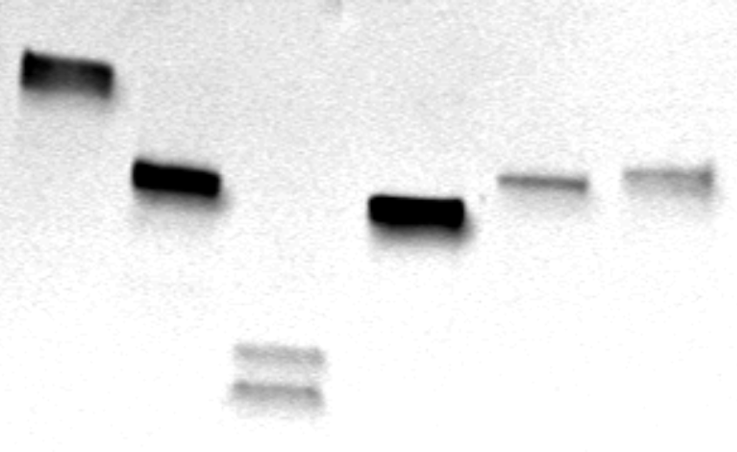
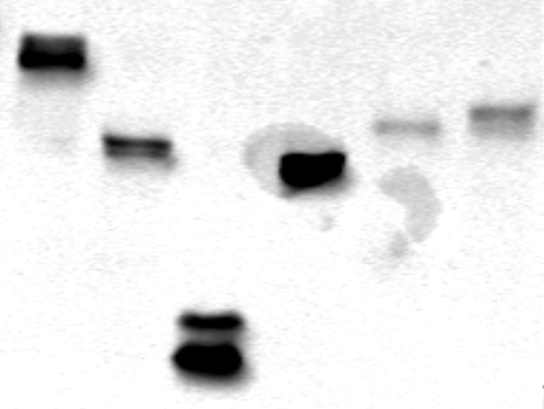
dEx1 MAML3 domain constructs
B.
dEx1 ∆C 364
dEx1 ∆C 772
dEx1 ∆S
dEx1 ∆N∆S
dEx1 ∆Q
dEx1
150
100
75
SK-N-SH
50
37
150
100
QGP-1
75
50
37
150
100
75
BON-1
50
37
Supplemental Figure S6B.

Slide 3




C.
Ctrl
β-Catenin Only
FL
NLS NLS NLS NLS NLS
FL∆C772
FL∆C364
FL∆Q
FL∆S
FL∆N∆S
dEx1
NLS NLS NLS NLS NLS
dEx1∆C772
dEx1∆C364
dEx1∆Q
dEx1∆S
dEx1∆N∆S
P SUMO
Ac
NLS
Notch Binding Motif
PolyQ Tracks
Supplemental Figure S6C.

Slide 4
Supplementary Figure S6. Western blot for expression of FL and dEx1 MAML3 domain constructs and luciferase assay. Cells for these blots were transfected at the same time as cells used for the luciferase experiment and harvested on the day the luciferase assay was performed. A. Protein expression of FL MAML3 domain constructs: FL∆C772 contains amino acids (aa) 1-772, FL∆C364 aa 1-364, FL∆Q aa 1-364 and 772-1133, FL∆S aa 1-195 and 365-1133, FL∆N∆S aa 1-155 and 365-1133. B. Protein expression of dEx1 MAML3 domain constructs: dEx1∆C772 contains amino acids (aa) 156-772, dEx1∆C364 aa 156-364, dEx1∆Q aa156-364 and 772-1133, dEx1∆S aa 156-195 and 365-1133, dEx1∆N∆S aa 365-1133. C. TCF/LEF promoter activation by MAML3 constructs in QGP-1 and BON-1. Diagrams of each MAML3 construct are shown to the left of their relative promoter activation. All MAML3 constructs were co-transfected with β-catenin. Cells transfected with β-catenin alone, or with neither MAML3 nor β-catenin are shown as controls, in addition to the negative control FOP vector for every combination. Experiments was done three separate times in triplicate.

