Slide 1
Supplement tables and figures

Slide 2
Table S1: Baseline characteristics of DLBCL PTLD cohort
 | N = 137
Median age at diagnosis (years) | 57.4 (IQR 46.5-65)
≥ 60 Years | 60 (43.8%)
Males (%) | 93 (67.9%)
Median age at transplant (years) | 50.6 (IQR 36.9-60.5)
Median time from transplant to PTLD (months) | 45.4 (1.7-499.8)
Transplant type Renal Liver Heart Lung Pancreas Renal + Pancreas Heart + Lung Others | 63 (46.0%) 30 (21.9%) 13 (9.5%) 10 (7.3%) 8 (5.3%) 5 (3.6%) 3 (2.2%) 5 (3.6%)
EBV positive | 78 (56.9%)
Grafted organ involvement | 23 (16.8%)
Stage III/IV | 85 (63%)
Extranodal sites ≥ 1 | 122 (89.1%)
PTLD ≥ 1 year after transplant | 86 (62.8%)
Elevated LDH | 34 (29.1%)

Slide 3
Supplement Table S2: Baseline characteristics of M-PTLD, DLBCL patients based on EBV status**
 | EBV Positive N=78 | EBV Negative N=57 | P value
Age > 60 | 35 (44.9%) | 24 (42.1%) | 0.93
Male | 49 (62.8%) | 42 (73.7%) | 0.25
LDH > ULN | 19 (28.8%) | 15 (30.0%) | 0.80
Stage III/IV | 46 (60.5%) | 38 (66.7%) | 0.71
IPI > 1 | 53 (67.9%) | 37 (67.3%) | 0.62
Extranodal disease | 69 (88.5%) | 51 (89.5%) | 0.86
Grafted organ | 17 (21.8%) | 5 (8.8%) | 0.06
PTLD < 1 year after transplant | 46 (59%) | 4 (7.0%) | <0.001
**Missing = 2

Slide 4
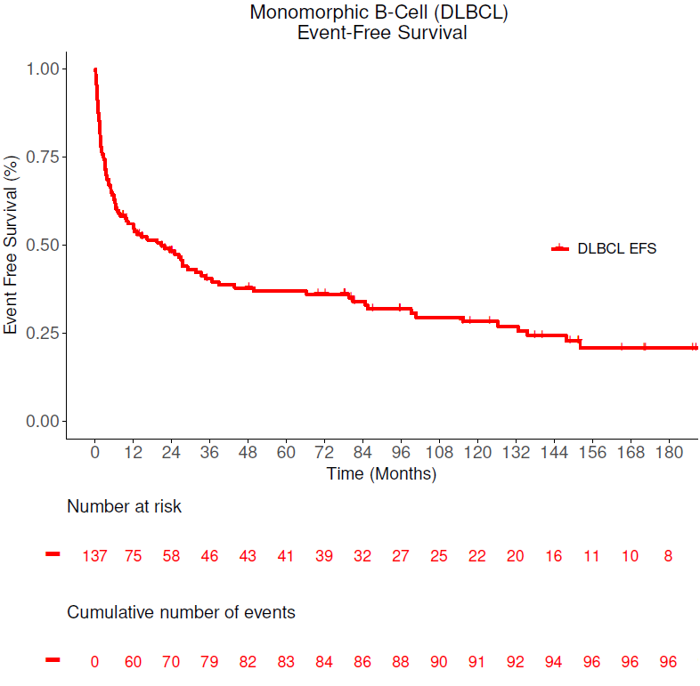
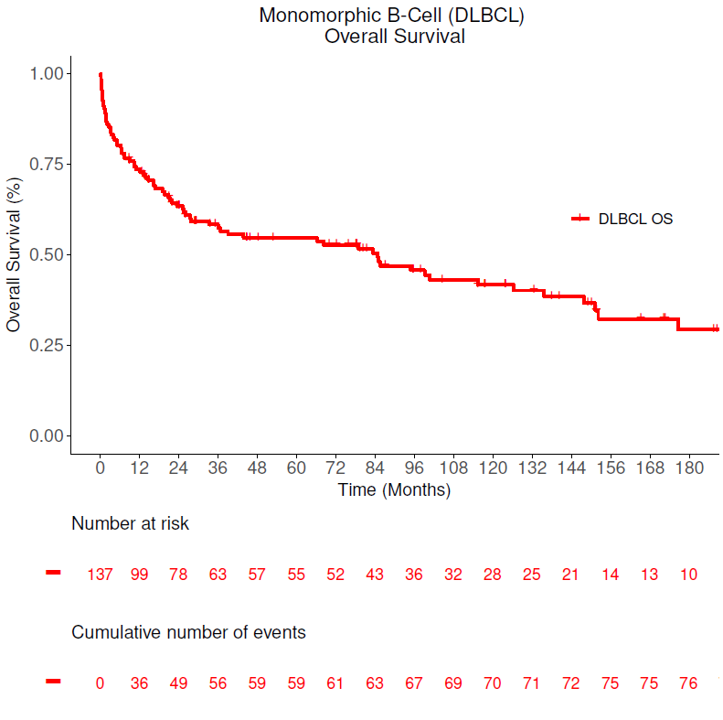
Figure S1: EFS/OS in the Monomorphic PTLD - DLBCL cohort
Median EFS: 22 months (95% CI: 9-37)
Median OS: 85 months (95% CI: 36-136)

Slide 5
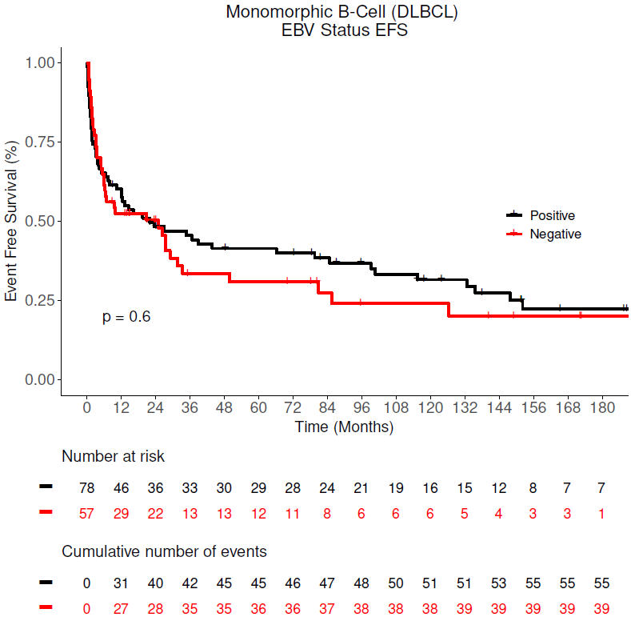
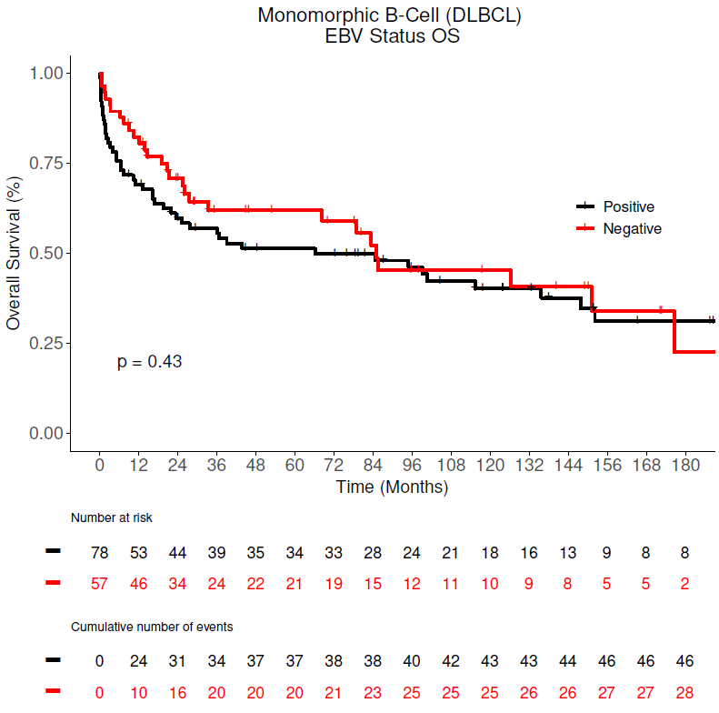
Figure S2: EFS/OS based on EBV status in Monomorphic PTLD – DLBCL cohort
Median Survival (Months)
 | Median EFS (95% CI) | Median OS (95% CI)
EBV Status
Positive | 21.8 (12.0, 84.7) | 66.2 (23.4, 148.0)
Negative | 25.0 (6.0, 49.7) | 85.0 (33.3, N/A)

