Slide 1
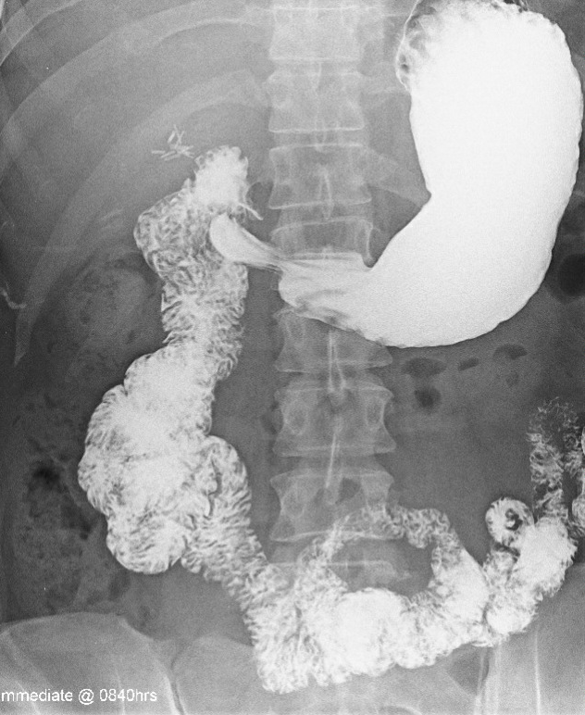
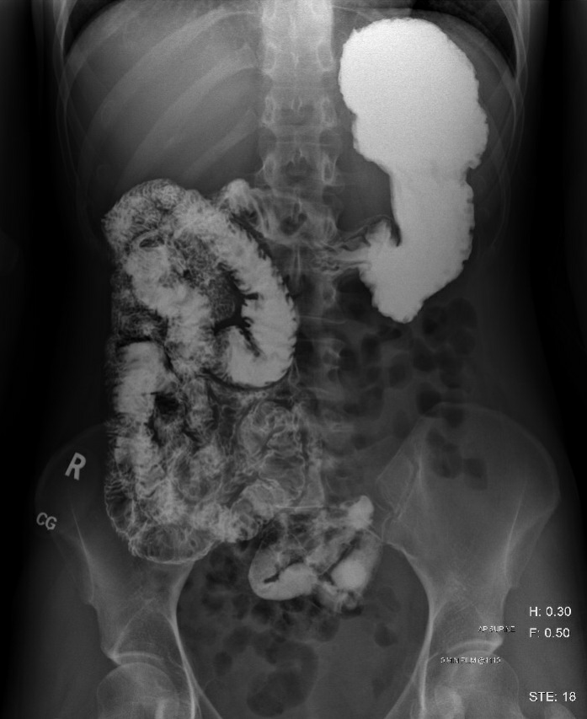
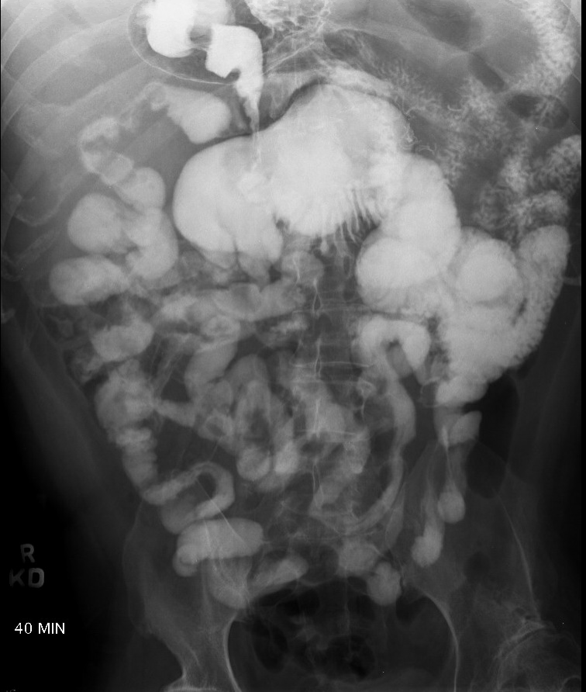
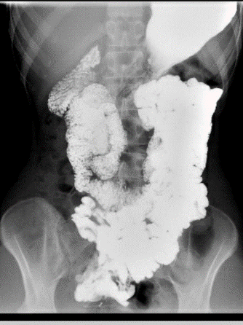
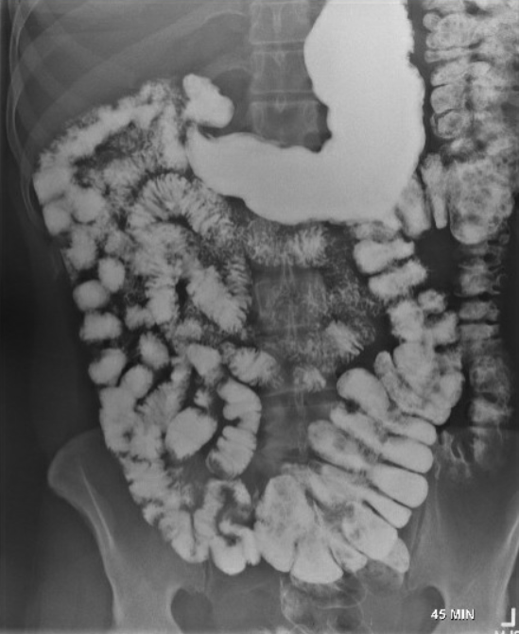
a
b
c
d
a
e
Appleton pre op
f
g
h
g
Figure-1A Supplement. Spot radiographs from upper gastrointestinal (UGI) series demonstrating different abnormal anatomic locations and configurations of the midgut compartments; duodenum (a-e) and right colon (f, g) with a case of abdominal situs inversus (h).

Slide 2
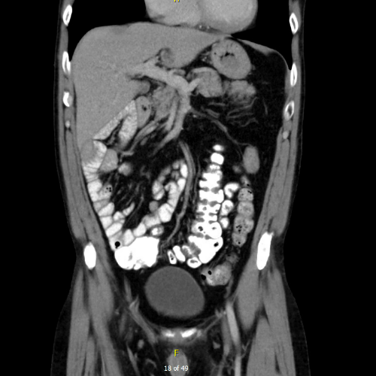
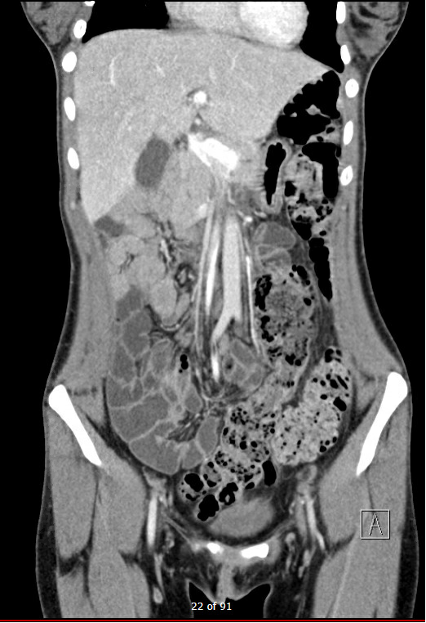
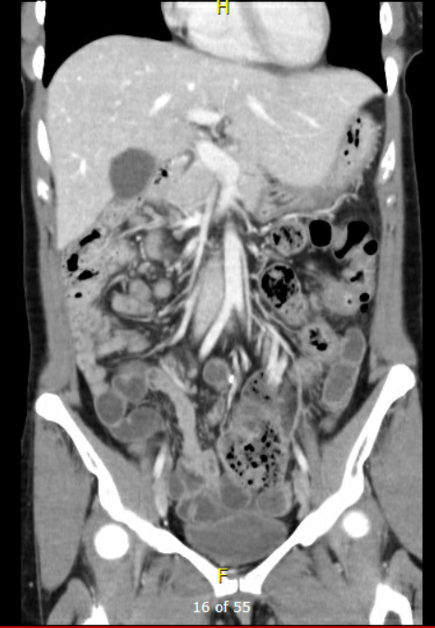
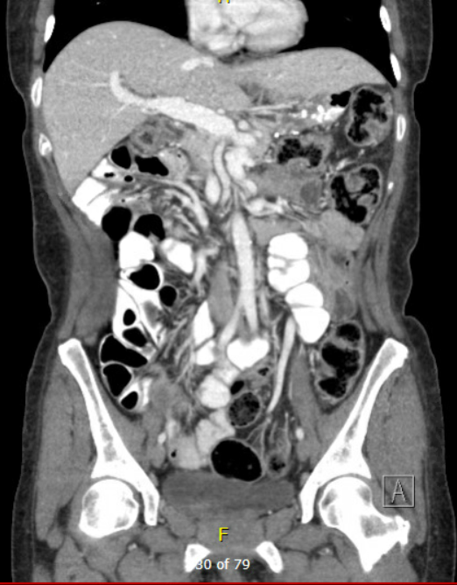
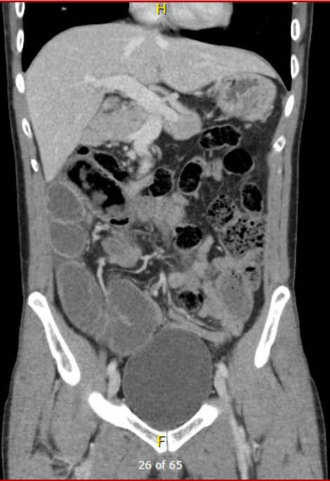
Figure-1B Supplement. Coronal reformatted and axial contrast-enhanced CT studies demonstrating different degrees of deviation from the normal anatomic relation between the superior mesenteric artery (SMA) and superior mesenteric vein (SMV) including left to right inversion or vertical relationship (axial image) along the course of both vessels throughout the mesenteric hilum to the terminal branches and tributaries, respectively. Note dilation of the portal and superior mesenteric vein in some patients.

Slide 3
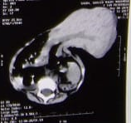
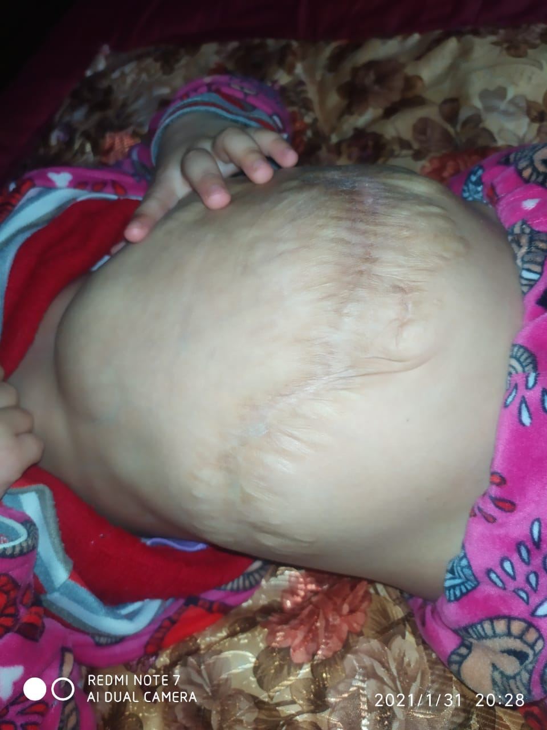
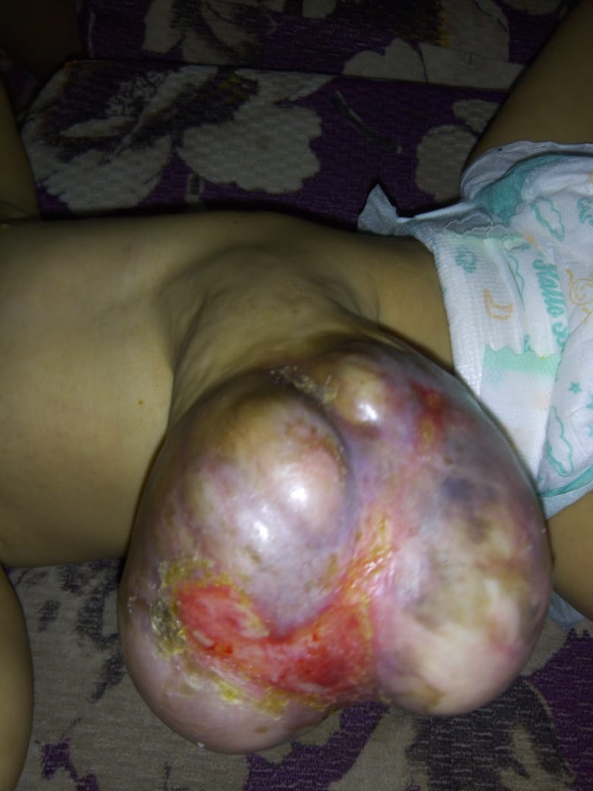
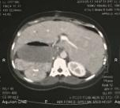
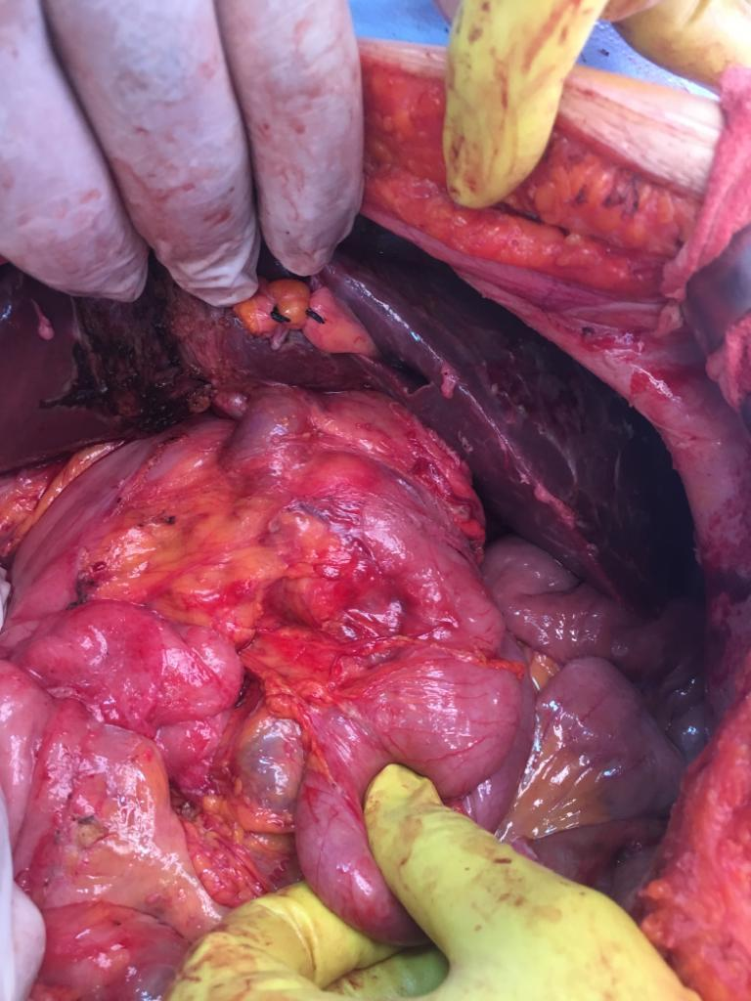
A
B
C
D
E
F
Figure-2 Supplement. Associated abdominal congenital anomalies. Upper panel is a thirteen-month old baby with exomphalos major (A) with axial abdominal CT imaging showing most of the liver and part of the intestine contained outside the abdominal cavity (B) with a picture of the abdomen three years after surgery (C). Lower panel is a forty-three year old lady with abdominal situs-inversus as shown in the upper GI series (D) and axial abdominal CT images (E). Note the abnormal location of the portal vein anterior to the duodenum (yellow arrow) that was observed during correction of the midgut malrotation in a mirror image fashion (F).

Slide 4
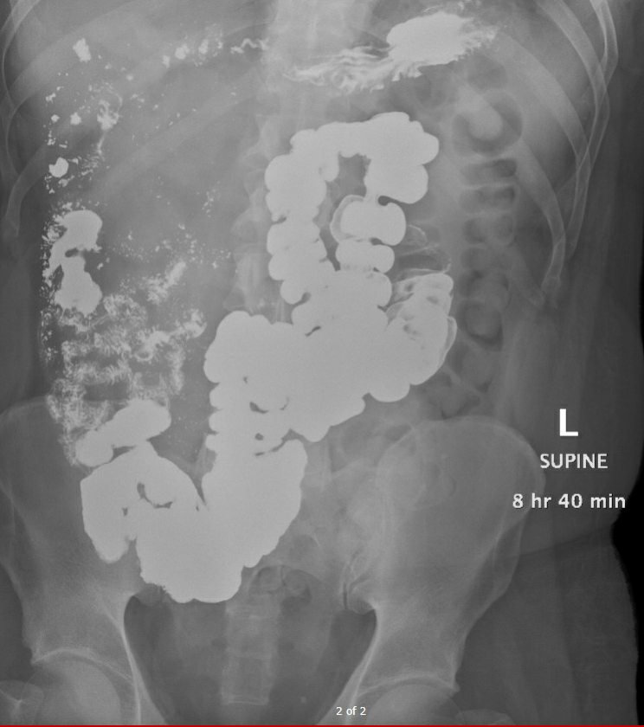
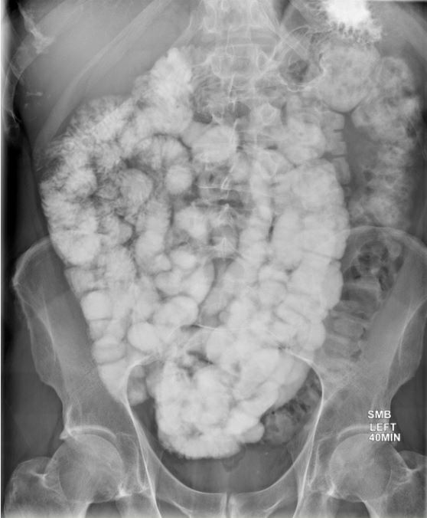
A
Delayed ( >8 hour)
B
Accelerated (40 min)
Figure-3 Supplement. Spot radiographs from upper gastrointestinal (UGI) series with follow-through measuring the orocecal transit
time. Note a delayed transit time in patient A with an accelerated time in patient B.

Slide 5
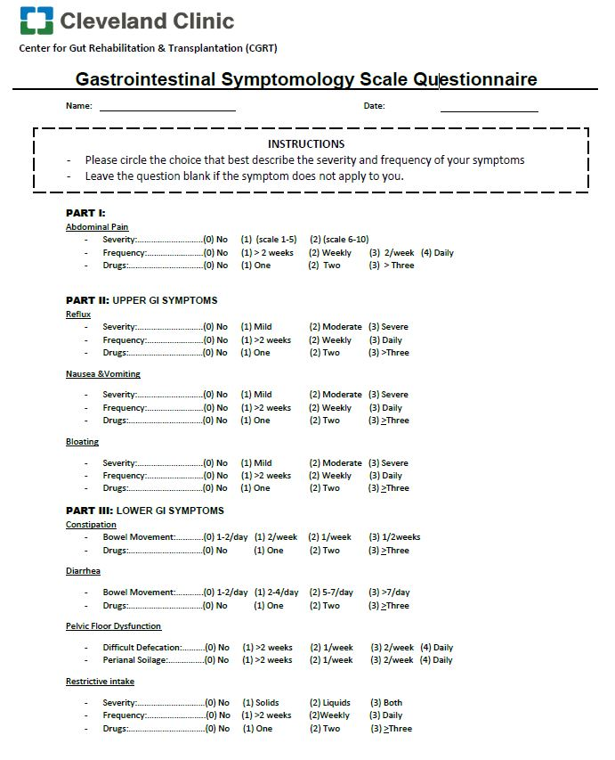
Figure-4 Supplement. The gastrointestinal symptomatology scale questionnaire. The format is a modification
of the National Institute of Health (NIH) patient-reported outcomes measurement information system (PROMIS) gastrointestinal symptom scales.

Slide 6
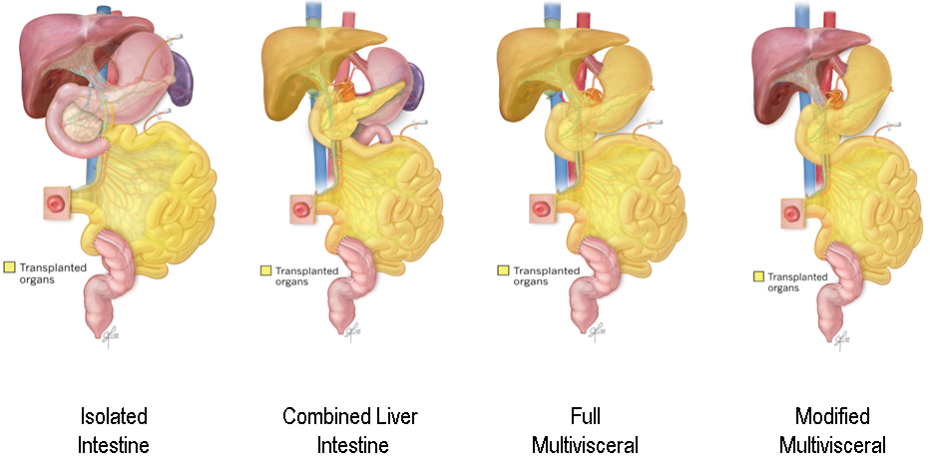
A
B
C
D
Figure-5 Supplement. The different types of gut transplantation; A) Isolated intestine, B) Liver, intestine, and pancreas, C) Full multivisceral with en-bloc inclusion of stomach, duodenum, pancreas, intestine and liver, and D) Modified multivisceral with stomach, duodenum, pancreas and intestine.

Slide 7
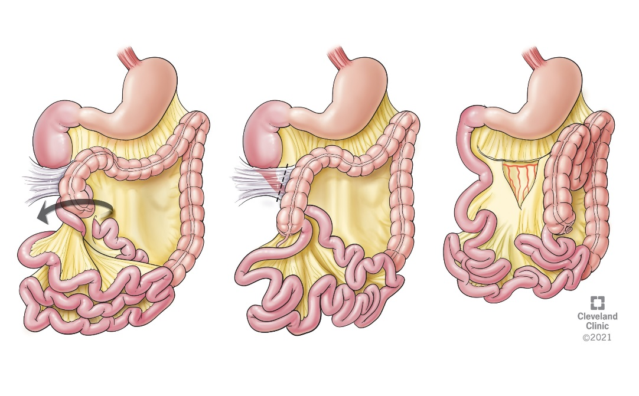
A
B
C
Figure-6 Supplement. The steps of the Ladd’s procedure; A) Detorsion of the volvulus, B) Release of Ladd bands and C) Reversion of the midgut malrotation to an earlier stage with widening of the mesentery.

Slide 8
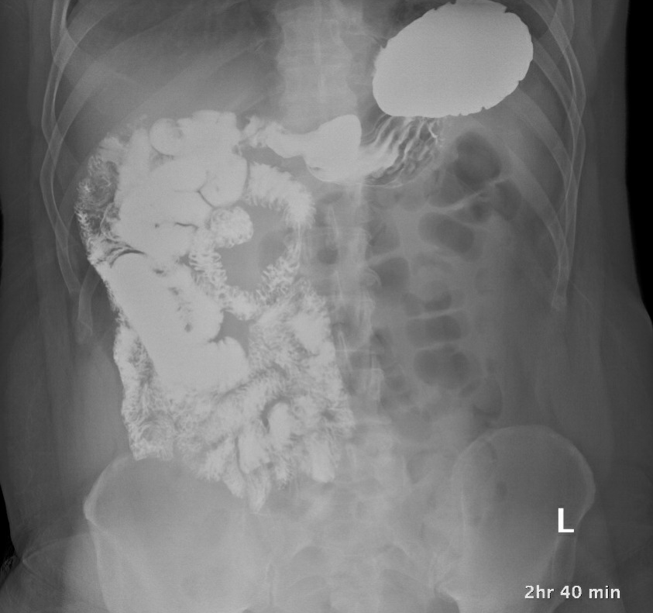
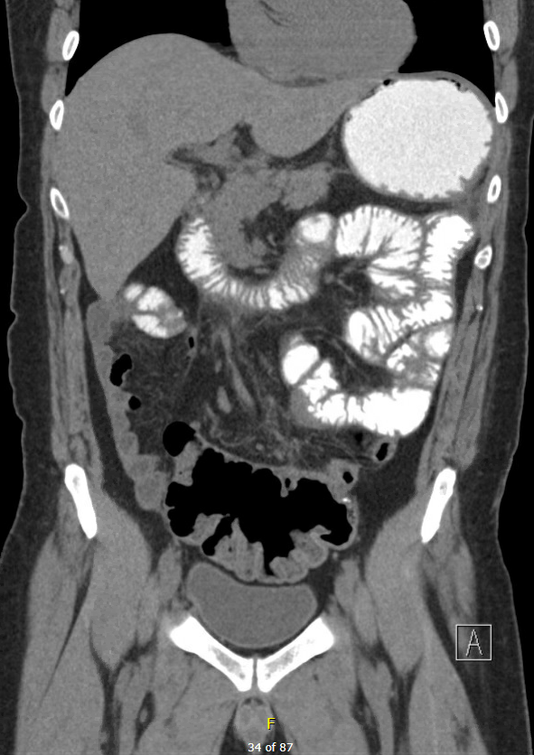
A
B
Figure-7 Supplement. Spot radiographs from upper GI series before and after the gut malrotation correction (GMC) surgery. Before surgery, duodenum was located on the right side of the abdomen and colon on the left with distorted anatomy (A). The postoperative series (B), showed normal anatomic location of the duodenum in a C-shaped course with neo- ligament of Treitz in the left upper abdomen. Also note the new location of the cecum in the right lower abdomen.

Slide 9
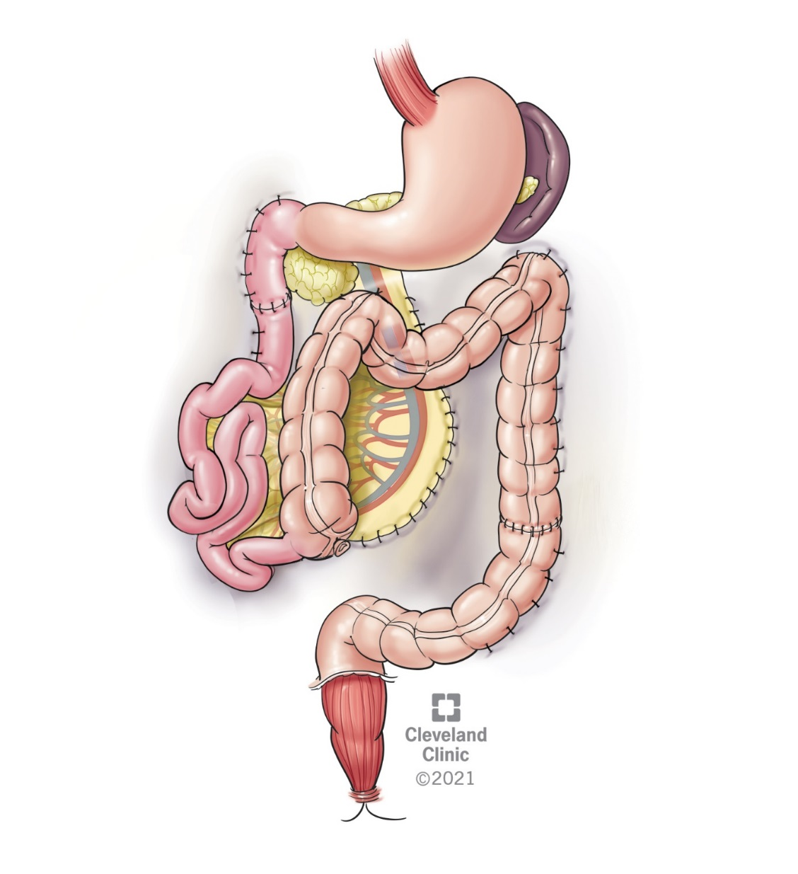
Figure-8 Supplement. Failure to complete the 270⁰ counterclockwise duodenal rotation because of at birth duodenojejunal reconstruction
for a long-segment duodenal atresia. Fixation of the residual duodenum and proximal jejunum with mesentericopexy
were performed in a modified fashion.

Slide 10
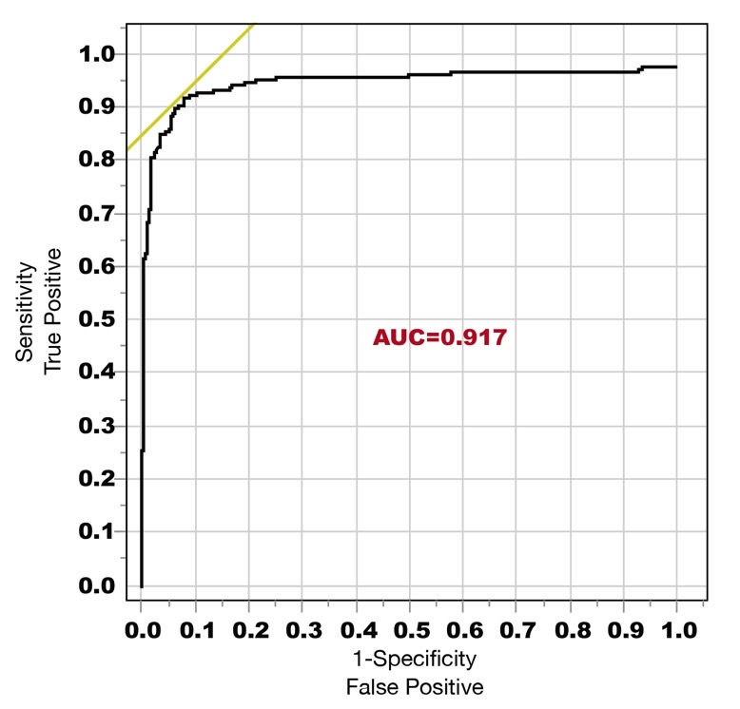
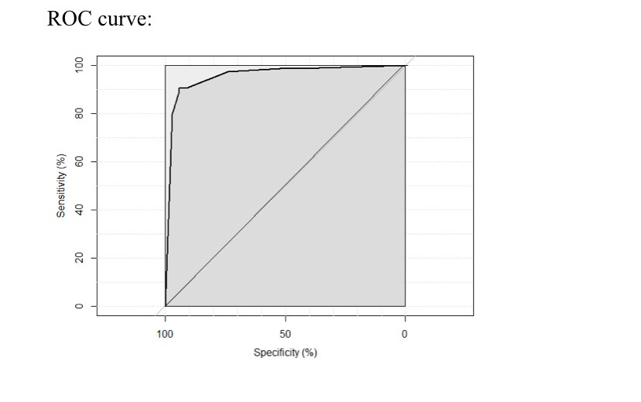
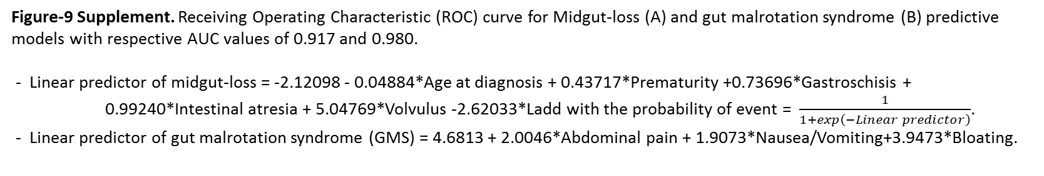
Sensitivity (%)
AUC=0.917
Sensitivity (%)
AUC =0.9795
A
Specificity (%)
B
Specificity (%)
Figure-9 Supplement. Receiving Operating Characteristic (ROC) curve for Midgut-loss (A) and gut malrotation syndrome (B) predictive models with respective AUC values of 0.917 and 0.980.
- Linear predictor of midgut-loss = -2.12098 - 0.04884*Age at diagnosis + 0.43717*Prematurity +0.73696*Gastroschisis + 0.99240*Intestinal atresia + 5.04769*Volvulus -2.62033*Ladd with the probability of event = $\frac{1}{1+\exp\left(−Linear predictor\right)}$.
- Linear predictor of gut malrotation syndrome (GMS) = 4.6813 + 2.0046*Abdominal pain + 1.9073*Nausea/Vomiting+3.9473*Bloating.

