Slide 1
Revision-western
April-May, 2021

Slide 2
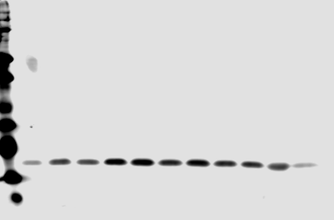
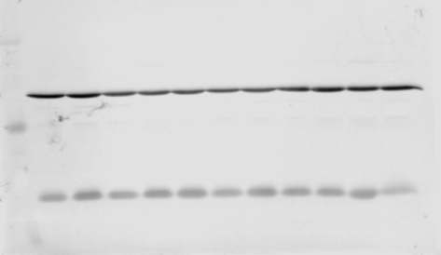
Cytochrome c (Fig.2C)
 | Cytosol
 | 1hr Sham |  |  | 1 hr PLB |  |  |  | 1 hr TRE
1 | 2 | 3 | 4 | 5 | 6 | 7 | 8 | 9 | 10 | 11 | 12
L | 69-1 | 82-1 | 82-2 | 29-2 | 29-3 | 57-2 | 60-2 | 11-1 | 11-2 | 11-5 | 11-6
100 kDa
70 kDa
55 kDa
35 kDa
15 kDa Cytoc
15 kDa
10 kDa
The above blot was stripped and reprobed for Gapdh
55 kDa
36 kDa Gapdh
35 kDa
15 kDa

Slide 3
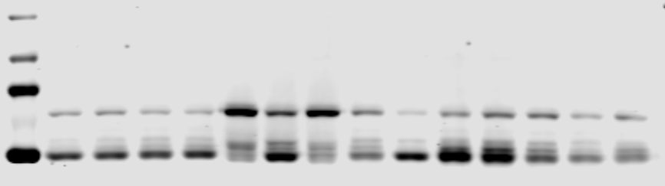
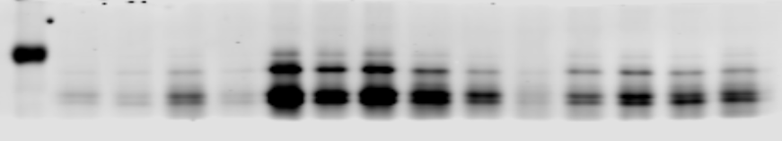
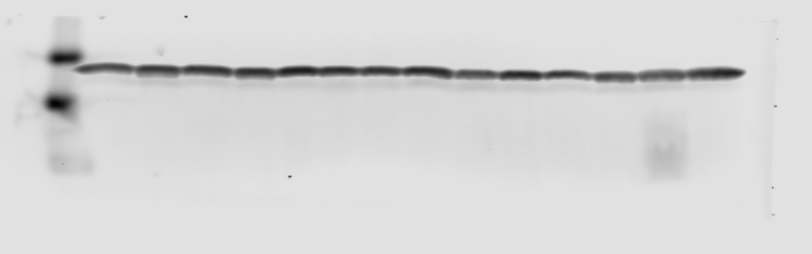
Drp1, MFF (Fig. 6A-B)
 | Mitochondria
 | 1hr Sham |  |  |  | 1 hr PLB |  |  |  |  | 1 hr TRE
1 | 2 | 3 | 4 | 5 | 6 | 7 | 8 | 9 | 10 | 11 | 12 | 13 | 14 | 15
L | 56-1 | 69-1 | 82-1 | 82-2 | 5-1 | 5-2 | 5-3 | 57-1 | 57-2 | 11-4 | 11-6 | 65-1 | 65-2 | 58-1
100 kDa
78-80 kDa Drp1
70 kDa
55 kDa
35 kDa
25-35 kDa MFF
15 kDa
17 kDa Cox4
10 kDa
The full blot was cut at 50 kDa to probe for Drp1, Mff, and approximately at 20 kDa to probe for Cox4

Slide 4
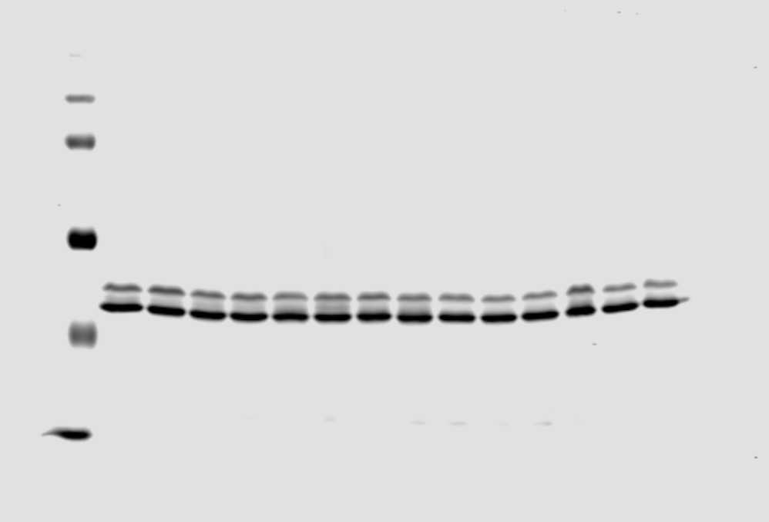
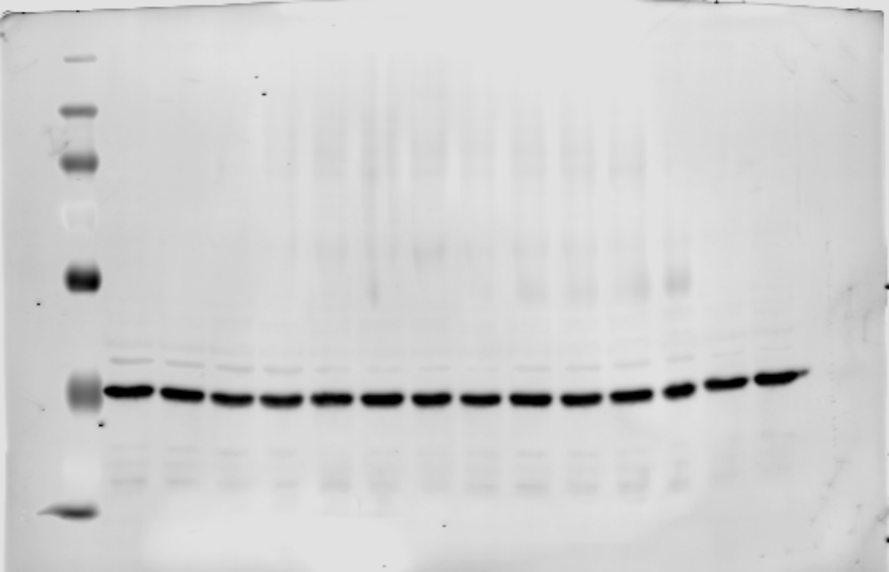
Total Erk
(Fig. 6C)
 | Whole cell
 | 3hr Sham |  |  |  | 3 hr PLB |  |  |  |  | 3 hr TRE
1 | 2 | 3 | 4 | 5 | 6 | 7 | 8 | 9 | 10 | 11 | 12 | 13 | 14 | 15
L | 42-1 | 68-1 | 81-1 | 81-2 | 45-1 | 45-2 | 41-1 | 47-2 | 47-3 | 67-1 | 67-2 | 12-1 | 12-3 | 48-3
55 kDa
42/44 kDa total Erk
35 kDa
The above blot was stripped and reprobed for Gapdh
55 kDa
35 kDa
36 kDa Gapdh

Slide 5
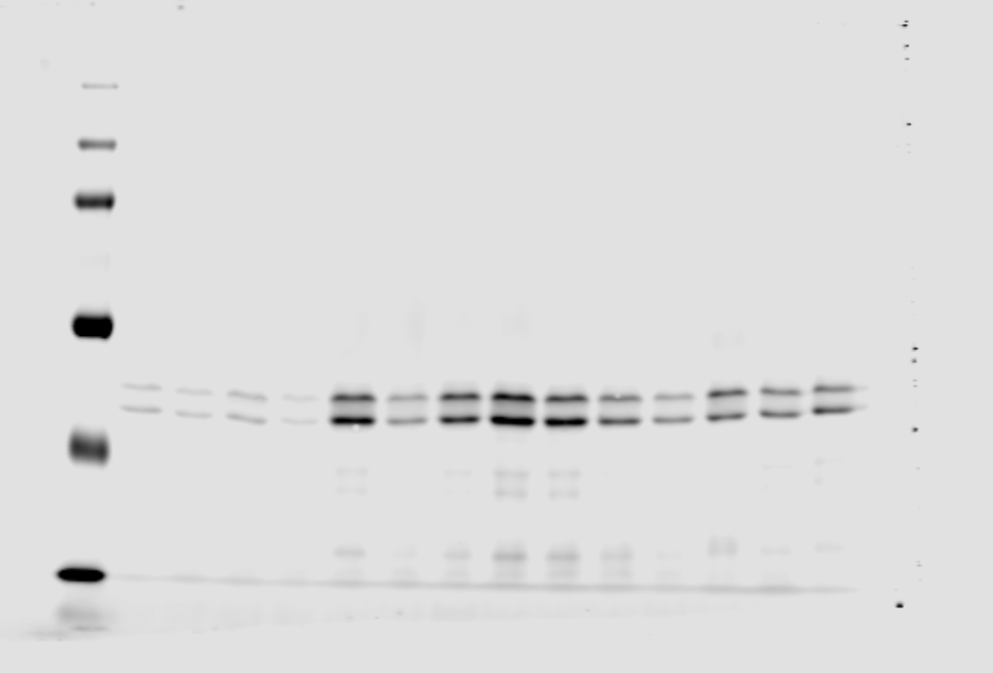
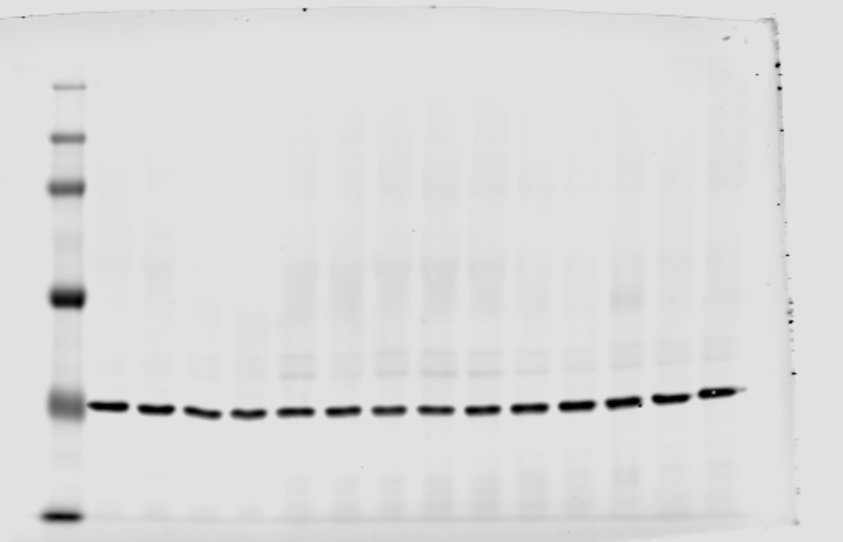
pErk
(Fig. 6C)
 | Whole cell
 | 3hr Sham |  |  |  | 3 hr PLB |  |  |  |  | 3 hr TRE
1 | 2 | 3 | 4 | 5 | 6 | 7 | 8 | 9 | 10 | 11 | 12 | 13 | 14 | 15
L | 42-1 | 68-1 | 81-1 | 81-2 | 45-1 | 45-2 | 41-1 | 47-2 | 47-3 | 67-1 | 67-2 | 12-1 | 12-3 | 48-3
55 kDa
42/44 kDa p-Erk
35 kDa
The above blot was stripped and reprobed for Gapdh
55 kDa
35 kDa
36 kDa Gapdh

Slide 6
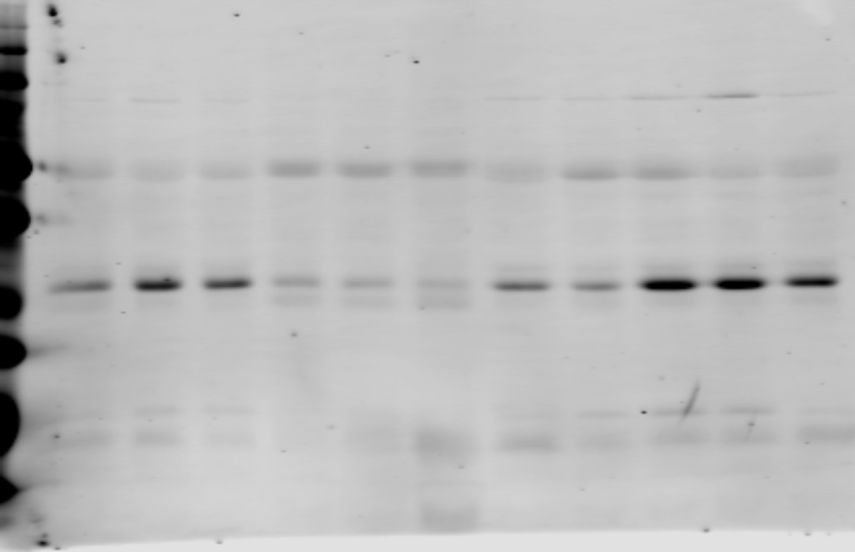
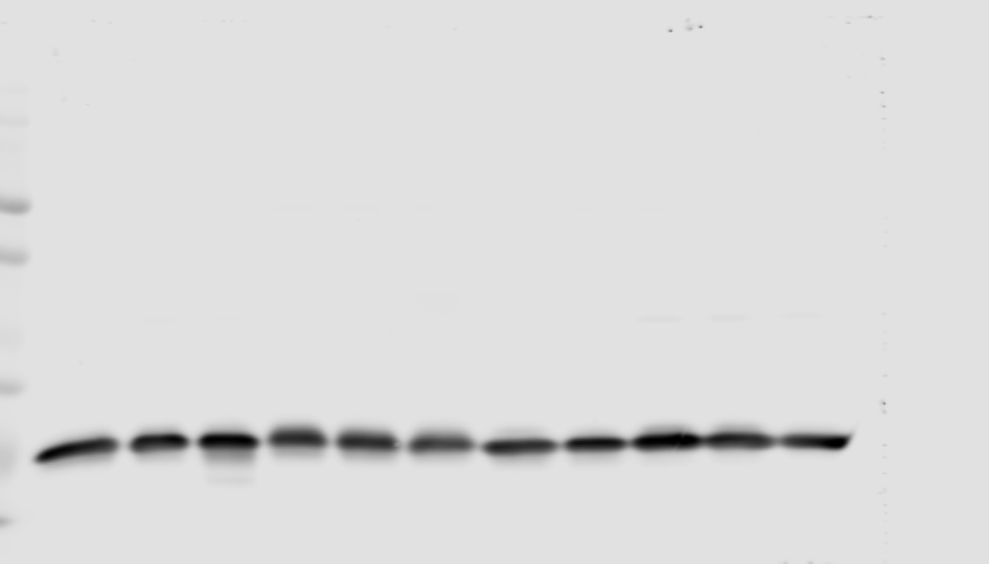
Sirt3
(Fig. 6D)
 | Mitochondria
 | CTRL |  |  | 1 hr PLB |  |  |  | 1 hr TRE
1 | 2 | 3 | 4 | 5 | 6 | 7 | 8 | 9 | 10 | 11 | 12
L | 83-3 | 83-5 | 83-6 | 5-1 | 5-2 | 5-3 | 57-1 | 11-4 | 11-6 | 65-1 | 65-2
50 kDa
37 kDa
28 kDa Sirt3
25 kDa
20 kDa
15 kDa
10 kDa
The above blot was stripped and reprobed for Gapdh
50 kDa
37 kDa
25 kDa
20 kDa
17 kDa Cox4
15 kDa
10 kDa

Slide 7
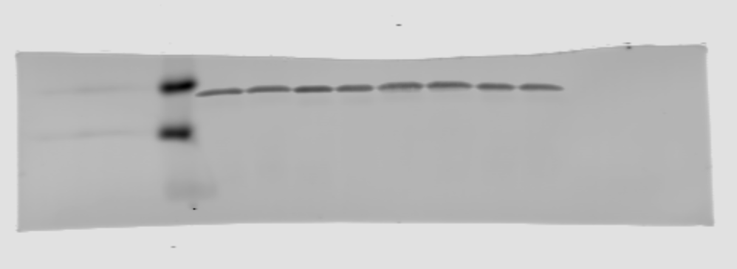
Sirt3: comparison of control vs. sham
 | mitochondria
 | Controls |  |  |  | 1-hour Sham
1 | 2 | 3 | 4 | 5 | 6 | 7 | 8 | 9
L | 83-2 | 83-3 | 83-5 | 83-6 | 82-1 | 82-2 | 69-1 | 29-4
100 kDa
70 kDa
55 kDa
35 kDa
28 kDa Sirt3
25 kDa
15 kDa
17 kDa Cox4
10 kDa
The full blot was cut below 20 kDa to probe for Sirt3 and Cox4

