Slide 1
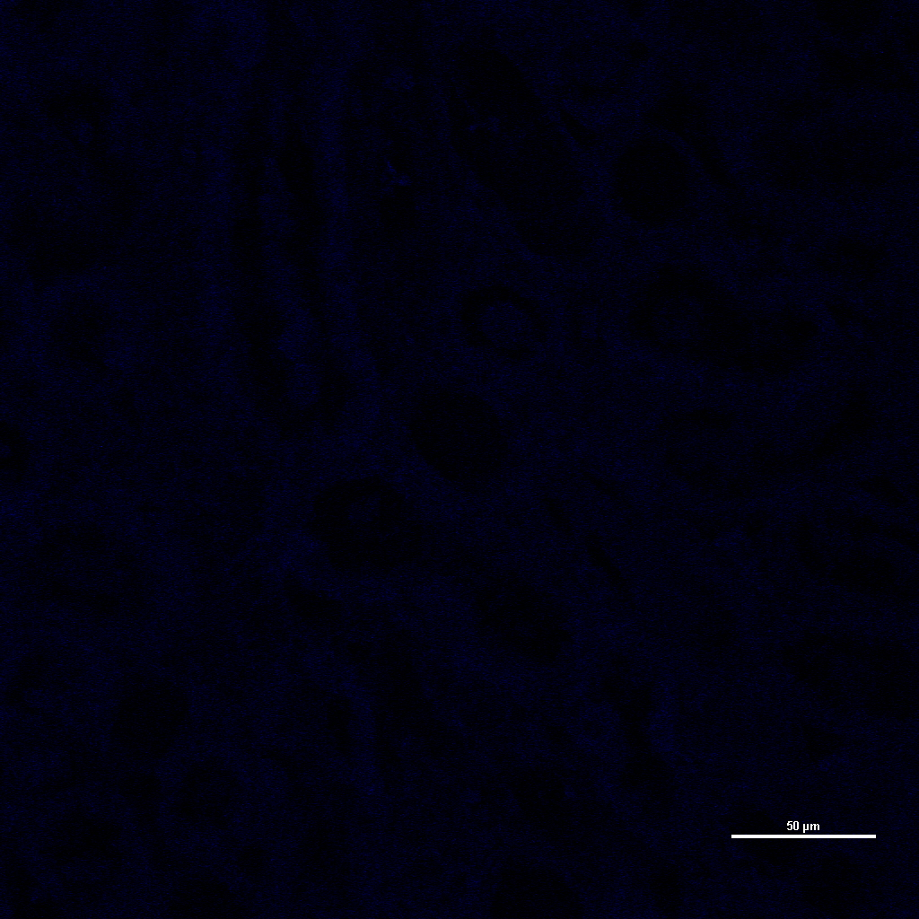
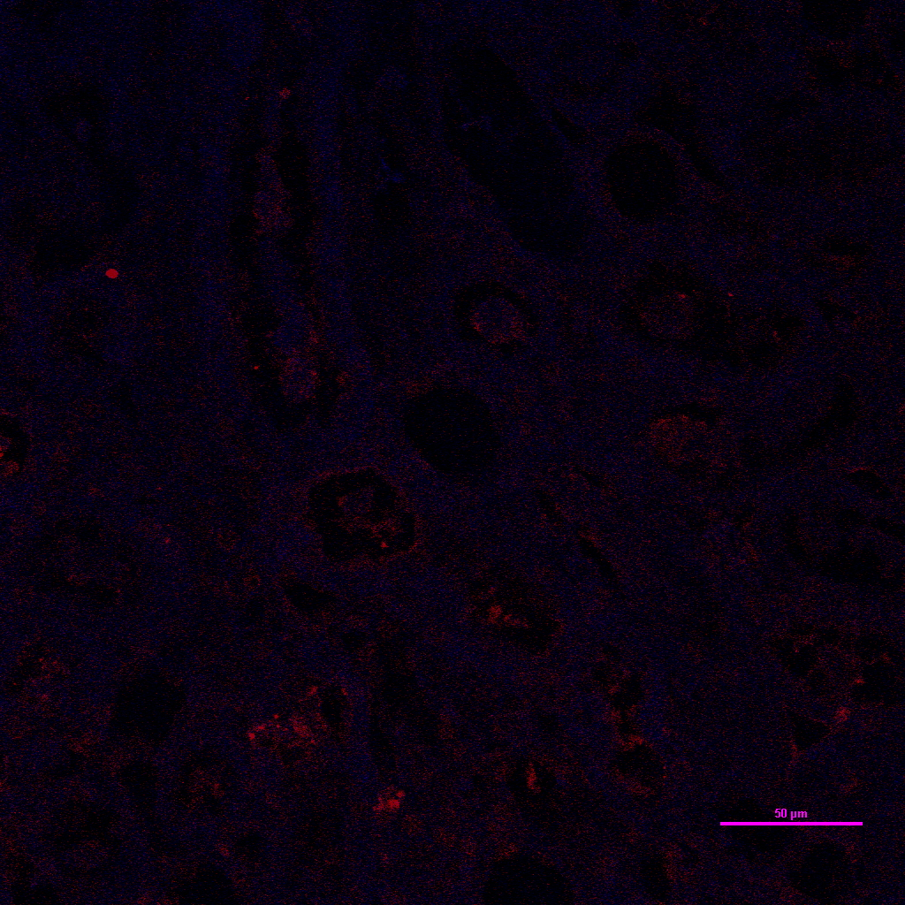
40x
TUNEL & Hoechst test
TUNEL
Hoechst
Merged
DNase I treated
without Hoechst

