Slide 1
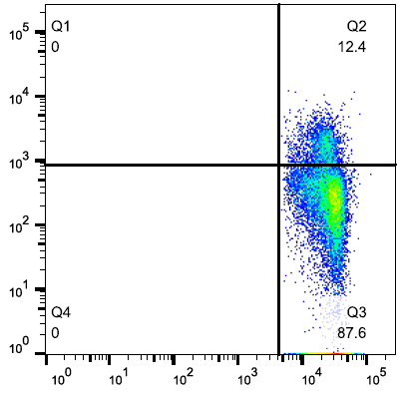
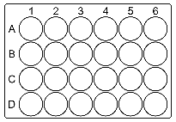
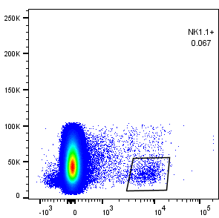
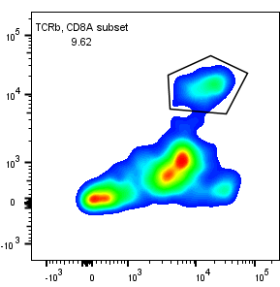
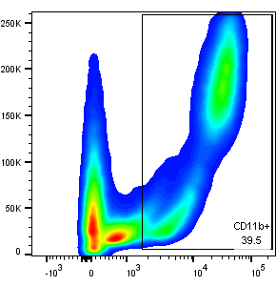
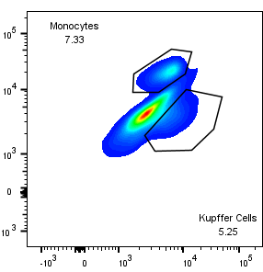
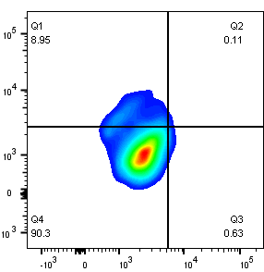
Supplemental Figure 1
Single Cell Discrimination
Gate for Lymphocytes
Gate for CD4+ Cells
Gate for T_{Regs}
Labeling
Liver
CD4-APC
FoxP3-FITC
SSC
SSC
FOXP3
CD4-APC
FOXP3-FITC
IFNγ-PE
FSC-H
Ionomycin & PMA Stimulation, + BFA
FSC
CD4
CD4
FSC-A
Single Cell Discrimination
Gate for Lymphocytes
Gate for NK Cells
NK1.1-PE
SSC
SSC
FSC-H
FSC-A
FSC
NK1.1
Single Cell Discrimination
Gate for Lymphocytes
Gate for TCRb+ Killer T Cells
TCRβ-APC
CD8α-PerCP-Cy5
SSC
CD8a
FSC-H
FSC-A
FSC
TCRb
Single Cell Discrimination
CD11c-APC
CD11b-PerCP-Cy5
Ly6C-FITC
F4/80-PE
CD206-Pacific Blue
Gate for CD11b+
Gate for KCs
Gate for M1/M2 KCs
M1
FSC-H
SSC
Ly6C
CD11c (M1)
M2
FSC-A
CD11b
F4/80
CD206 (M2)
Supplemental Figure 1. Cell labeling, gating strategy, and identification of hepatic immune cells by flow cytometry.

