Slide 1
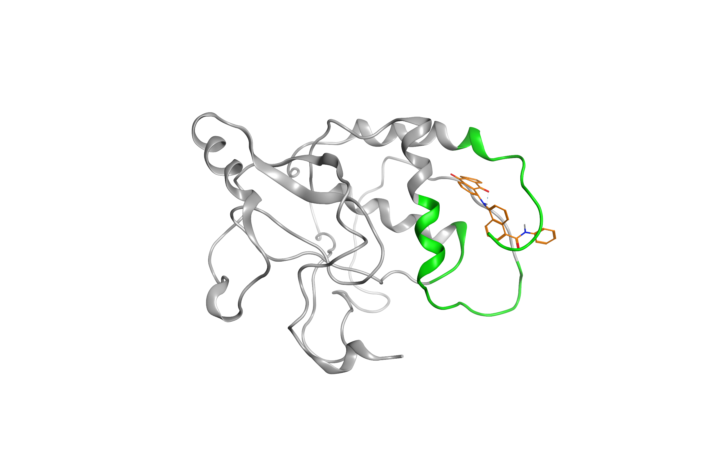
A
B
C
D
E
Figure S11. Binding parameters for AMS-55 docked to site II of Nef and simulated with MD for 30 ns without trajectory recording and for 20 ns with trajectory recording. A - Nef:AMS-55 complex after 50 ns of molecular dynamics simulation. The ABCA1 interaction sites I-III on Nef are shown in green. AMS-55 is colored orange. B - RMSD for Nef:AMS-55 complex, calculated for the last 20 ns of 50 ns trajectory. C - RMSF for Nef:AMS-55 complex, calculated for the last 20 ns of 50 ns trajectory. Top panel - RMSF for Nef Ca atoms. Bottom panel - RMSF for AMS-55 atoms. D - Solvent accessible surface area for AMS-55 molecule for the last 20 ns of 50 ns trajectory for Nef:AMS-55 complex. E - Number of hydrogen bonds between Nef and AMS-55 calculated for the last 20 ns of the 50 ns trajectory.

