Slide 1
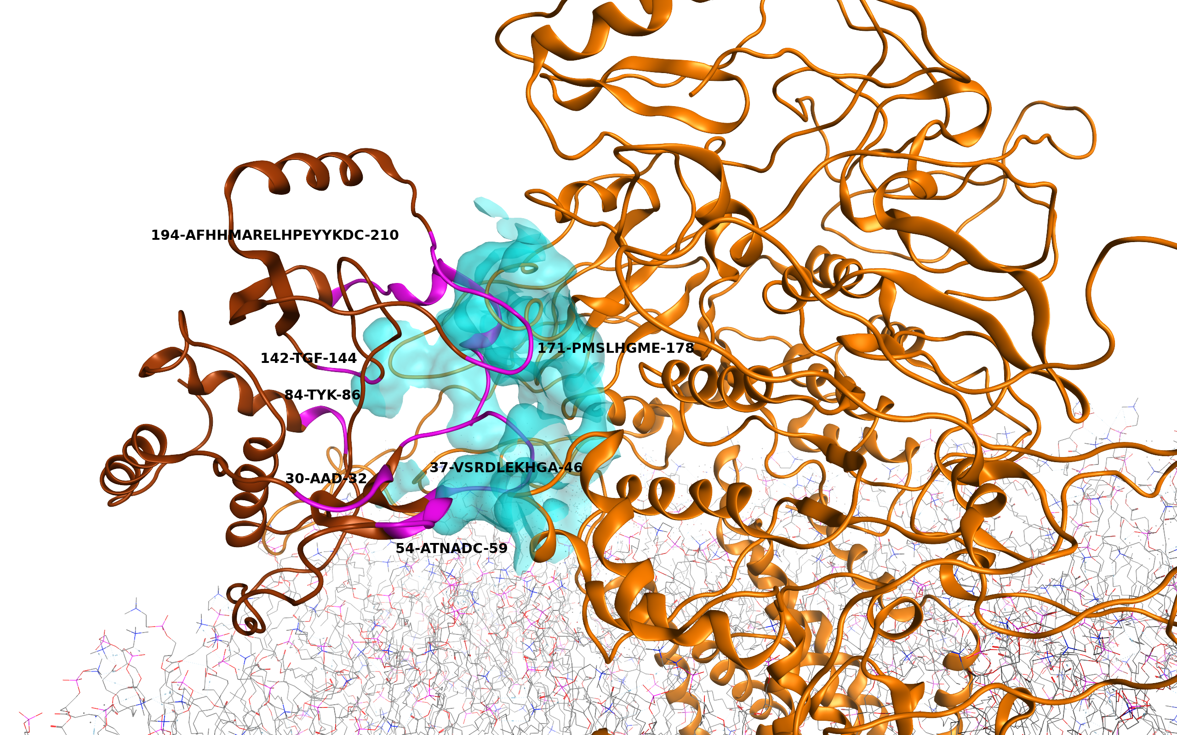
Figure S4: Interaction interface between ABCA1 (orange) and Nef protein (brown) after 50 ns MD simulation (docking model 4). The interacting sites on Nef are shown and highlighted with magenta color. Interaction surface for ABCA1 is colored cyan.

