Slide 1
Case report of Barth syndrome: A forgotten cause of cardiomyopathy
December 2020

Slide 2
Introduction
Barth syndrome (BTHS) is an extremely rare condition with an incidence of 1 in 400,000 in the United States
It was first described in 1983, as an X-Linked recessive genetic disorder caused by mutations in the TAZ gene
We present a rare case of a 27-year-old man with Barth syndrome, with dilated cardiomyopathy and neutropenia

Slide 3
Case Presentation
History and Examination Findings
A 27-year-old man presenting with lightheadedness, dyspnea, orthopnea and bilateral lower extremity edema
Symptoms associated with chest discomfort
On presentation, he was tachycardic with otherwise normal vital signs
On physical exam, he had diminished breath sounds at the bases, JVD, 2+ lower extremity pitting edema
Family history was remarkable for Barth syndrome diagnosed by genetic testing in a brother

Slide 4
Case Presentation
Laboratory Investigations
Complete blood count:
      Leukopenia: 2.9 k/uL
      Neutropenia: 27.7%
      Monocytosis: 37.1%
HIV testing: Non-reactive
Urine toxicology: Negative
Ethanol level: < 3 mg/dL
Lipid panel:
      Total cholesterol: 91 mg/dL
      Calculated LDL: 44 mg/dL
      HDL: 22 mg/dL
Thyroid panel:
      TSH: 5.120 uIU/mL
      Free T4: 1.16 ng/dL

Slide 5
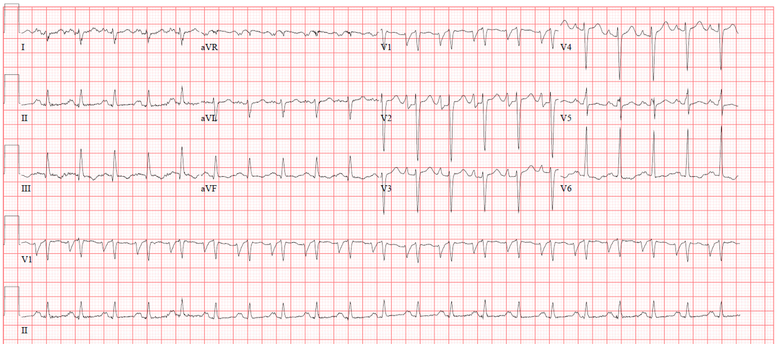
Case Presentation
Diagnostic Imaging: Electrocardiogram
Sinus tachycardia (128 beats per min), left atrial enlargement, prolonged QTc interval (589 msec)

Slide 6
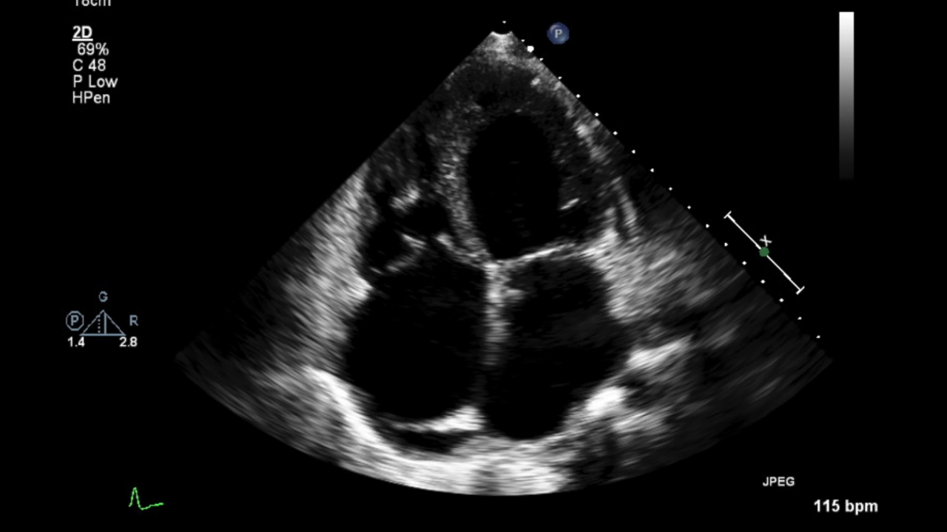
Case Presentation
Diagnostic Imaging: Trans-Thoracic Echocardiogram
Findings:
      Left ventricular ejection fraction (LVEF) of 15-20%
      Global enlargement of all chambers
      Mild pulmonary hypertension

Slide 7
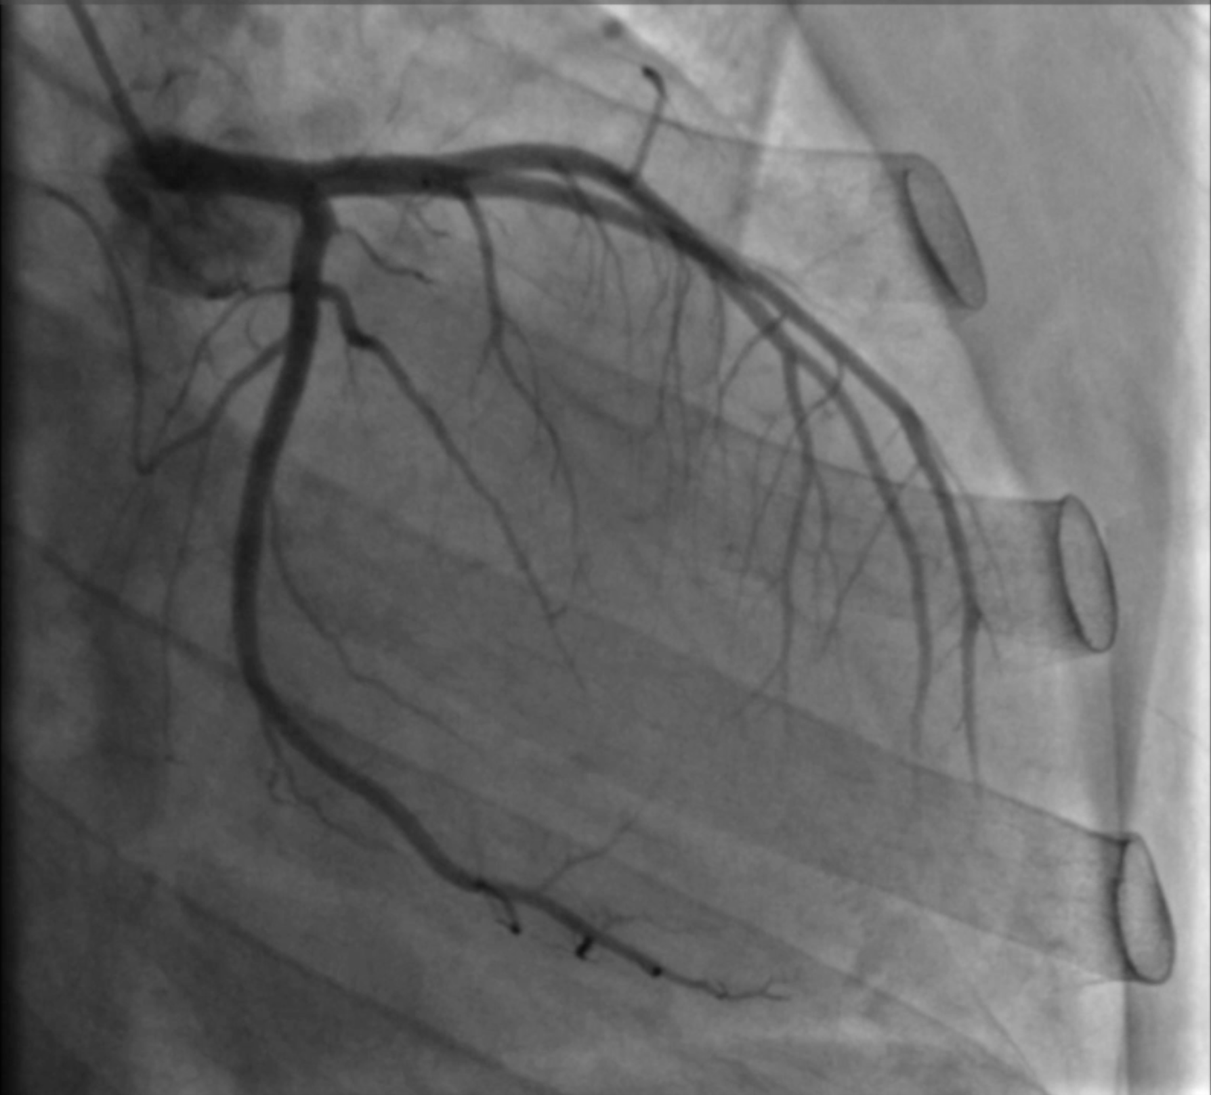
Case Presentation
Management
Left Heart Catheterization
      Coronary angiography: Patent coronary arteries
      Ventriculogram: LVEF of 20%
Right heart catheterization
      Calculated Fick Cardiac Output of 3.18 L/min
      Cardiac Index of 2.02 L/min/m²
Patient carefully diuresed to euvolemia

Slide 8
Case Presentation
Discharge and follow-up
Discharged on LifeVest wearable defibrillator for 3 months
Medications: Furosemide, carvedilol, sacubitril-valsartan
Outpatient cardiac MRI non-suggestive of infarction, infiltrates, or other abnormal enhancement
Diagnosis confirmed by outpatient genetic testing
Close follow-up with advanced heart failure cardiologist
Addition of spironolactone to medication regimen
Repeat echocardiogram 2 years later showed improvement in LVEF to 45-50%

Slide 9
Discussion
Pathogenesis of BTHS
      Reduced remodelling of cardiolipin
      Alteration of aerobic respiration and mitochondrial activity in tissues with high energy demand (heart, skeletal muscle)
Clinical features
      Dilated cardiomyopathy
      Left ventricular non-compaction
      Prolonged QTc interval
      Exercise intolerance
      Growth delay
      3-methylglutaconic aciduria
      Hypocholesterolemia

Slide 10
Discussion
Neutropenia is usually one of the earliest manifestations of the disease
Prompt diagnosis is crucial and leads to earlier interventions
Routine use of cardiac medications for patients with cardiac complications of BTHS has resulted in improvement
Lower mortality outcomes reported in prospectively identified patients with proactive management of disease

Slide 11
Learning Points
Barth syndrome is a genetic condition with a wide spectrum of clinical features including cardiomyopathy, neutropenia, exercise intolerance, growth delay, 3-methylglutaconic aciduria and hypocholesterolemia
In the absence of an obvious underlying cause, with the appropriate historical information, clinical exam, laboratory investigations and imaging findings, Barth syndrome should be considered as a likely cause of non-ischemic cardiomyopathy

Slide 12
References
Barth PG, Scholte HR, Berden JA, Van Der Klei-Van Moorsel JM, Luyt-Houwen IEM, Van’T Veer-Korthof ETh, et al. An X-linked mitochondrial disease affecting cardiac muscle, skeletal muscle and neutrophil leucocytes. J Neurol Sci. 1983 Dec;62(1–3):327–55.
Clark SLN, Bowron AB, Gonzalez IL, Groves SJ, Newbury-Ecob R, Clayton N, et al. Barth Syndrome. Orphanet J Rare Dis. 2013 Feb 12;8:23.
Barth PG, Valianpour F, Bowen VM, Lam J, Duran M, Vaz FM, et al. X-linked cardioskeletal myopathy and neutropenia (Barth syndrome): An update. Am J Med Genet. 2004 May 1;126A(4):349–54.
Vreken P, Valianpour F, Nijtmans LG, Grivell LA, Plecko B, Wanders RJA, et al. Defective Remodeling of Cardiolipin and Phosphatidylglycerol in Barth Syndrome. Biochem Biophys Res Commun. 2000 Dec;279(2):378–82.
Dudek J, Maack C. Barth syndrome cardiomyopathy. Cardiovasc Res. 2017 Mar 15;113(4):399–410.
Reynolds S. Successful management of Barth syndrome: a systematic review highlighting the importance of a flexible and multidisciplinary approach. J Multidiscip Healthc. 2015 Jul;345.
Huhta JC, Pomerance HH, Barness EG: Clinicopathologic conference: Barthsyndrome. Fetal Pediatr Pathol 2005, 24:239–254.
Cantlay AM, Shokrollahi K, Allen JT, Lunt PW, Newbury-Ecob RA, Steward CG. GGenetic analysis of the G4.5 gene in families with suspected Barth syndrome. J Pediatr. 1999;135(3):5.

