Slide 1
Supplementary Table 1. Descriptive Statistics of 13,642 patients with COVID-19
Variables | All Subjects (N=13,642) | By Hospitalization |  |  | By Mortality
 |  | In-patients (N=3,898) 28.6% | Out-patients (N=9,744) 71.4% | P-value | Death (N=679) 5% | Alive (N=12,963) 95.0% | P-value
 | Mean (SD), [min, max] | Mean (SD) | Mean (SD) |  | Mean (SD) | Mean (SD)
Age | 51.2 (19.5) [18, 120] | 62.7 (19.5) | 46.6 (17.5) | <0.0001 | 77.7 (13.5) | 49.8 (18.8) | <0.0001
BMI | 30.3 (7.7) [11.4, 135.3] | 29.7 (7.9) | 30.6 (7.5) | <0.0001 | 27.9 (7.9) | 30.4 (7.6) | <0.0001
N. of Chronic Conditions | 4.79 (5.7) [0, 34] | 8.8 (8. 6) | 3.2 (3.1) | <0.0001 | 12.1 (6.9) | 4.4 (5.3) | <0.0001
 | N (%) | N (%) | N (%) |  | N (%) | N (%)
Gender: Male | 5,855 (42.9%) | 1,850 (47.5%) | 4,005 (41.1%) | <0.0001 | 340 (50.1%) | 5,515 (42.6%) | 0.0001
Race
Non-Hispanic White | 2,977 (21.8%) | 972 (24.9%) | 2,005 (20.6%) | <0.0001 | 133 (19.6%) | 2,844 (21.9%) | <0.0001
Black | 5,365 (39.3) | 1,686 (43.2%) | 3,679 (37.8%) |  | 421 (62.0%) | 4,944 (38.1%)
Hispanic | 3,903 (28.6%) | 1,028 (26.4%) | 2,875 (29.5%) |  | 99 (14.6%) | 3,804 (29.3%)
Asian | 278 (2.0%) | 76 (1.9%) | 202 (2.1%) |  | 15 (2.2%) | 263 (2.0%)
Other/unknown | 1,119 (8.2) | 136 (3.5%) | 983 (10.1%) |  | 11 (1.6%) | 1,108 (8.5%)

Slide 2
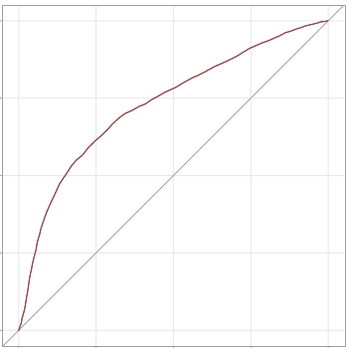
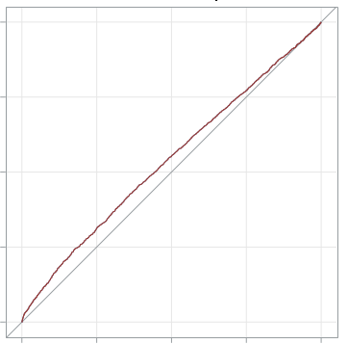
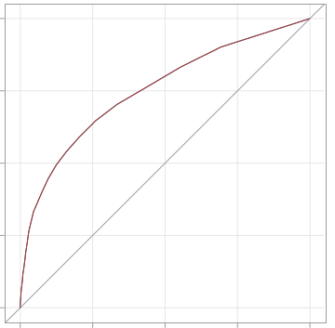
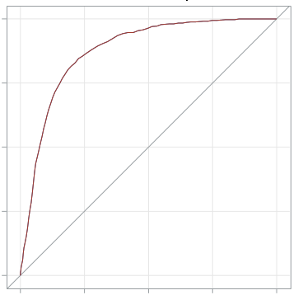
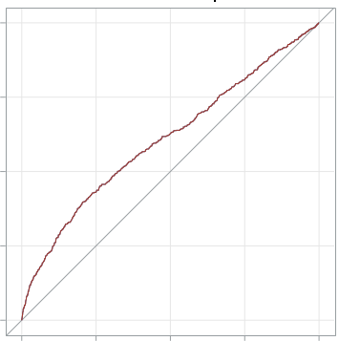
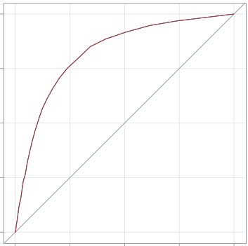
Supplementary Figure 1.
Age BMI Number of Comorbidities
1.00
0.75
0.50
0.25
0.00
Hospitalization
(Inpatient vs outpatient)
Sensitivity
AUC=0.73
[0.72, 0.74]
AUC=0.54
[0.53, 0.55]
AUC= 0.75
[0.74, 0.76]
0.00 0.25 0.50 0.75 1.00
0.00 0.25 0.50 0.75 1.00
0.00 0.25 0.50 0.75 1.00
1.00
0.75
0.50
0.25
0.00
Sensitivity
Mortality (Alive vs. Death)
AUC=0.88
[0.86,0.89]
AUC=0.61
[0.58, 0.63]
AUC= 0.82
[0.81, 0.84]
0.00 0.25 0.50 0.75 1.00
0.00 0.25 0.50 0.75 1.00
0.00 0.25 0.50 0.75 1.00
1-Specificity
1-Specificity
1-Specificity
Supplementary Figure 1. The receiver operating characteristic (ROC) curves of age, body mass index (BMI) and number of comorbidities for hospitalization and mortality in a cohort of 13,642 adult patients with COVID-19. We extracted a set of demographic and clinical data from 13,642 adult patients (age > 18) who were diagnosed with SARS-CoV-2 infection. The number of comorbidities was determined based on the Elixhauser Comorbidity Index and 17 additional medical conditions. The areas under the ROC curve (AUC) of age, BMI, and number of comorbidities for hospitalization and mortality were assessed. The numbers in the brackets indicate 95% confidence intervals.

Slide 3
Supplementary Table 2. Ranked Chronic Conditions Based on Correlations with Hospitalization and Mortality
Chronic Conditions | Hospitalization |  | Mortality
 | Correlation | Odds Ratio Adjusted for age, gender, and No. of comorbidity | Correlation | Odds Ratio Adjusted for age, gender, and No. of comorbidity
Electrolyte Disorder (ELX) | 0.382 | 2.06 [1.82, 2.34] | 0.251 | 1.71 [1.36, 2.14]
Complicated Hypertension (ELX) | 0.333 | 1.11 [0.94, 1.30] | 0.249 | 1.02 [0.83, 1.30]
Uncomplicated Hypertension (ELX) | 0.322 | 0.99 [0.89, 1.11] | 0.209 | 1.23 [0.93, 1.62]
Neurological Disorder (ELX) | 0.308 | 1.65 [1.43, 1.90] | 0.245 | 1.59 [1.30, 1.95]
Chronic Heart Failure (ELX) | 0.300 | 1.03 [0.87, 1.21] | 0.229 | 0.93 [0.74, 1.17]
Renal Failure (ELX) | 0.297 | 1.15 [0.98, 1.35] | 0.236 | 1.25 [1.00, 1.57]
Chronic Kidney Disease | 0.296 | 1.13 [0.06, 1.34] | 0.235 | 1.20 [0.96, 1.51]
Arrhythmia (ELX) | 0.281 | 1.07 [0.95, 1.20] | 0.191 | 0.90 [0.72, 1.11]
Complicated DM (ELX) | 0.272 | 1.17 [1.03, 1.34] | 0.168 | 1.24 [1.01, 1.54]
Cardiovascular Diseases | 0.266 | 0.99 [0.86, 1.16] | 0.191 | 0.87 [0.70, 1.08]
Peripheral vascular Diseases (ELX) | 0.265 | 0.86 [0.73, 1.01] | 0.198 | 0.84 [0.67, 1.05]
Uncomplicated DM (ELX) | 0.261 | 1.14 [1.03, 1.28] | 0.152 | 1.20 [0.99, 1.46]
Valvular Disorder (ELX) | 0.253 | 0.84 [0.73, 0.97] | 0.182 | 0.77 [0.62, 0.96]
Lipid Disorder | 0.249 | 0.64 [0.57, 0.71] | 0.184 | 0.94 [0.75, 1.18]
Atrial Fibrillation and flutter | 0.238 | 0.87 [0.73, 1.03] | 0.206 | 0.85 [0.68, 1.06]
COPD | 0.219 | 0.93 [0.80, 1.07] | 0.164 | 1.08 [0.87, 1.34]
Myocadiac diseases | 0.219 | 1.13 [0.92, 1.38] | 0.158 | 0.98 [0.76, 1.25]
Stroke | 0.215 | 1.01 [0.83, 1.22] | 0.157 | 0.95 [0.74, 1.21]
Weight loss (ELX) | 0.212 | 1.21 [1.03, 1.42] | 0.173 | 1.26 [1.01, 1.57]
Pulmonary circulatory Dx (ELX) | 0.190 | 1.16 [0.93, 1.43] | 0.148 | 1.16 [0.89, 1.52]
Elixhauser comorbidity (ELX), Diabetes Mellitus (DM), Chronic obstructive pulmonary disease (COPD)

Slide 4
Supplementary Table 3. COVID-19 treatment for patients <65 years old (yo) and ≥65 yo.
 | <65 yo |  | ≥ 65 yo |  | p value
 | YES | NO | YES | NO
HCQ | 389 (68.7) | 177 (31.3) | 508 (70.6) | 211 (29.4) | 0.501
Remdesivir | 102 (18.0) | 464 (82.0) | 97 (13.5) | 620 (86.5) | 0.027
Glucocorticoids | 208 (36.4) | 360 (63.6) | 245 (34.2) | 472 (65.8) | 0.407
Tocilizumab | 308 (54.4) | 258 (45.6) | 398 (55.5) | 319 (44.5) | 0.696

Slide 5
Supplementary Table 4. Relationship of disease severity at admission, ICU care and mortality with clinical and laboratory data in younger (<65 years old) adult patients.
<65 yo (n=566) | Non-severe vs. severe at admission (n=403 vs. 163) |  | Non-ICU vs ICU (n=371 vs 195) |  | Alive vs. Death (n=522 vs. 44)
Demographics | p value | Odd Ratio | p value | Odd Ratio | p value | Odd Ratio
Gender | 0.005390 | 1.815590 | 0.000944 | 1.951905 | 0.101928 | 1.851394
Race | 0.414658 |  | 0.083520 |  | 0.470428
Ethnicity | 0.639044 |  | 0.054448 |  | 0.388286
Age | 0.002408 | 1.032764 | 0.033876 | 1.020836 | 0.013630 | 1.054761
BMI | 0.029146 | 1.027019 | 0.132124 | 1.017121 | 0.486073 | 0.984329
ELX score | 0.066382 | 0.917827 | 0.364974 | 0.963709 | 0.388021 | 1.058297
Electrolyte do | 0.675124 | 1.142771 | 0.030476 | 0.535623 | 0.119238 | 0.435207
Neurological do | 0.259101 | 1.468408 | 0.612070 | 0.864247 | 0.393382 | 0.674859
Renal failure | 0.301747 | 0.684600 | 0.895559 | 0.958989 | 0.150553 | 0.500512
Uncomplicated DM | 0.506374 | 0.813812 | 0.143801 | 0.653413 | 0.983692 | 0.989243
Complicated DM | 0.915561 | 1.036918 | 0.367791 | 1.331948 | 0.256465 | 1.936564
Weight loss | 0.886957 | 1.057528 | 0.240428 | 1.499298 | 0.133703 | 2.326174
First Labs
Albumin | 0.269172 | 0.782559 | 0.195606 | 0.768327 | 0.026183 | 0.458379
CRP | 0.000003 | 1.006686 | 0.870251 | 1.000211 | 0.929661 | 1.000182
D-Dimer | 0.786647 | 0.993814 | 0.131459 | 1.035797 | 0.001451 | 1.074594
Ferritin | 0.005489 | 1.000217 | 0.069199 | 1.000116 | 0.018385 | 1.000133
Procalcitonin | 0.455897 | 0.965693 | 0.486425 | 1.018203 | 0.644587 | 1.006739
WBC | 0.526136 | 1.019195 | 0.462509 | 1.020711 | 0.335251 | 1.039474
Neutrophil % | 0.164616 | 1.028087 | 0.783409 | 0.995541 | 0.023958 | 0.957738
Lymphocyte % | 0.167834 | 1.034500 | 0.015183 | 0.949503 | 0.007041 | 0.917521
Monocyte % | 0.107198 | 0.942183 | 0.016651 | 0.925969 | 0.884004 | 1.005859
Max Labs
Albumin | 0.703231 | 1.097732 | 0.194634 | 1.405203 | 0.049795 | 0.446299
CRP | 0.000148 | 1.005092 | 0.738633 | 0.999532 | 0.803541 | 1.000617
D-Dimer | 0.637029 | 0.994072 | 0.000033 | 1.061782 | 0.016284 | 1.042040
Ferritin | 0.054163 | 1.000086 | 0.216282 | 1.000065 | 0.056121 | 1.000116
Procalcitonin | 0.227789 | 0.994674 | 0.634590 | 0.996903 | 0.895296 | 1.000646
WBC | 0.005261 | 1.042904 | 0.000097 | 1.074757 | 0.000030 | 1.090351
Neutrophil % | 0.072295 | 1.026763 | 8.5417E-7 | 1.081447 | 0.862818 | 0.994697
Lymphocyte % | 0.940756 | 1.000745 | 0.074647 | 1.018578 | 0.039336 | 0.957574
Monocyte % | 0.019420 | 0.940668 | 0.691113 | 0.990753 | 0.733236 | 1.015346
First Cytokines
IL-1β | 0.634763 | 0.993281 | 0.020437 | 1.028335 | 0.946164 | 0.998383
IL-2 | 0.454934 | 0.977663 | 0.420905 | 0.981177 | 0.679763 | 0.982154
IL-2R | 0.931301 | 1.000007 | 0.269021 | 1.000096 | 0.004301 | 1.000246
IL-4 | 0.707280 | 1.016297 | 0.784470 | 0.990232 | 0.039259 | 0.789375
IL-5 | 0.773739 | 0.991425 | 0.341660 | 1.058267 | 0.298647 | 1.081376
IL-6 | 0.000484 | 1.004472 | 0.000084 | 1.007656 | 0.005691 | 1.003305
IL-8 | 0.681787 | 0.997083 | 0.118398 | 1.190796 | 0.747964 | 1.006925
IL-10 | 0.002095 | 1.020781 | 0.043675 | 1.010854 | 0.688021 | 1.003171
IL-12 | 0.490920 | 1.045809 | 0.785827 | 0.986533 | 0.639472 | 1.058661
IL-13 | 0.981559 | 0.998492 | 0.429931 | 0.945969 | 0.998214 | 0.999748
IL-17 | 0.353743 | 0.961836 | 0.262095 | 0.994582 | 0.969588 | 0.999563
IFN-γ | 0.447725 | 0.965717 | 0.157925 | 0.951034 | 0.002897 | 1.149453
Max Cytokines
IL-1β | 0.532963 | 1.007637 | 0.221526 | 1.011977 | 0.116153 | 1.020353
IL-2 | 0.229344 | 0.967781 | 0.753353 | 1.003368 | 0.537814 | 0.981556
IL-2R | 0.295285 | 0.999934 | 0.085238 | 1.000116 | 0.003645 | 1.000179
IL-4 | 0.960898 | 0.999440 | 0.876778 | 0.997323 | 0.495540 | 1.001065
IL-5 | 0.266780 | 1.017875 | 0.273440 | 1.042597 | 0.157631 | 1.068549
IL-6 | 0.004359 | 1.001219 | 0.000001 | 1.002957 | 0.355136 | 1.000361
IL-8 | 0.792452 | 0.998423 | 0.163728 | 1.043440 | 0.019284 | 1.037063
IL-10 | 0.001023 | 1.019030 | 0.068227 | 1.008347 | 0.991364 | 1.000046
IL-12 | 0.971217 | 1.002113 | 0.137408 | 0.946945 | 0.244367 | 0.905163
IL-13 | 0.161567 | 1.075155 | 0.558798 | 1.031693 | 0.282184 | 1.075071
IL-17 | 0.103755 | 0.979393 | 0.085347 | 0.993048 | 0.161857 | 0.993863
IFN-γ | 0.376229 | 0.980024 | 0.721451 | 1.005830 | 0.209769 | 1.029768

Slide 6
Supplementary Table 5. Relationship of disease severity at admission, ICU care and mortality with clinical and laboratory data in older (≥65 years old) adult patients.
≥ 65 yo (n=717) | Non-severe vs. severe at admission (n=557 vs 160) |  | Non-ICU vs ICU (n=531 vs 186) |  | Alive vs. Death (n=542 vs. 175)
Demographics | p value | Odd Ratio | p value | Odd Ratio | p value | Odd Ratio
Gender (male) | 0.028029 | 1.541311 | 0.003633 | 1.719542 | 0.029069 | 1.529479
Race | 0.141123 |  | 0.507906 |  | 0.423967
Ethnicity | 0.657420 |  | 0.357707 |  | 0.999575
Age | 0.288966 | 0.987444 | 0.002777 | 0.966481 | 1.1488E-8 | 1.070258
BMI | 0.011978 | 1.036389 | 0.566540 | 1.007981 | 0.891309 | 0.997900
ELX score | 0.034493 | 0.923610 | 0.429959 | 0.972991 | 0.207852 | 0.956067
Electrolyte do | 0.060136 | 0.627412 | 0.077053 | 0.657332 | 0.771220 | 1.072788
Neurological do | 0.135371 | 1.424661 | 0.057099 | 1.529786 | 0.032134 | 0.630652
Renal failure | 0.276238 | 1.324355 | 0.136364 | 1.429111 | 0.433820 | 0.827599
Uncomplicated DM | 0.262353 | 0.732889 | 0.919717 | 1.027481 | 0.150141 | 0.668456
Complicated DM | 0.987715 | 0.995358 | 0.861333 | 0.950452 | 0.392421 | 1.294992
Weight loss | 0.371872 | 0.785099 | 0.162075 | 0.705646 | 0.003178 | 0.482100
First Labs
Albumin | 0.183764 | 1.315090 | 0.173950 | 0.773058 | 0.001950 | 0.552320
CRP | 0.000002 | 1.006441 | 0.001339 | 1.004094 | 0.865945 | 1.000221
D-Dimer | 0.171298 | 1.019333 | 0.353893 | 1.012728 | 0.931782 | 0.998769
Ferritin | 0.141632 | 1.000124 | 0.201882 | 1.000105 | 0.031281 | 1.000176
Procalcitonin | 0.679564 | 0.994265 | 0.730718 | 0.995310 | 0.962298 | 1.000785
WBC | 0.734951 | 1.004466 | 0.205842 | 1.023567 | 0.716482 | 1.004942
Neutrophil % | 0.398752 | 1.015059 | 0.881408 | 0.997811 | 0.096862 | 1.041715
Lymphocyte % | 0.519521 | 1.013293 | 0.494810 | 0.988197 | 0.203577 | 1.034551
Monocyte % | 0.091631 | 0.949715 | 0.256244 | 0.971758 | 0.386366 | 1.028820
Max Labs
Albumin | 0.669280 | 1.099166 | 0.463544 | 0.845886 | 0.003012 | 0.512965
CRP | 0.046449 | 1.002532 | 0.414363 | 1.001064 | 0.101870 | 0.997795
D-Dimer | 0.001245 | 1.033940 | 0.000119 | 1.043939 | 0.253194 | 1.012542
Ferritin | 0.391457 | 0.999976 | 0.340135 | 1.000045 | 0.013732 | 1.000129
Procalcitonin | 0.917651 | 0.999081 | 0.801993 | 0.997918 | 0.966522 | 1.000396
WBC | 0.011030 | 1.021888 | 0.000003 | 1.061494 | 0.000360 | 1.030310
Neutrophil % | 0.116376 | 1.017986 | 1.564E-8 | 1.081322 | 0.052342 | 1.023930
Lymphocyte % | 0.642132 | 0.995962 | 0.074039 | 1.015882 | 0.002773 | 0.971631
Monocyte % | 0.413003 | 0.982952 | 0.282411 | 1.022944 | 0.001621 | 0.928146
First Cytokines
IL-1β | 0.165160 | 1.016187 | 0.669681 | 0.994403 | 0.309418 | 0.989909
IL-2 | 0.568267 | 0.995623 | 0.222603 | 1.012407 | 0.641327 | 1.001952
IL-2R | 0.743574 | 0.999973 | 0.159877 | 1.000103 | 0.424101 | 0.999933
IL-4 | 0.245419 | 0.902124 | 0.228081 | 0.881224 | 0.605428 | 0.989542
IL-5 | 0.247014 | 1.184087 | 0.298606 | 0.860026 | 0.619754 | 1.058205
IL-6 | 0.000179 | 1.004298 | 0.000016 | 1.006366 | 0.896737 | 1.000126
IL-8 | 0.348946 | 0.899075 | 0.135129 | 1.097837 | 0.521547 | 1.032131
IL-10 | 0.020719 | 1.011196 | 0.022870 | 1.011953 | 0.004974 | 1.014502
IL-12 | 0.526287 | 1.023562 | 0.168044 | 1.065633 | 0.179610 | 1.053269
IL-13 | 0.300527 | 0.967063 | 0.797055 | 0.991108 | 0.863910 | 0.994502
IL-17 | 0.123054 | 0.987127 | 0.759628 | 0.998884 | 0.497956 | 0.997419
IFN-γ | 0.388162 | 1.016579 | 0.811380 | 1.005047 | 0.713972 | 1.005667
Max Cytokines
IL-1β | 0.396774 | 1.007496 | 0.866553 | 1.001415 | 0.696181 | 0.996994
IL-2 | 0.856518 | 0.999017 | 0.183354 | 1.008154 | 0.679408 | 1.001677
IL-2R | 0.848349 | 0.999988 | 0.348921 | 1.000055 | 0.421298 | 0.999948
IL-4 | 0.144170 | 0.917322 | 0.099112 | 0.931048 | 0.456431 | 0.980625
IL-5 | 0.094286 | 1.140593 | 0.431531 | 1.022483 | 0.281828 | 1.032997
IL-6 | 0.000275 | 1.001869 | 0.000147 | 1.001956 | 0.635027 | 1.000239
IL-8 | 0.237055 | 1.035458 | 0.450547 | 1.018828 | 0.570322 | 0.570322
IL-10 | 0.152234 | 1.005029 | 0.006361 | 1.010177 | 0.015207 | 1.008294
IL-12 | 0.774429 | 0.996069 | 0.245447 | 1.019857 | 0.876472 | 1.001949
IL-13 | 0.828027 | 0.994417 | 0.961563 | 1.001325 | 0.639312 | 1.010572
IL-17 | 0.250936 | 0.996319 | 0.205133 | 0.997079 | 0.424252 | 0.997849
IFN-γ | 0.807764 | 1.002987 | 0.827356 | 0.997317 | 0.612603 | 1.005593

Slide 7
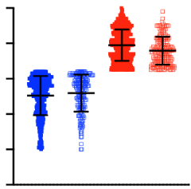
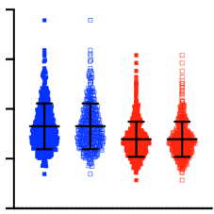
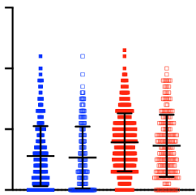
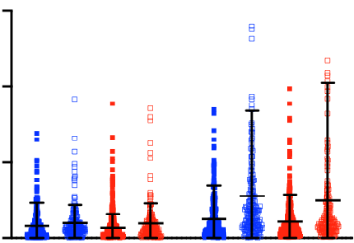
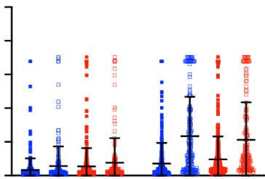
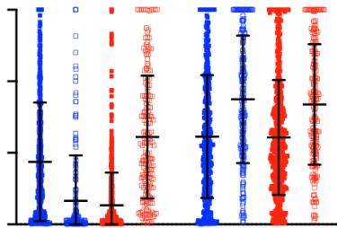
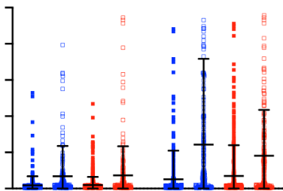
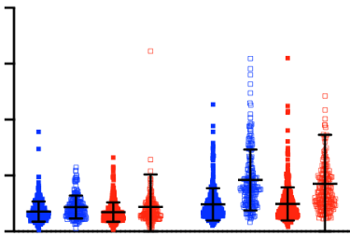
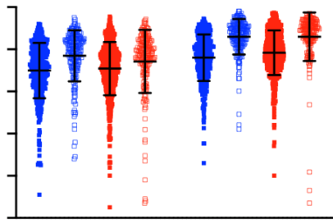
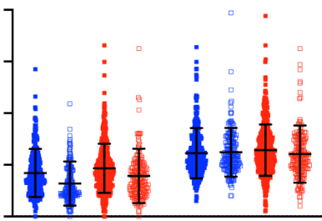
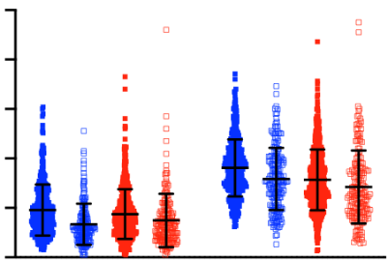
Supplementary Figure 2A.
<0.0001
ICU care
<0.0001
<0.0001
0.0008
0.0008
<0.0001
0.999
30
20
10
0
<0.0001
Young noICU (YnI)
Young ICU (YI)
100
80
60
40
20
0
80
60
40
20
0
0.999
0.952
0.551
0.355
Old noICU (OnI)
Old ICU (OI)
Age
BMI
Elixhauser
Index Score
YnI YI OnI OI
YnI YI OnI OI
YnI YI OnI OI
0.889
0.28
0.573
15x10³
10x10³
5x10³
0
0.995
0.934
50
40
30
20
10
0
0.0009
0.116
0.416
0.0001
0.06
0.09
<0.0001
<0.0001
0.307
0.03
0.0004
Ferritin (ng/ml)
D-Dimer (mg/L)
YnI YI OnI OI
YnI YI OnI OI
YnI YI OnI OI
YnI YI OnI OI
<0.0001
0.8371
0.957
0.077
<0.0001
0.998
0.9849
0.696
300
200
100
0
<0.0001
<0.0001
<0.0001
<0.0001
1000
800
600
400
200
0
<0.0001
<0.0001
<0.0001
<0.0001
CRP (mg/L)
IL-6 (pg/ml)
YnI YI OnI OI
YnI YI OnI OI
YnI YI OnI OI
YnI YI OnI OI
0.183
0.999
0.483
0.730
0.004
80
60
40
20
0
0.995
100
80
60
40
20
0
<0.0001
0.012
<0.0001
<0.0001
0.999
<0.0001
<0.0001
0.947
0.001
WBC (cells/ul)
0.005
Neutrophil (%)
YnI YI OnI OI
YnI YI OnI OI
YnI YI OnI OI
YnI YI OnI OI
0.015
0.892
0.026
0.027
0.264
0.413
0.056
80
60
40
20
0
<0.0001
0.001
0.971
100
80
60
40
20
0
0.069
0.014
<0.0001
<0.0001
0.001
0.038
Monocyte (%)
Lymphocyte (%)
YnI YI OnI OI
YnI YI OnI OI
YnI YI OnI OI
YnI YI OnI OI
< 65 ≥ 65
< 65 ≥ 65 yo
< 65 ≥ 65
< 65 ≥ 65 yo
First Max
First Max

Slide 8
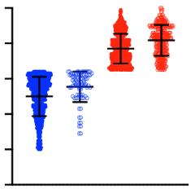
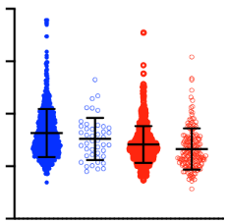
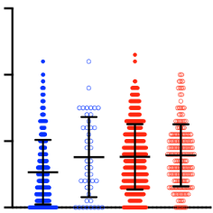
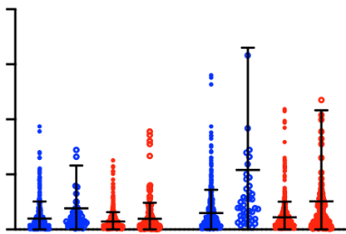
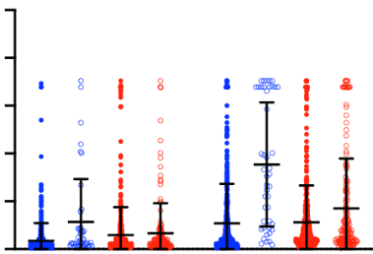
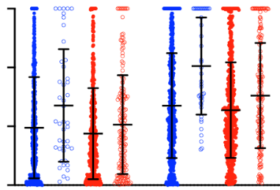
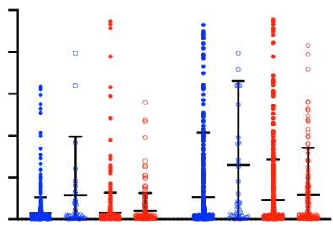
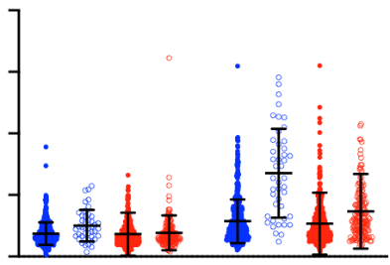
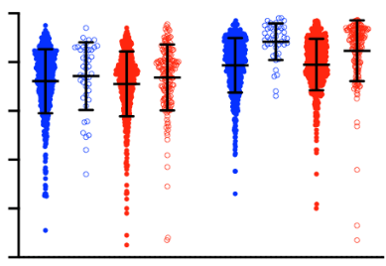
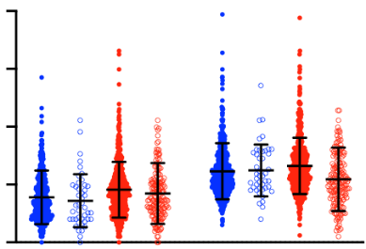
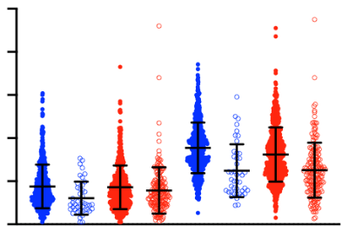
Supplementary Figure 2B.
Mortality
<0.0001
0.03
<0.0001
0.205
30
20
10
0
<0.0001
100
80
60
40
20
0
<0.0001
80
60
40
20
0
<0.0001
0.247
<0.0001
<0.0001
0.001
0.9
Young live (YL)
Young dead (YD)
Old live (OL)
Old dead (OD)
Age
BMI
Elixhauser
Index Score
YL YD OL OD
YL YD OL OD
YL YD OL OD
<0.0001
0.021
<0.0001
20x10³
15x10³
10x10³
5x10³
0
0.0003
0.326
50
40
30
20
10
0
0.0009
0.972
0.007
0.0001
<0.001
0.698
<0.0001
0.003
Ferritin (ng/ml)
0.001
0.144
0.0001
D-Dimer (mg/L)
YL YD OL OD
YL YD OL OD
YL YD OL OD
YL YD OL OD
0.05
0.0015
<0.0001
0.004
0.131
0.355
0.003
0.925
0.785
300
200
100
0
0.001
0.08
<0.0001
1000
800
600
400
200
0
<0.0001
0.321
0.0005
0.503
CRP (mg/L)
IL-6 (pg/ml)
YL YD OL OD
YL YD OL OD
YL YD OL OD
YL YD OL OD
0.994
0.192
<0.0001
0.532
0.970
80
60
40
20
0
0.065
0.567
<0.0001
100
80
60
40
20
0
0.748
0.104
<0.0001
<0.0001
0.948
<0.0001
WBC (cells/ul)
0.017
0.8
Neutrophil (%)
YL YD OL OD
YL YD OL OD
YL YD OL OD
YL YD OL OD
0.408
0.250
<0.0001
0.014
<0.0001
0.993
0.9993
80
60
40
20
0
0.869
0.398
0.997
100
80
60
40
20
0
<0.0001
0.0002
0.0002
<0.0001
<0.0001
<0.0001
Monocyte (%)
Lymphocyte (%)
YL YD OL OD
YL YD OL OD
YL YD OL OD
YL YD OL OD
< 65 ≥ 65
< 65 ≥ 65 yo
< 65 ≥ 65
< 65 ≥ 65 yo
First Max
First Max

Slide 9
Supplementary Figure 2. Clinical and laboratory data compared in (A) ICU-admitted and non-admitted younger and older patients with COVID-10 as well as in (B) surviving and decreased younger and older patients with COVID-19. P-values were obtained by the ANOVA with the Sidak multiple comparison test as a post-hoc analysis.

