Slide 1
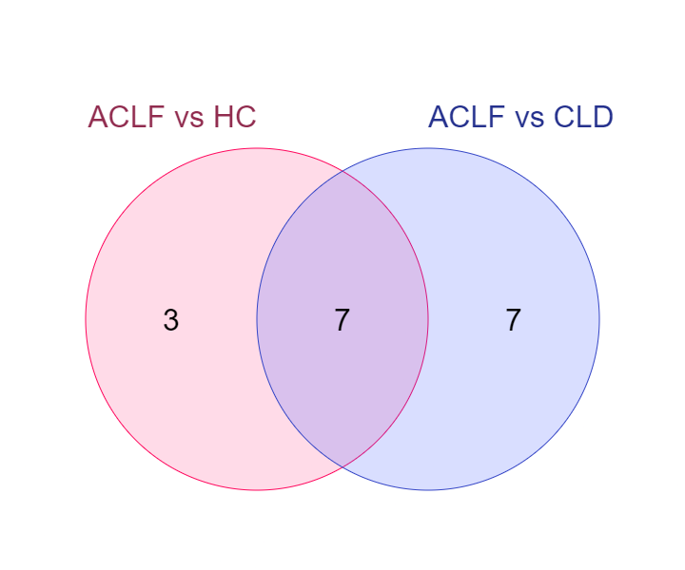
GO_CC Analysis Using ClueGO
ACLF vs HC
ACLF vs CLD
nucleolus
secretory vesicle
secretory granule
cytoplasmic vesicle lumen
secretory granule membrane
secretory granule lumen
secretory granule
secretory granule membrane
specific granule
tertiary granule
specific granule membrane
tertiary granule membrane
secretory vesicle
secretory granule
cytoplasmic vesicle membrane
secretory granule membrane
endocytic vesicle
clathrin-coated endocytic vesicle membrane
azurophil granule
primary lysosome
cytoplasmic vesicle lumen
secretory granule lumen
specific granule
tertiary granule
specific granule lumen
tertiary granule lumen
Supplementary Figure 5. GO_CC analysis using ClueGO reveals an overrepresentation of azurophilic, secretory and tertiary granule components suggestive of neutrophilic activation even among the granulocyte genes.
ACLF vs HC ∩ ACLF vs CLD
cytoplasmic vesicle lumen
secretory granule
secretory granule lumen
secretory granule membrane
secretory vesicle
specific granule
tertiary granule

