Slide 1
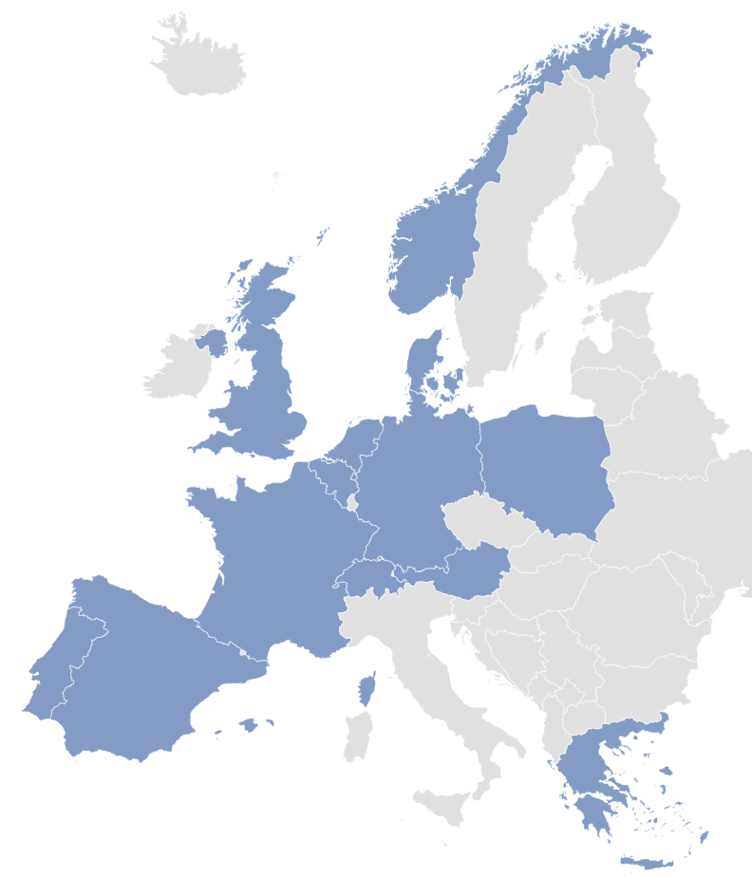
6/19
8/160
11/161
2/25
10/290
32/216
12/102
6/155
31/659
2/40
6/239
6/76
20/371
7/112
The first number is the number of ICUs per country, the second the total number of included patients per country.

