Slide 1
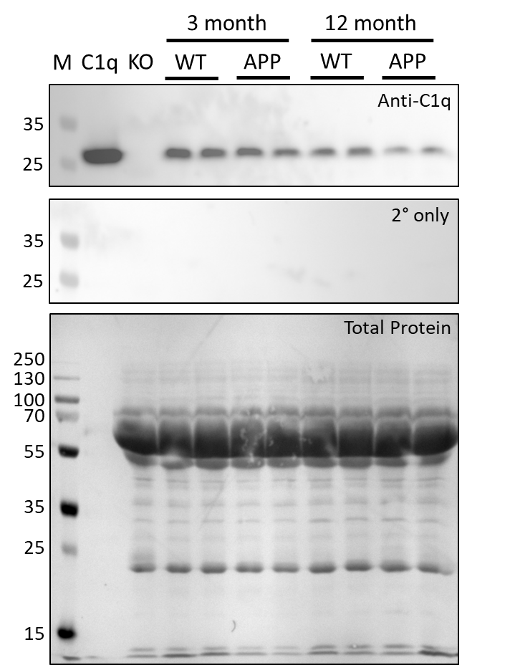
Supplementary Figure 1
A
B

Slide 2
Supplementary Figure 2
A
B

