Slide 1
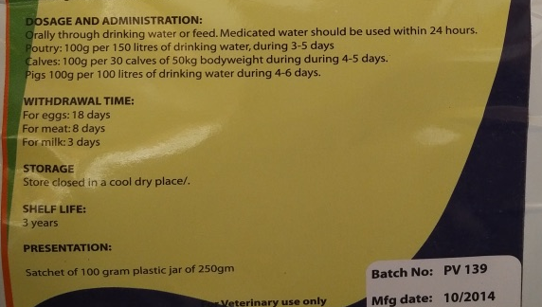
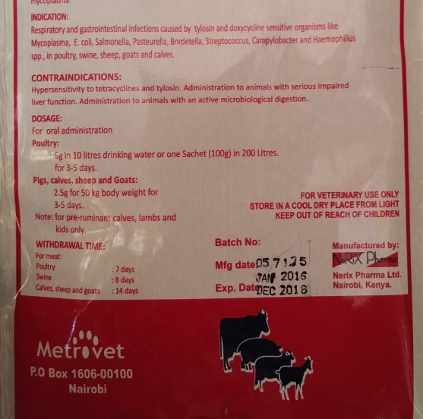
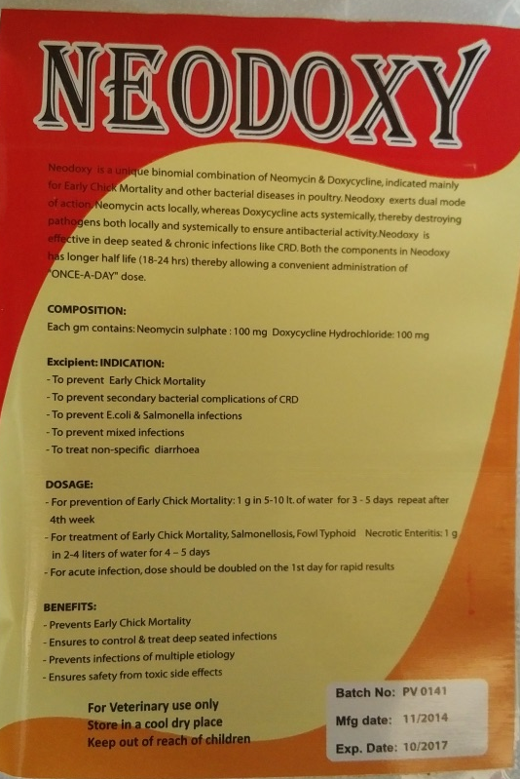
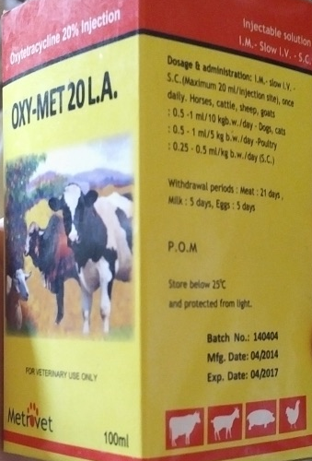
A)
B)
C)
D)
Supplementary Figure 1 A-D. Example packaging for several antimicrobials obtained from agrovet shops from Busia County. Of note is the simplistic withdrawal periods marked on the packaging, and in some cases e.g., C), a lack of withdrawal period altogether.

