Slide 1
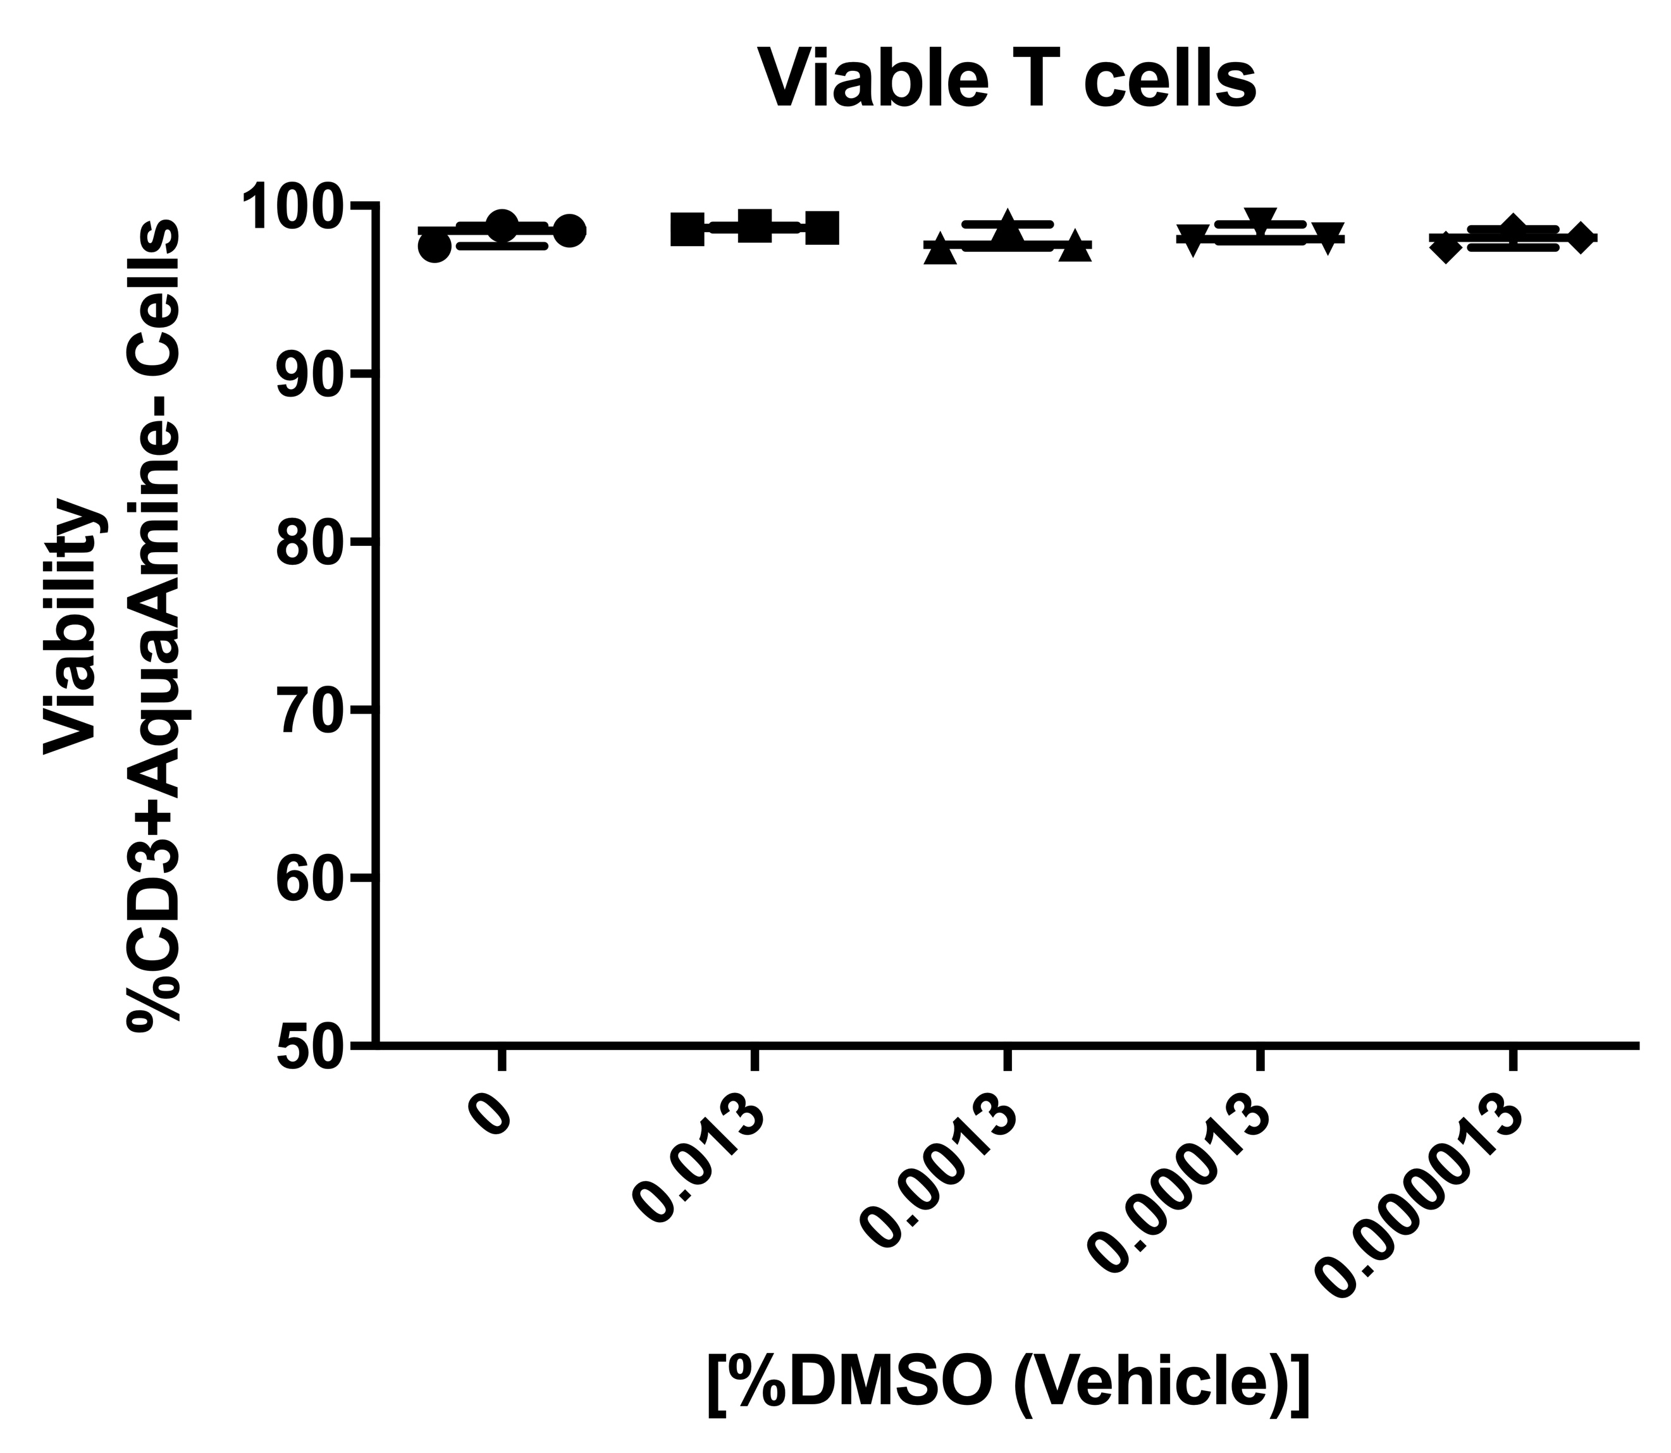
A5: Viability of T cells following DMSO, vehicle control, treatment. Vehicle controls shown for ATRA at 0, 100, 10, 1 and 0.1uM ATRA.

