Slide 1
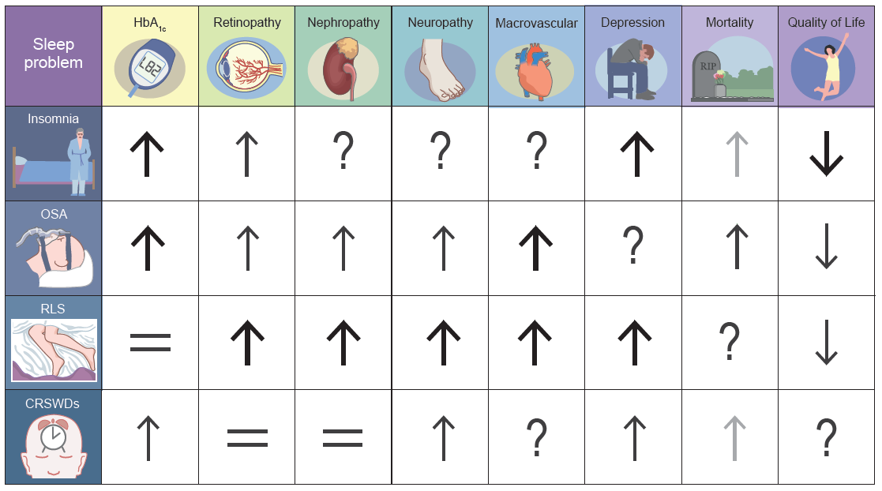
Summary of the literature to date on association between sleep disorders, health outcomes and quality of life in people with type 2 diabetes
Schipper et al (2021) Diabetologia DOI 10.1007/s00125-021-05541-0
©The Authors 2021. Distributed under the terms of the CC BY 4.0 Attribution License (http://creativecommons.org/licenses/by/4.0/)

Slide 2
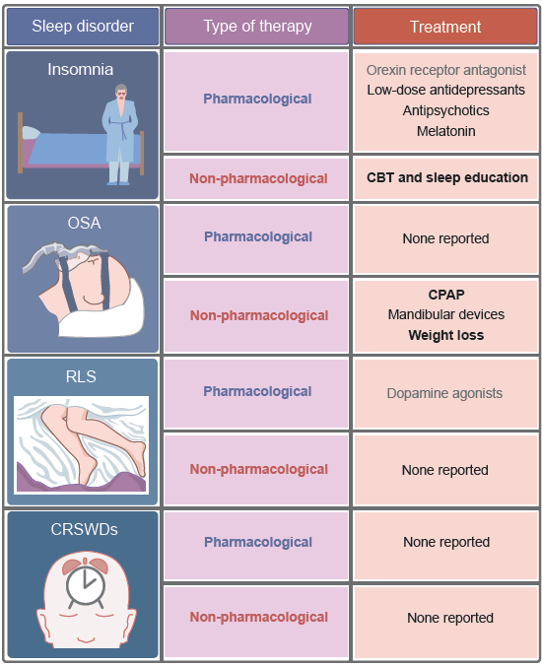
Summary of the possible pharmacological and non-pharmacological treatment options for sleep disorders highly prevalent in people with type 2 diabetes
Schipper et al (2021) Diabetologia DOI 10.1007/s00125-021-05541-0
©The Authors 2021. Distributed under the terms of the CC BY 4.0 Attribution License (http://creativecommons.org/licenses/by/4.0/)

