Slide 1
Supplementary Material S9. The location of passengers in the aircraft
Number | Study | Technical specifications | Flight duration
1 | Bae 2020 | N/R | 11 h
2 | Chen 2020 | Boeing 787 | 4 h 50 min
3 | Choi 2020 | Boeing 777-300ER | ≈15h
4 | Hoehl 2020 | Boeing 737-900 | 4 h 40 min
5 | Khanh 2020 | Flight VN54 | 10 h 10 min
6 | Kong 2020 | Flight AF 139 | 12 h
 |  | Flight AF 116 | 10 h 40 min
7 | Murphy 2020 | N/R | 7.5 h
8 | Nir-Paz 2020 | Charter Bombardier Galaxy 6000 | 13.5 h
9 | Speake 2020 | Airbus A330-200 | 5 h
10 | Swadi 2021 | Boeing 777–300ER | 18 h 2 min

Slide 2
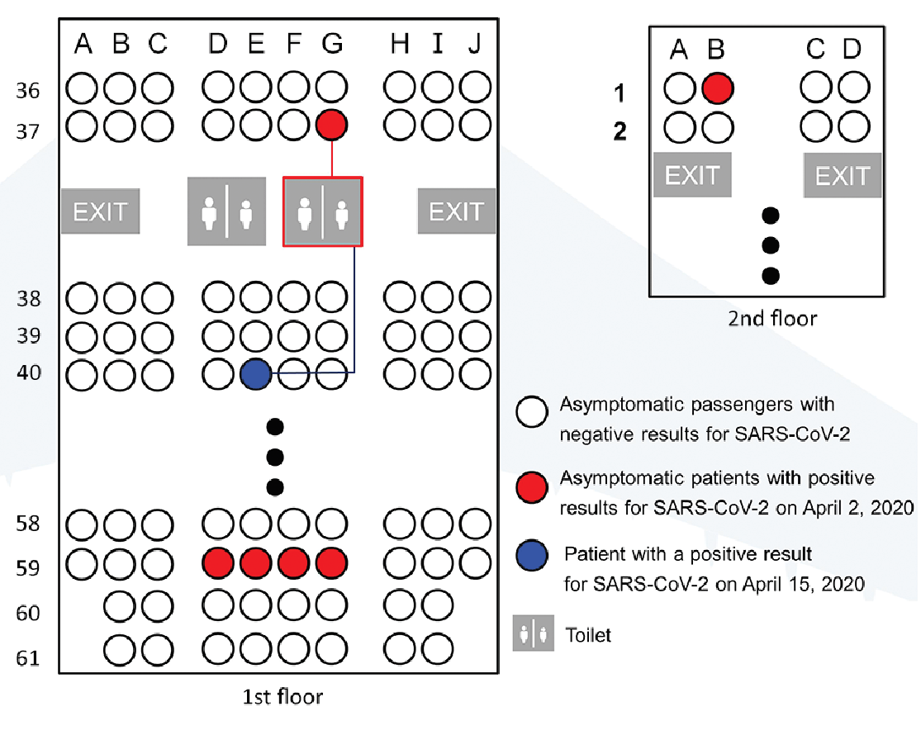
1
Index cases = 6 (red)
Secondary case = 1 (blue)
The secondary case was seated three rows away from an asymptomatic individual. Also, she used the nearby toilet, shared by an asymptomatic passenger.
Bae SH, Shin H, Koo HY, et al. Asymptomatic Transmission of SARS-CoV-2 on Evacuation Flight. Emerg Infect Dis. 2020; 26(11):2705-2708. doi: 10.3201/eid2611.203353.

Slide 3
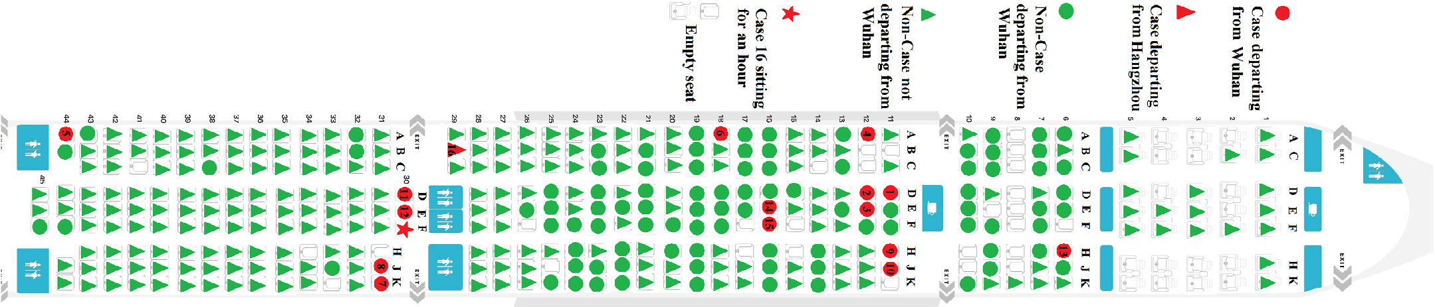
2
Case 16 (secondary case) was seated at 29B, with no infected passengers in the first three rows. He was sitting for one hour on 30F, in close proximity to the seats of index cases 7, 8, 11, and 12 (31J; 31K; 30D; 30E)
Chen J, He H, Cheng W, Liu Y, Sun Z, Chai C, Kong Q, Sun W, Zhang J, Guo S, Shi X, Wang J, Chen E, Chen Z. Potential transmission of SARS-CoV-2 on a flight from Singapore to Hangzhou, China: An epidemiological investigation. Travel Med Infect Dis. 2020 Jul-Aug;36:101816. doi: 10.1016/j.tmaid.2020.101816.

Slide 4
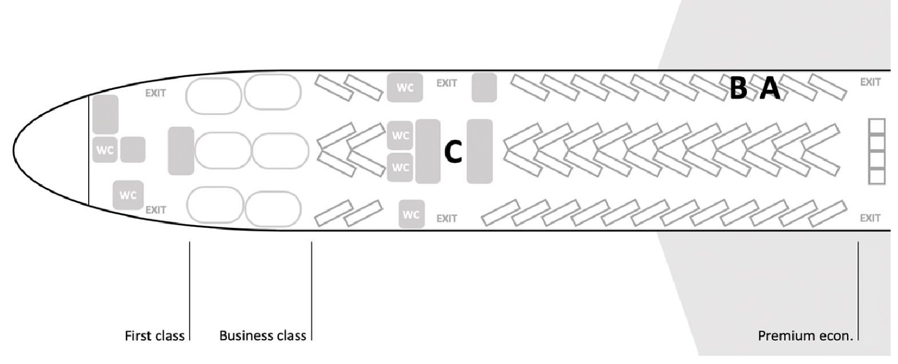
3
Index cases: A, B.
Secondary cases: C, D.
Case C was a business class flight attendant who served passengers A and B during the flight. Case D was also a flight attendant, but there is no data on the sections that she worked in.
Choi EM, Chu DKW, Cheng PKC, et al. In-Flight Transmission of SARS-CoV-2. Emerg Infect Dis. 2020; 26(11):2713-2716. doi: 10.3201/eid2611.203254

Slide 5
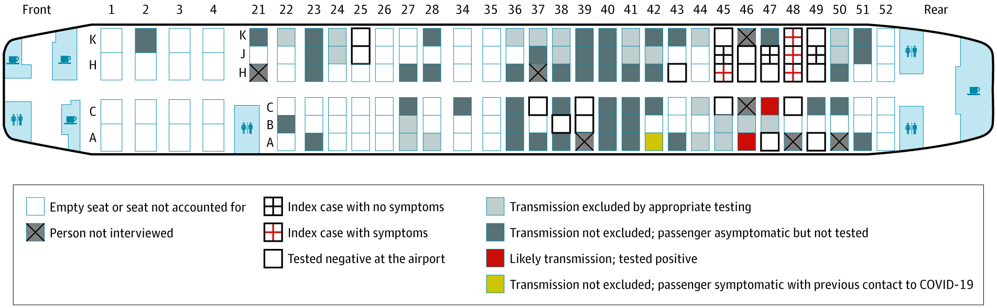
4
Index cases = 7 passengers
Secondary cases = 2 passengers (red)
Hoehl S, Karaca O, Kohmer N, Westhaus S, Graf J, Goetsch U, Ciesek S. Assessment of SARS-CoV-2 Transmission on an International Flight and Among a Tourist Group. JAMA Netw Open. 2020; 3(8):e2018044. doi: 10.1001/jamanetworkopen.2020.18044.

Slide 6
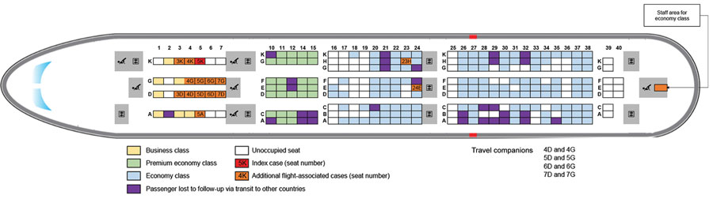
5
Index case = 1 passenger (red)
Secondary cases = 15 passengers (orange)
Khanh NC, Thai PQ, Quach HL, et al. Transmission of SARS-CoV 2 During Long-Haul Flight. Emerg Infect Dis. 2020; 26(11):2617-2624. doi: 10.3201/eid2611.203299.

Slide 7
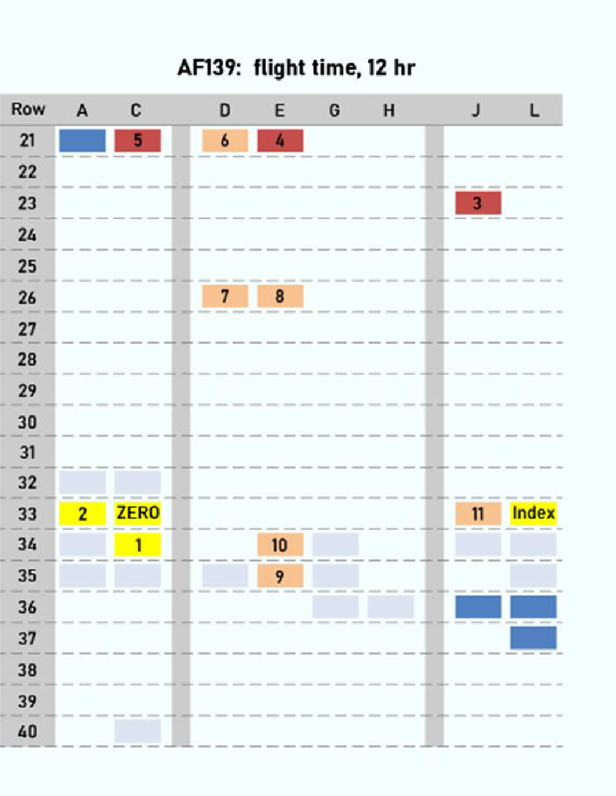
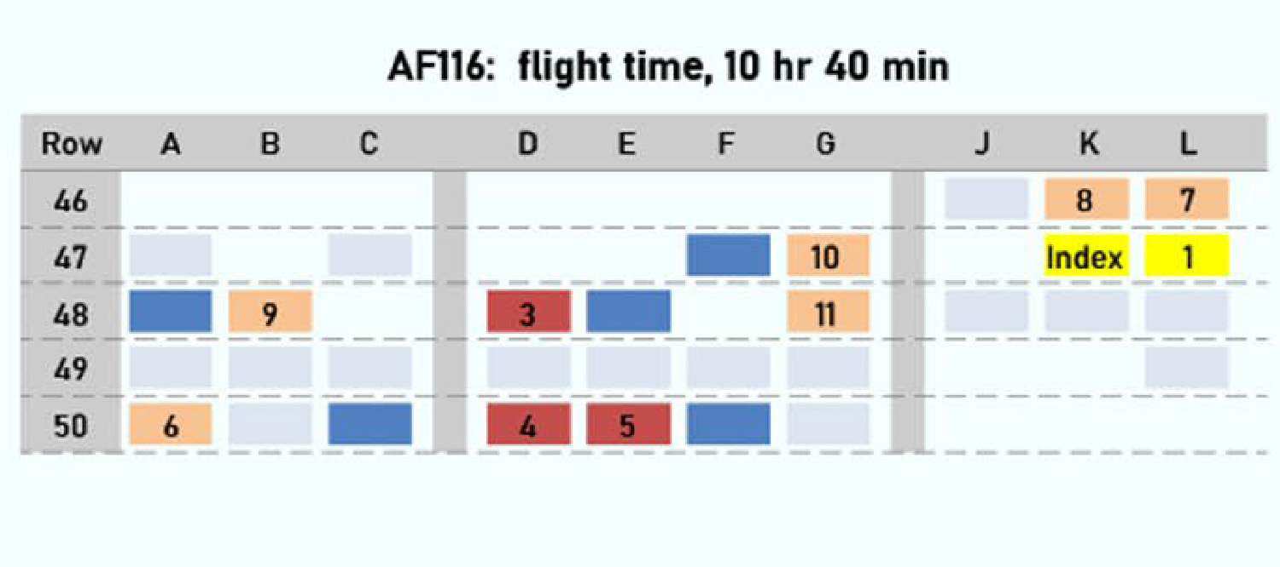
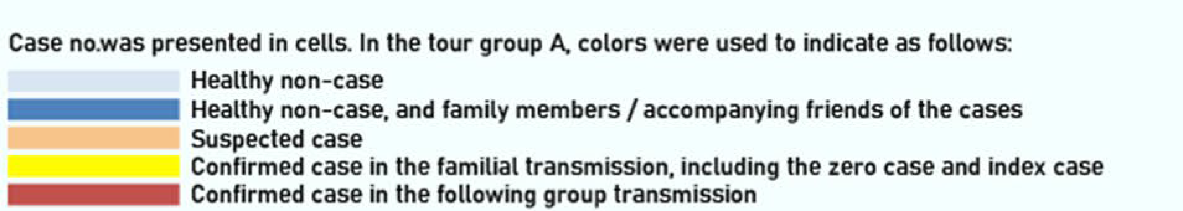
6
Flight AF116
Index cases = 5 passengers with confirmed SARS-CoV-2 infection and 6 with suspected infection
Secondary cases = 2 suspected cases (seated < 3 rows)
Flight AF 139
Index case = 1 passenger (yellow)
Secondary cases = 3 passengers (2 confirmed cases and 1 suspected case, all seated > 3 rows)
Kong D, Wang Y, Lu L, et al. Clusters of 2019 coronavirus disease (COVID-19) cases in Chinese tour groups. Transbound Emerg Dis. 2021 Mar;68(2):684-691. doi: 10.1111/tbed.13729.

Slide 8
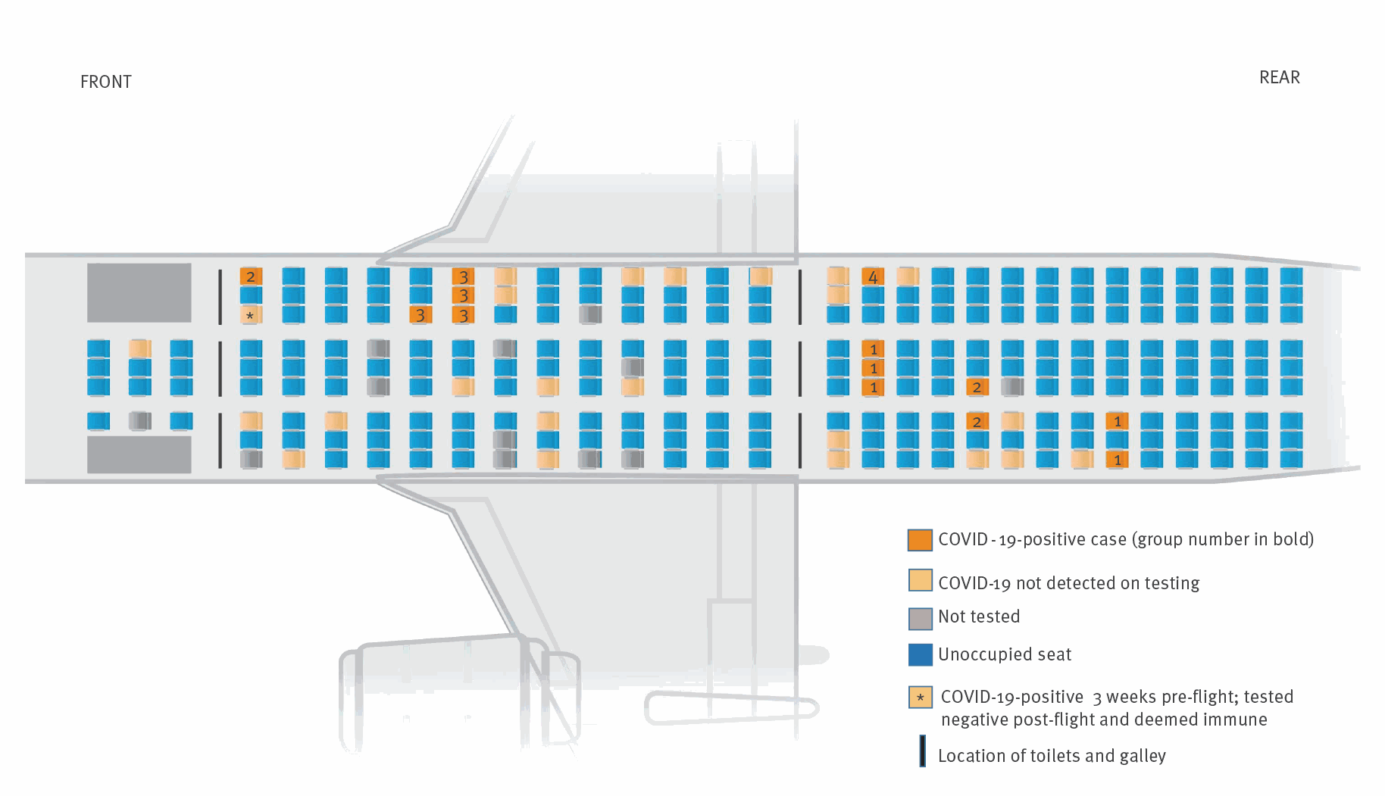
7
Index cases – unknown number (1 to 7 passengers)
Secondary cases – unknown number (4 to 12 passengers)
There were 4 flight groups (numbered 1 to 4).
Murphy N, Boland M, Bambury N, et al. A large national outbreak of COVID-19 linked to air travel, Ireland, summer 2020. Euro Surveill. 2020; 25(42):2001624. doi: 10.2807/1560-7917.ES.2020.25.42.2001624.

Slide 9
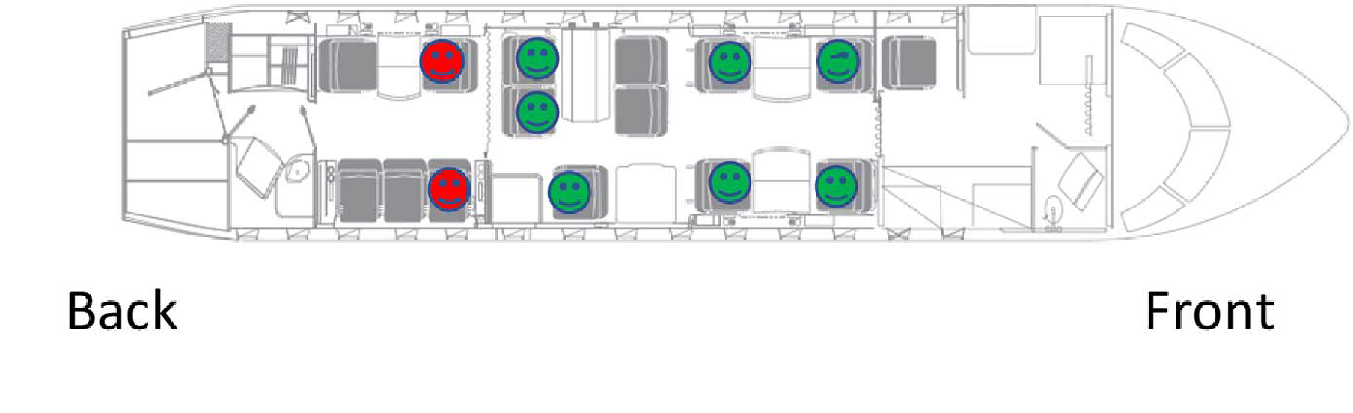
8
Index cases = 2 passengers (red)
Secondary cases = 0 passengers
Nir-Paz R, Grotto I, Strolov I, et al. Absence of in-flight transmission of SARS-CoV-2 likely due to use of face masks on board. J Travel Med. 2020 Dec 23;27(8):taaa117. doi: 10.1093/jtm/taaa117.

Slide 10
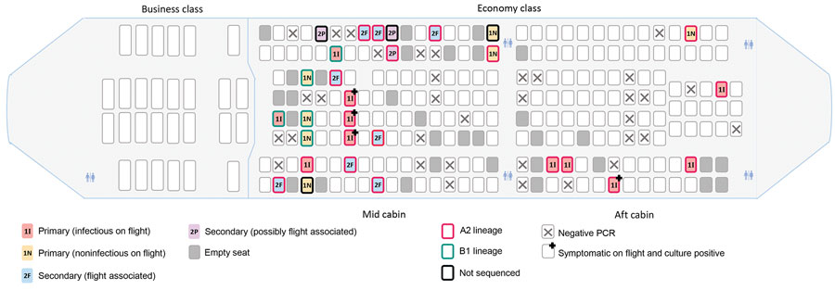
9
Index cases = 18 passengers; 12 were seated in the mid cabin (6 infectious; 6 non-infectious), and 6 in the aft cabin (5 infectious, 1 non-infectious)
Secondary cases = 8 passengers (all seated in the mid cabin)
Speake H, Phillips A, Chong T, et al. Flight-Associated Transmission of Severe Acute Respiratory Syndrome Coronavirus 2 Corroborated by Whole-Genome Sequencing. Emerg Infect Dis. 2020 Dec;26(12):2872-2880. doi: 10.3201/eid2612.203910.

Slide 11
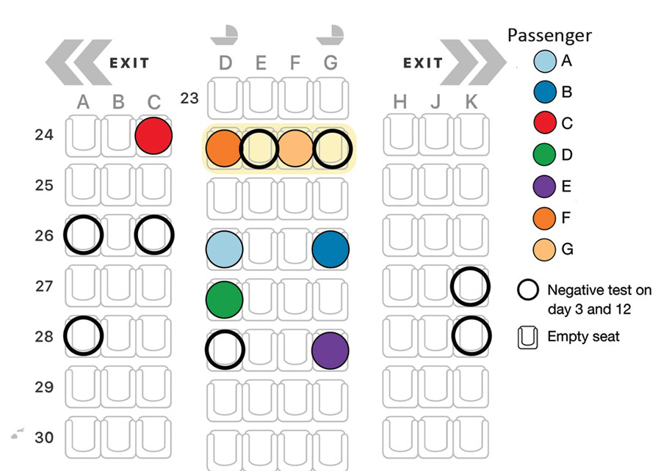
10
Index cases = passengers A,B
Secondary cases = passengers C, D, E, F
Passengers F and G were part of a family; they reported having changed seats within their row during the flight.
Swadi T, Geoghegan JL, Devine T, et al. Genomic Evidence of In-Flight Transmission of SARS-CoV-2 Despite Predeparture Testing. Emerg Infect Dis. 2021 Mar;27(3):687-693. doi: 10.3201/eid2703.204714.

