Slide 1
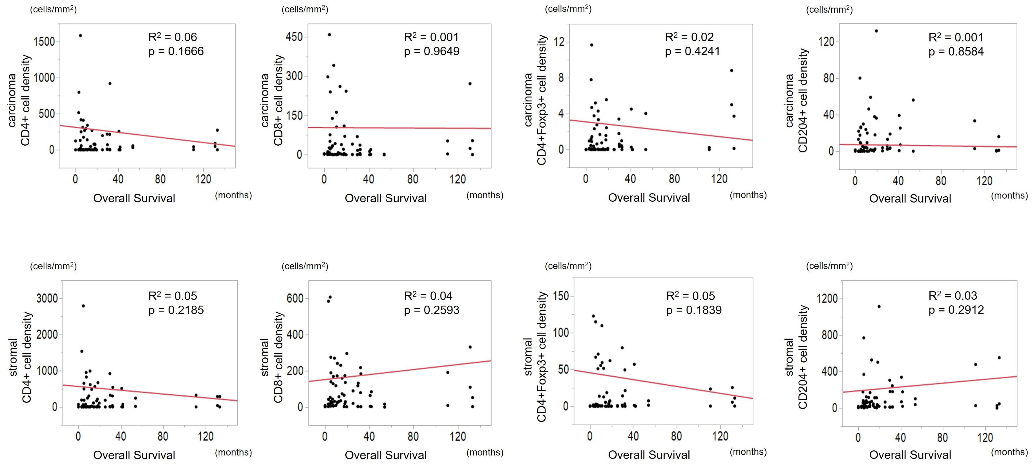
Supplemental Figure
Relationship between each immune cells in primary lesion and progression free survival

