Slide 1
Supplemental Figure 1
A
B
C
Supplemental Figure 1: Locomotion with glial knockdown of Syt4 (1A), fray (1B), and control RNAi (1C). The genotypes of control flies (black) and α-synuclein flies (red) that lack an RNAi are nSybQF2, repo-Gal4/+ and QUAS-α-Syn, nSybQF2, repo-Gal4/+, respectively. Locomotion assay was performed 10 days post-eclosion. N = minimum 60 flies per genotype, 6 biological replicates of 9-14 flies/vial. * = p < 0.05 , ** = p <0.01, *** = p < 0.005, *** = p <0.001

Slide 2
Supplemental Figure 2
Supplemental Figure 2: Knockdown of each gene of interest was validated by qRT-PCR. In each case relative expression is shown in comparison to flies containing the genetic drivers but not the RNAi in question, normalized to 1. Ric knockdown was confirmed using the pan-glial driver repo-Gal4, aux knockdown was confirmed using the astrocyte-like glial driver alrm-Gal4, and Lrrk and Vps13 knockdown were confirmed using the ubiquitously expressed da-Gal4 driver. These experiments were performed at day 1 post-eclosion. N= 3 biological replicates per genotype. Note that in the second panel the error bar is small but present.

Slide 3
Supplemental Figure 3
Lrrk
Ric
Vps13
aux
RNAi
+ + + + + -
α-syn
pSer129 α-syn
Total α-syn
Supplemental Figure 3: Glial modifiers do not affect baseline α-synuclein transgene expression or phosphorylation on serine 129. This immunoblot is cropped for clarity. Additional lanes have been cropped out on the left as these conditions were not included in the final manuscript. The genotypes of control (lane 6) or α-synuclein (lane 5) flies that lack an RNAi are nSybQF2, repo-Gal4/+ and QUAS-α-Syn, nSybQF2, repo-Gal4/+, respectively. This experiment was performed at 1 day post-eclosion using homogenized fly heads.

Slide 4
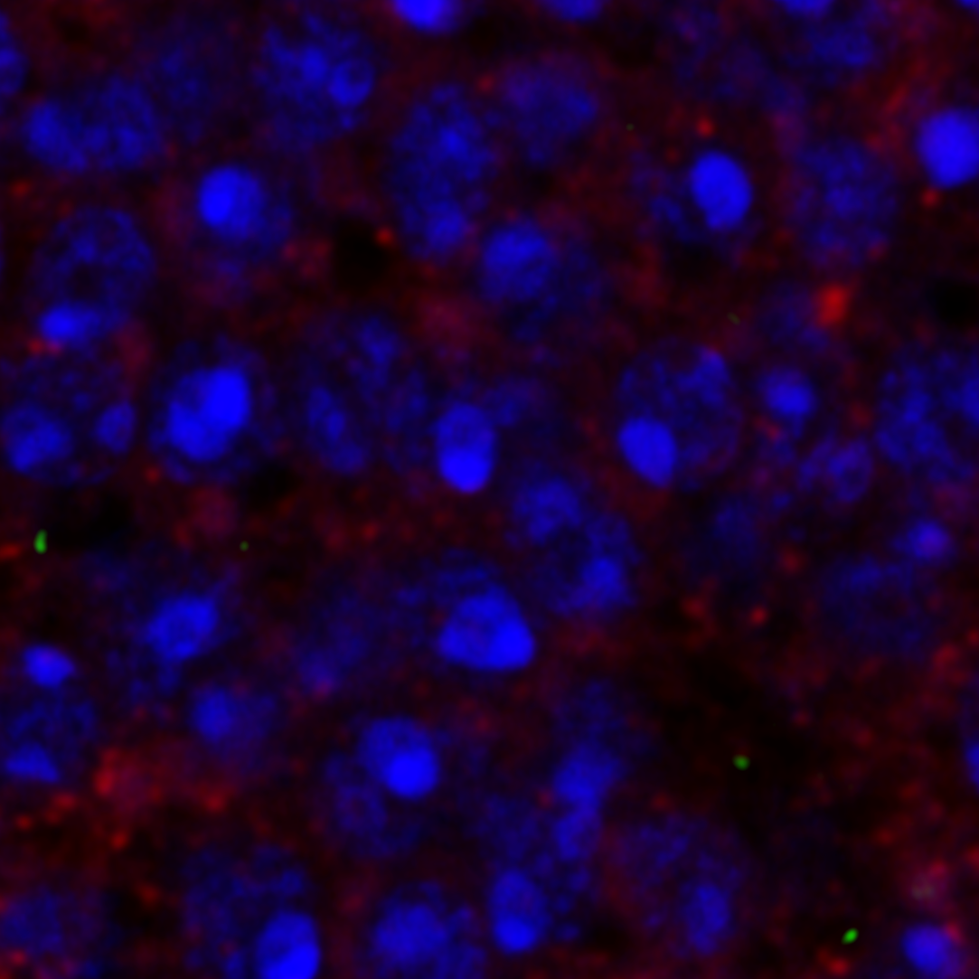
Supplemental Figure 4
Control
α-synuclein
α-synuclein + aux KD
α-synuclein + Lrrk KD
α-synuclein + Ric KD
α-synuclein + Vps13 KD
Supplemental Figure 4: LC3 puncta are found in neurons. LC3 (green staining, yellow arrowheads) and α-synuclein (red) were detected by immunofluorescence. Nuclei are stained with DAPI. The genotypes of control flies (black) and α-synuclein flies (red) that lack an RNAi are nSybQF2, repo-Gal4/+ and QUAS-α-Syn, nSybQF2, repo-Gal4/+, respectively.

