Slide 1


Western Blot original pictures
Figure 3N
N T N T N T N T
N T N T N T N T
CENPA
17KD
CENPA
17KD
β-actin
42KD
β-actin
N T N T N T N T
CENPA
17KD
β-actin
42KD

Slide 2
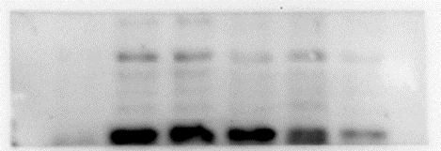

Figure 3Q
HK-2
786OA498
ACHN
Caki-1
OSRC-2
CENPA
17KD
β-actin
42KD

Slide 3
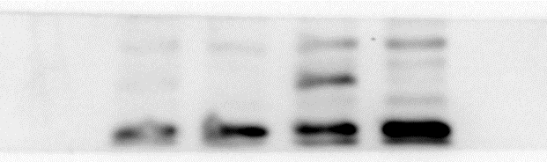



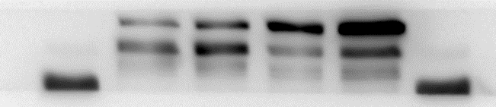







Figure 4C
A498
Caki-1
A498
Caki-1
Vec CENPA Vec CENPA
NC Si NC Si
CENPA
17KD
17KD
CENPA
β-actin
42KD
β-actin
42KD
Figure 6C
Figure 6D
A498
Caki-1
A498
Caki-1
Vec CENPA Vec CENPA
NC Si NC Si
120KD
92KD
β-catenin
120KD
92KD
β-catenin
CCND1
37KD
37KD
CCND1
17KD
CENPA
17KD
CENPA
β-actin
42KD
β-actin
42KD

Slide 4
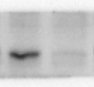

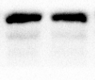





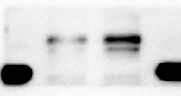
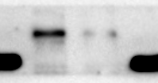
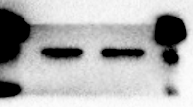
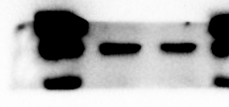
Figure 6E
CENPA
17KD
Β-actin
42KD
CTNNB1
120KD
92KD
Β-actin
42KD
CTNNB1
92KD
LaminB1
70KD

Slide 5

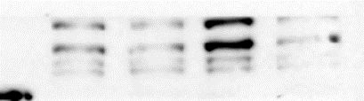

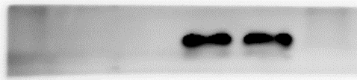
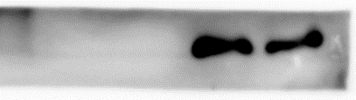


Figure 7A
A498
Caki
CENPA
Si-CTNNB1
- - + +
- - + +
- + - +
- + - +
CTNNB1
β-actin

Slide 6
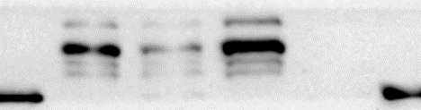
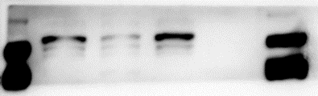
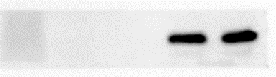
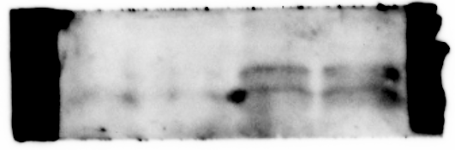
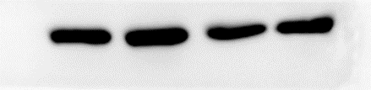

Figure 7B
A498
Caki
CENPA
XAV
- - + +
- - + +
- + - +
- + - +
120KD
92KD
CTNNB1
17KD
β-actin
42KD

Slide 7


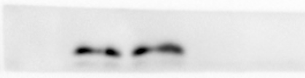



Figure 7C
A498
Caki
Si-CENPA
CHIR
- - + +
- - + +
- + - +
- + - +
CTNNB1
120KD
100KD
CENPA
17KD
β-actin
42KD

Slide 8

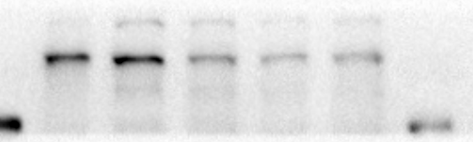


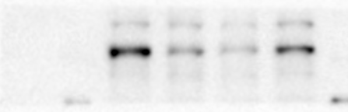
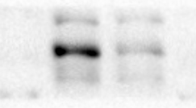
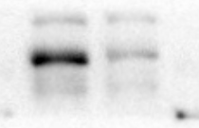
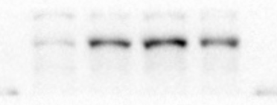
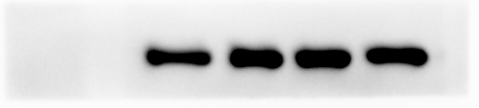



Supplementary Figure 2
E
Caki-1
C
CHIR(uM) 0 3 6 10 15
Caki-1
XAV(uM) 0 3 6 10 15
CTNNB1
92KD
CTNNB1
120KD
92KD
β-actin
42KD
β-actin
42KD
F
Caki-1
G
H
10uMXAV(h) 0 12 24 48
A498
Caki-1
Caki-1
10uMCHIR(h) 0 12 24 48
CTNNB1
CTNNB1
CTNNB1
120KD
92KD
β-actin
β-actin
β-actin
42KD

