Slide 1
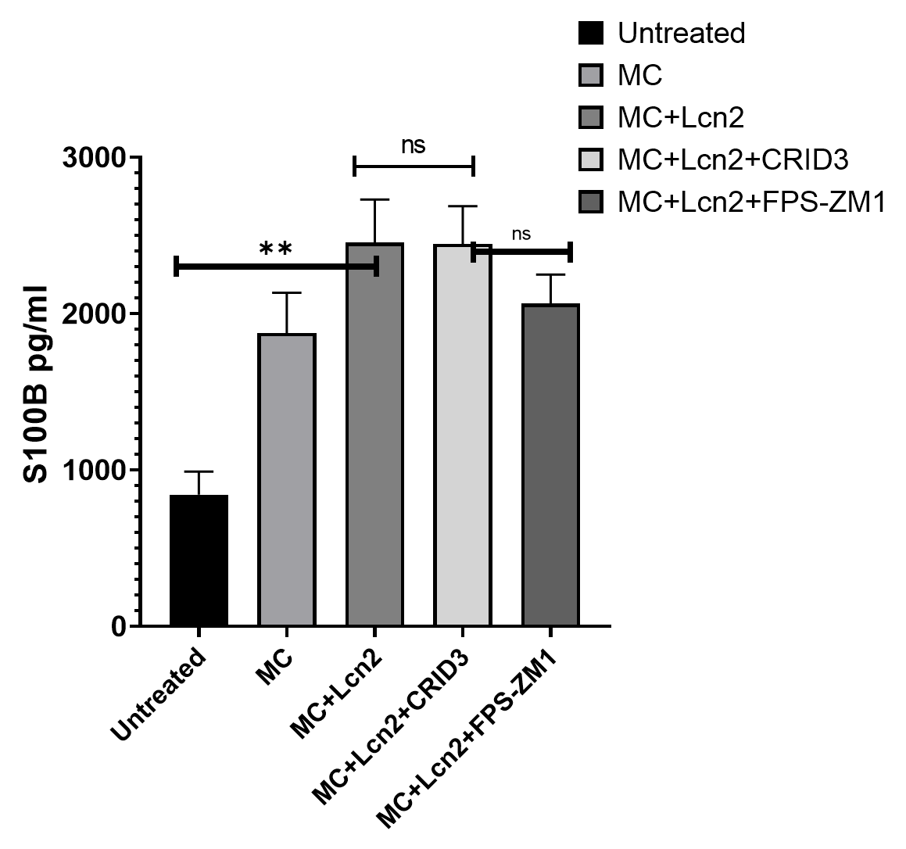
Supplementary Figure. 1
* *

