Slide 1


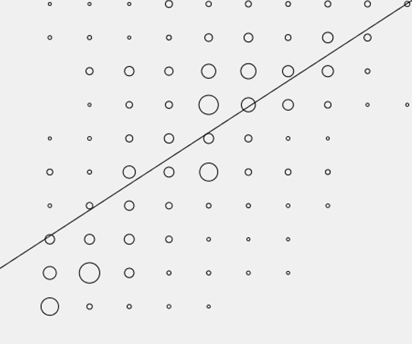
Suppl Figure 1. Correlation between frequency of prescription and perceived efficacy of antitussives by primary care physicians for the treatment of refractory or unexplained chronic cough
10
8
6
Frequency of prescription score
4
2
0
2
4
6
8
10
Efficacy perception score

Slide 2

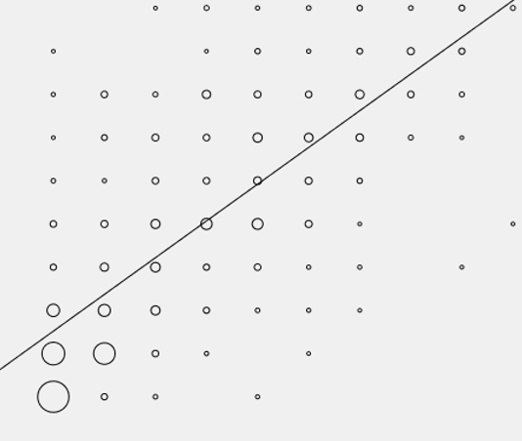
Suppl Figure 2. Correlation between frequency of prescription and perceived efficacy of mucolytics by primary care physicians for the treatment of refractory or unexplained chronic cough
10
8
6
Frequency of prescription score
4
2
0
2
4
6
8
10
Efficacy perception score

Slide 3

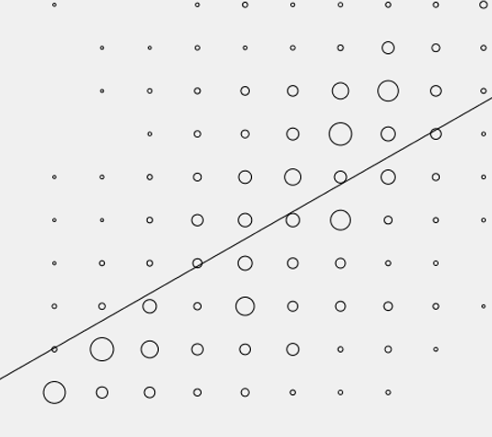
Suppl Figure 3. Correlation between frequency of prescription and perceived efficacy of opioids by all physicians for the treatment of refractory or unexplained chronic cough
10
8
6
Frequency of prescription score
4
2
0
2
4
6
8
10
Efficacy perception score

Slide 4

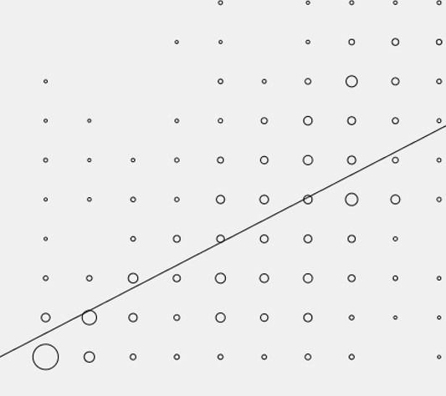
Suppl Figure 4. Correlation between frequency of prescription and perceived efficacy of oral corticosteroids by all physicians for the treatment of refractory or unexplained chronic cough
10
8
6
Frequency of prescription score
4
2
0
2
4
6
8
10
Efficacy perception score

