Slide 1
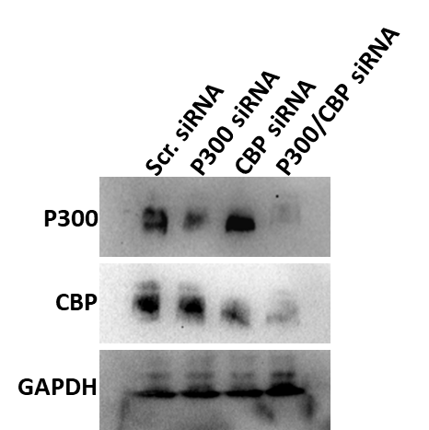
Supplementary Figure 1
A
B
Supplementary Figure 1. RT-qPCR for CIC-DUX4 target genes in Kitra-SRC cells
Western blot analyses for P300 and CBP expression in Kitra-SRC cells at 72 post- transfection with siRNAs targeting P300 and CBP.
RT-qPCR for P300, CBP and CIC-DUX4 ETVs target genes. RNA was harvested 48 hours post-transfection. Data are presented as mean ± SEM; *p<0.05, **p<0.01, ***p<0.001 by one-way ANOVA. Results are presented as relative expression to B2M control (n=3).

