Slide 1
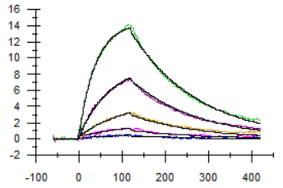
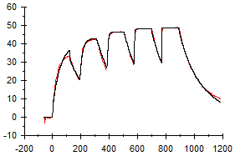
Supplemental Figure 1
A
anti-mCD3
B
anti-mBCMA
KD = 169 nM
KD = 5 nM
Supplemental Figure 1. Kinetic measurement of BsAb to mouse CD3 and mouse BCMA extracellular domains by surface plasmon resonance.
A. For murine CD3 affinity measurement, BsAb was captured by anti-mouse Fc and monomeric mouse CD3εδ complex was flowed at 6.2 nM, 18.5 nM, 55.6 nM, 167 nM and 500 nM. B. For murine BCMA measurement, mBCMA-Fc is captured by anti-Fc surface and BsAb was flowed at 12.3 nM, 37 nM, 111 nM, 333 nM and 1000 nM.

Slide 2
Supplemental Figure 2
A
B
Supplemental Figure 2. PD1 and KLRG1 expression in T and NK cells derived from the BM or SPL of aged mice with Vk*MYC MM.
A bar graph summarizing the frequency of CD4⁺ T cells, CD8⁺ T cells and NK cells of total live cells in the BM, A, or in the SPL, B, of de novo Vk*MYC mice with MM, measured by FCM. Subsequent bars represent the mean frequency of parent cell type expressing PD1, KLRG1, or both. Unpaired T test P values are represented by *. * P < 0.05; **P < 0.01; ***P < 0.001; ****P < 0.0001.

Slide 3
Supplemental Figure 3
A
B
C
ns
Supplemental Figure 3. Gamma-secretase inhibition does not improve survival after BCMA-CD3 targeting BsAb in Vk*MYC MM.
WT mice bearing Vk12598 tumor cell line were treated once per week for two weeks with anti-KLH/CD3 BsAb or anti-BCMA/CD3 BsAb (1 mg/kg) with or without LY-411575-I (1.25 mg/kg) by IP injection. A, B. Relative M-spike levels (% of day 0) in Vk12598 tumor bearing mice measured 7 or 14 days after treatment. Each dot represents an M-spike from an individual mouse. Mice shown in (A) were selected for those with high tumor burden at initial treatment (M-spike > 0.4). Bars show mean M-spike levels with SD. C. Kaplan-Meier survival plot in days from the initiation of treatment of Vk12598 tumor bearing mice receiving treatments in (A, B). Unpaired T test P values in A, B, are represented by *. * P < 0.05.

Slide 4
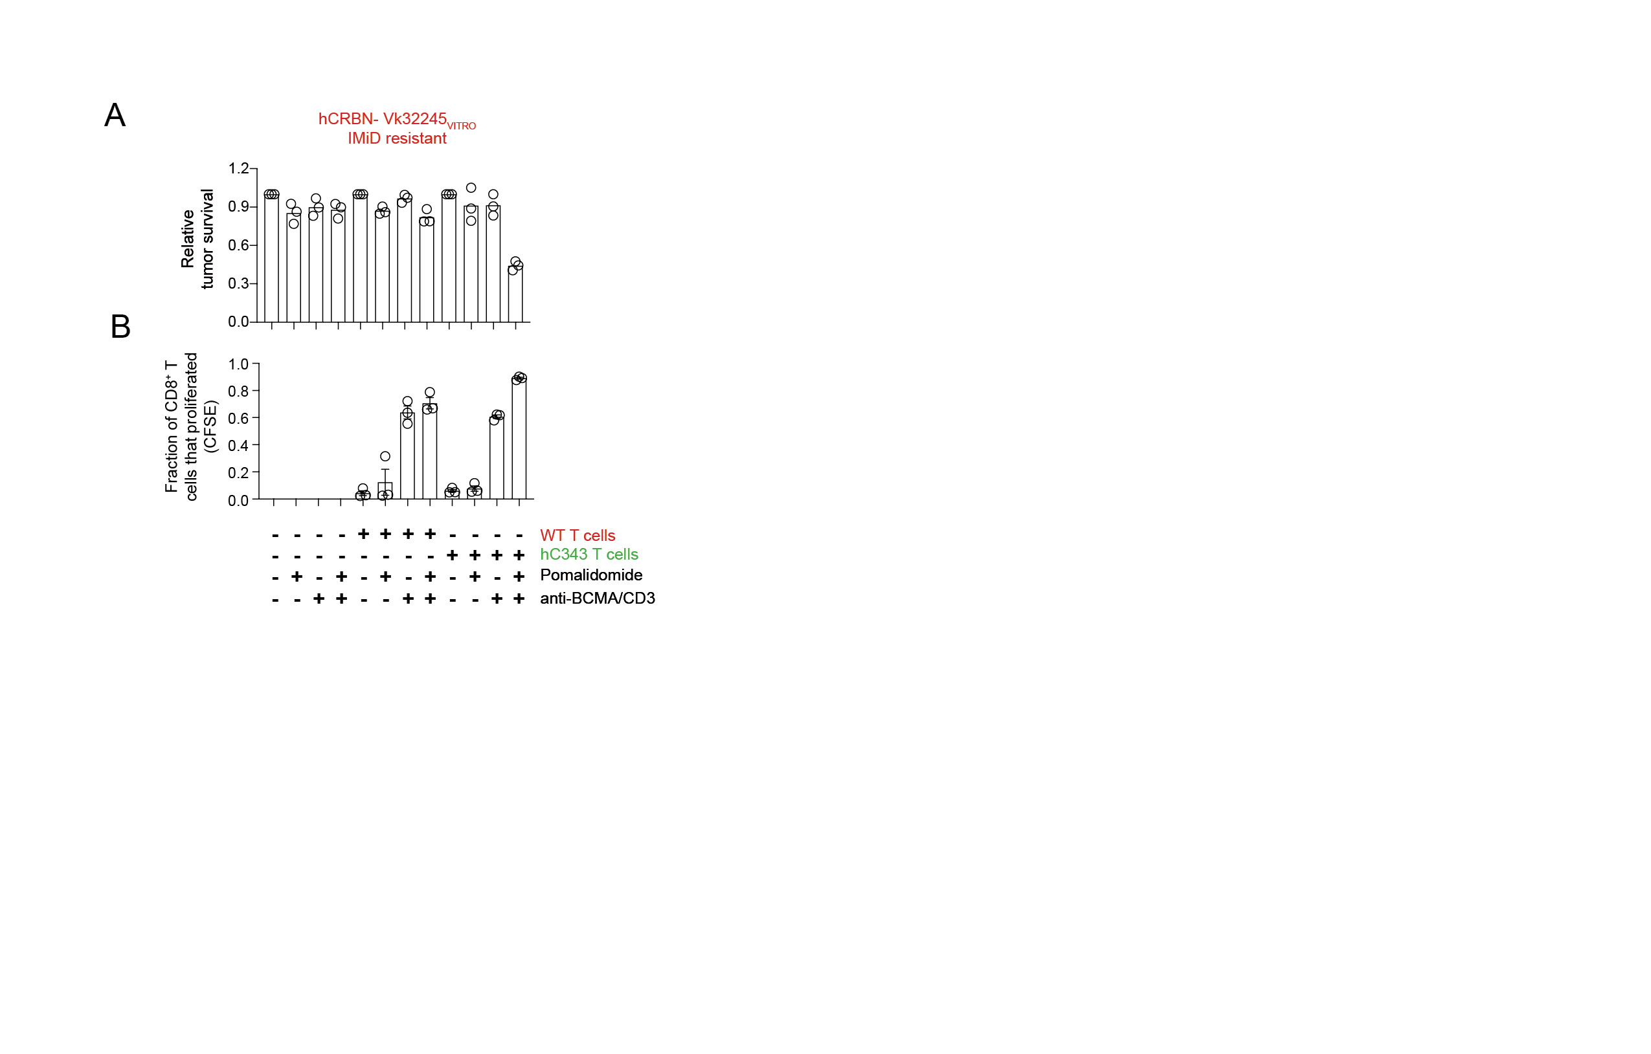
Supplemental Figure 4
Supplemental Figure 4. T cell intrinsic Cereblon role in the efficacy of IMiDs and BCMA/CD3 BsAb. A. The survival of Vk32245^{VITRO} expressing the empty vector, co-cultured with purified T cells from WT- or hC343 mice and exposed to anti-BCMA/CD3 with or without Pom is shown, normalized to the untreated conditions. B. The proliferation of CD8⁺ T cells from the conditions in (A) were quantified by dilution of cytoplasmic CFSE by FCM. Bars indicate the fraction of total cells that proliferated (1 = 100%) and the SEM.

Slide 5
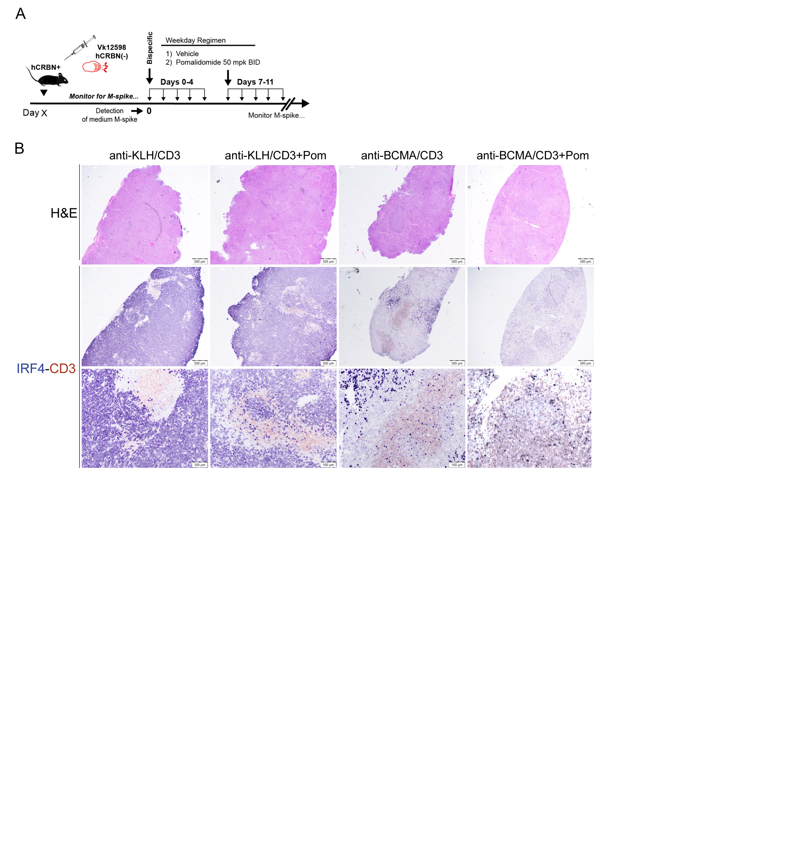
Supplemental Figure 5
Supplemental Figure 5. Pom enhances BsAb mediated tumor killing of IMiD resistant MM tumors in vivo.
A. Treatment schedule for IMiD sensitive hC343 recipient mice engrafted with IMiD resistant Vk12598 MM cells. B. H&E and IHC staining of FFPE spleen sections harvested from Vk12598 tumor bearing mice three days after treatment initiation in A, stained with antibodies to CD3 in red and IRF4 in blue. Scale bar indicates the magnification.

Slide 6
Supplemental Figure 6
A
anti-KLH/CD3
anti-BCMA/CD3
anti-KLH/CD3 + Pom
anti-BCMA/CD3 + Pom
Weight relative to D0
B
Days of treatment
ns
ns
ns
ns
Anti-KLH/CD3
Anti-KLH/CD3 + Pom
Anti-KLH/CD3 + Cy
Anti-BCMA/CD3
Anti-BCMA/CD3 + Pom
Anti-BCMA/CD3 + Cy
C
Week 1
Week 2
Week 1
Week 2
Week 1
Week 2
Week 1
Week 2
D
Week 1
Week 2
Week 1
Week 2
E
*
F
**
*
ns
Anti-KLH/CD3
Anti-KLH/CD3 + Pom
Anti-KLH/CD3 + Cy
Anti-BCMA/CD3
Anti-BCMA/CD3 + Pom
Anti-BCMA/CD3 + Cy
Week 1
Week 2

Slide 7
Supplemental Figure 6. Weight loss, immune checkpoint expression, and regulatory T cell phenotype in Vk32908 MM after treatment with anti-BCMA/CD3 and Pom or Cy
A. Weight, relative to day 0, of mice determined daily during Pom or anti-BCMA/CD3 with Pom treatment. Each line represents an individual mouse. Frequency of CD8⁺ (left) or CD4⁺ (right) T cells expressing PD1, B, KLRG1, C., or LAG3, D., in the SPL from hC343 mice transplanted with Vk32908 and harvested three or ten days after receiving anti-KLH/CD3 or anti-BCMA/CD3 BsAb (1 mg/kg day 1,8) with concurrent pomalidomide (50 mg/kg day 1-7, 8-12) or cyclophosphamide (100 mg/kg day 1,8). E. Estimated absolute number of regulatory T cells (T-reg) per SPL from mice transplanted with Vk32908 and treated with anti-KLH/CD3 or anti-BCMA/CD3 BsAb with pomalidomide or Cy. T-reg identified by FCM as CD3⁺ CD4⁺ CD25⁺ FoxP3⁺. F. IFN-γ production by T-regs ex vivo upon 4 hours stimulation with PMA-ionomycin measured by ICS staining. Unpaired T test P values are represented by *. * P < 0.05; **P < 0.01.

Slide 8
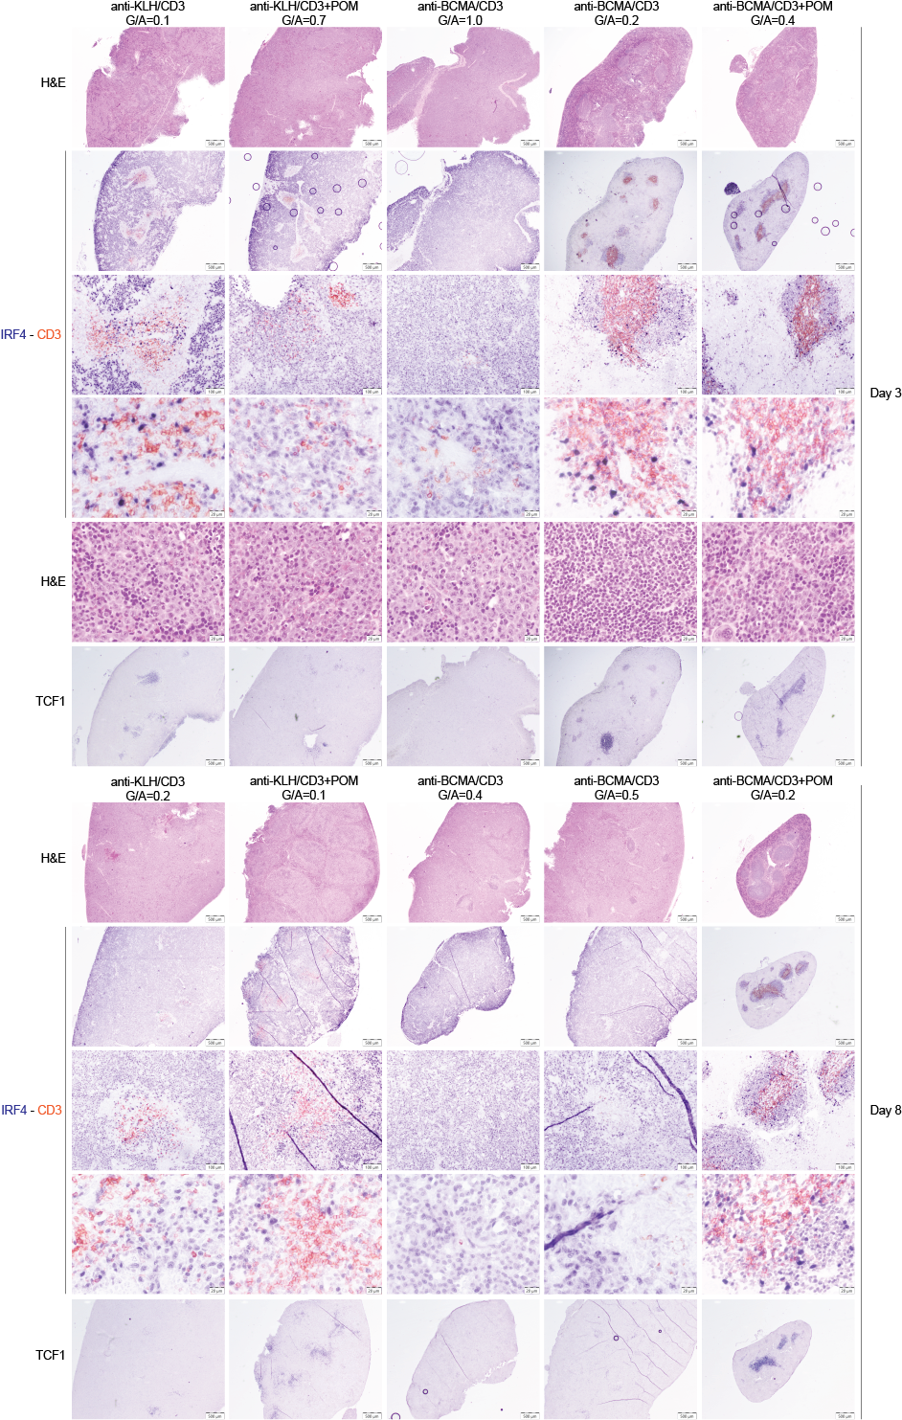
Supplemental Figure 7
Day 3
Day 8
Supplemental Figure 7. Immunohistochemistry of SPL section from hC343 mice transplanted with Vk32908 MM and treated with anti-KLH/CD3 or anti-BCMA/CD3 BsAb with or without Pom.
Mice were necropsied three- or ten-days post treatment initiation. Sections were stained with anti-CD3 (red) or anti-IRF4 (blue). The M-spike G/A ratio at the beginning of treatment is indicated above each section.

Slide 9
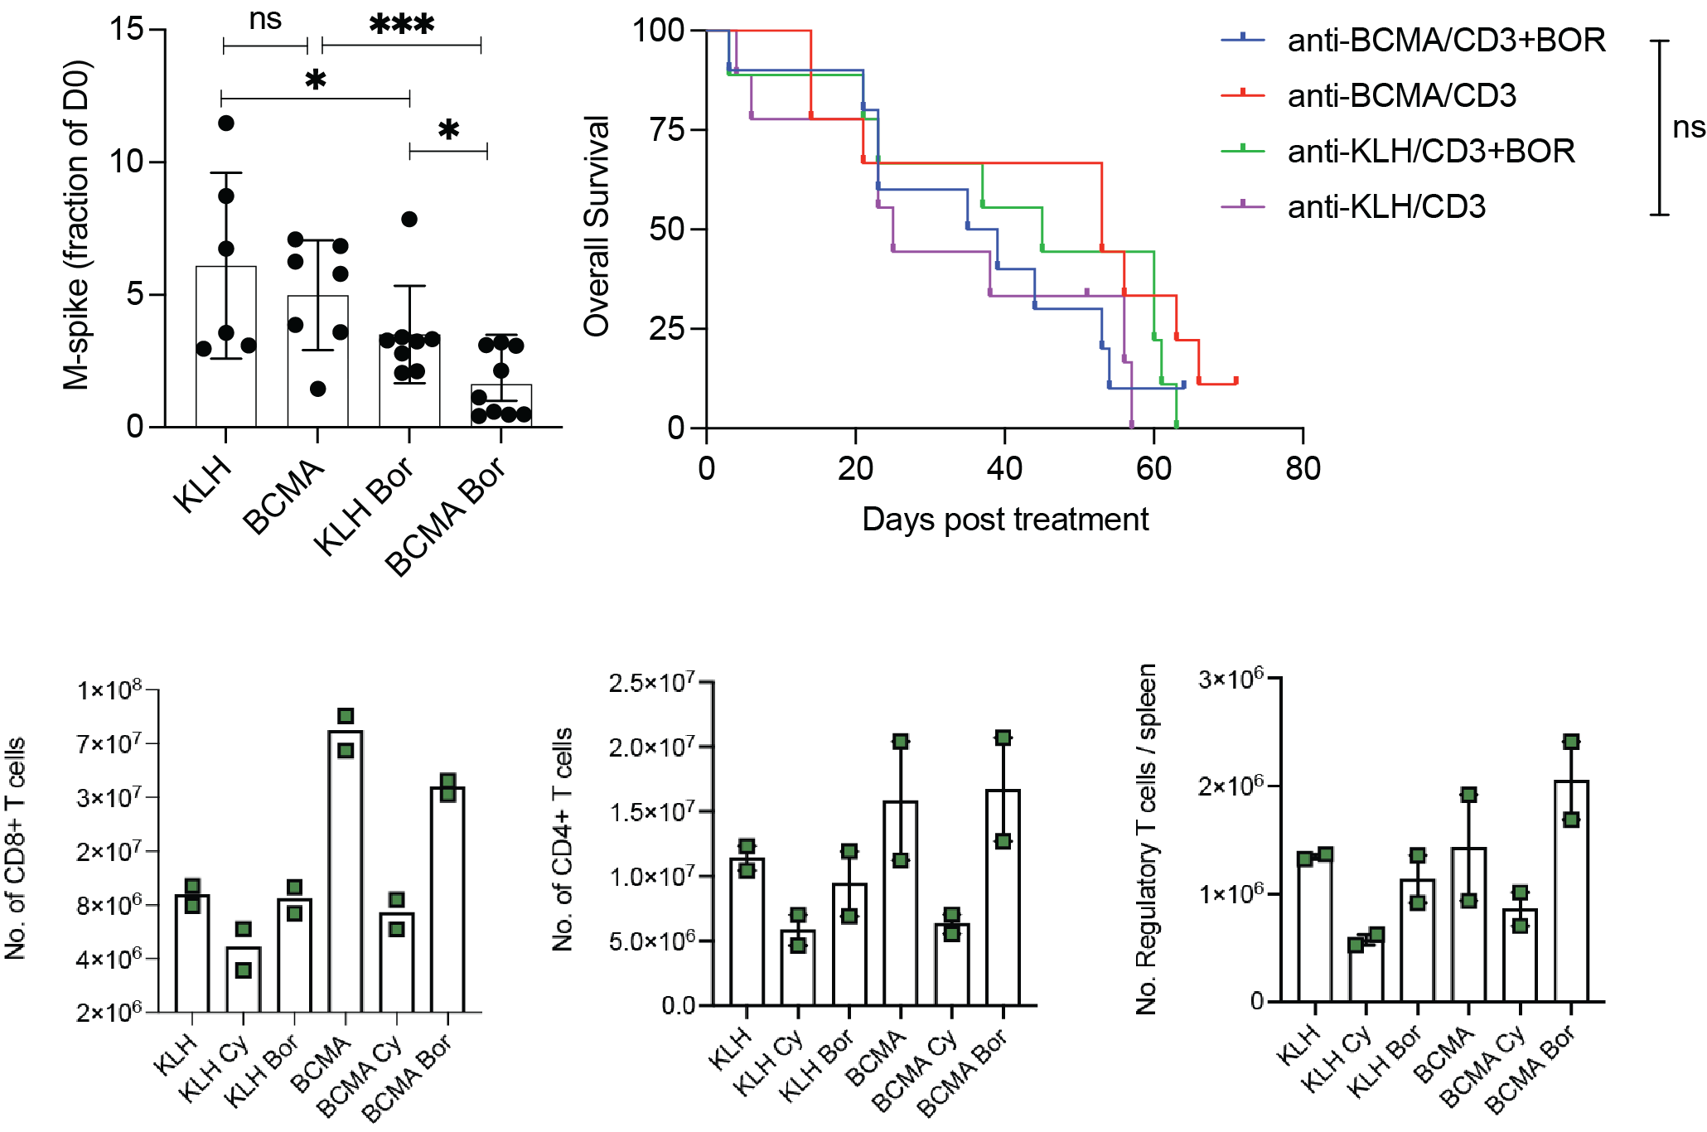
Supplemental Figure 8
A
B
C
D
Supplemental Figure 8. Evaluation of anti-BCMA/CD3 in combination with bortezomib or cyclophosphamide.
A. FCM analysis of CD8⁺ T cells from splenocytes of Vk12598 tumor bearing mice harvested three days after treatment initiation with anti-KLH/CD3 or anti-BCMA/CD3 with or without Cy. Percentage of CD8⁺ T cells expressing Ki67, IFN-γ, or granzyme B are shown. M-spikes levels, B. and overall survival, C. in Vk27181 bortezomib sensitive tumor bearing mice treated with anti-KLH/CD3 or anti-BCMA/CD3 at 1mg/kg on day 1 and 8 with or without bortezomib given at 0.5 mg/kg on day 1,4,8,11. D. FCM analysis of T cells from from splenocytes of Vk12598 tumor bearing mice harvested three days after treatment initiation with anti-KLH/CD3 or anti-BCMA/CD3 with or without bortezomib given as in B,C.

