Slide 1
COMPLEMENT INHIBITION FOR THE TREATMENT OF COVID-19 TRIGGERED THROMBOTIC MICROANGIOPATHY WITH CARDIAC FAILURE – a case report
August 2021
EHJ-CR-D-21-00313R1

Slide 2
Introduction
Severe coronavirus disease 2019 (COVID-19) has been increasingly recognized as a multisystem disease.
SARS-CoV-2 can infect human cells by attaching to angiotensin-converting enzyme 2 (ACE2) receptor¹ expressed on various cell types including the endothelium²
This phenomenon might explain the frequent involvement of multiple organs, including the heart³
Activation of the complement system seems to plays a central role in the pathophysiology of severe COVID-19 and the associated endotheliopathy⁴

Slide 3
Case Presentation
History and Examination Findings
74-year-old Caucasian male presents with malaise, dyspnea and cough
SARS-CoV-2 + (nasal swap)
    Begin treatment with remdesivir and dexamethason
Past medical history: atrial fibrillation (under amiodarone)
5 days after admission → acute chest pain:
    ECG: ST-elevation in leads II, III, aVF
    troponin I: 116 ng/L (ref < 14 ng/L)
    Coronary angiogram: chronic thrombotic occlusion of the marginal branches of the left coronary artery circumflex branch
    → no coronary intervention
    → ICU admission

Slide 4
Case Presentation
Investigations
Hemodynamic parameters:
    CI: 1.2 ml/(min*m2), PCWP: 27 mmHg, mPAP: 33 mmHg
TTE: LVEF 15% with global hypo-/ to akinesia.
Blood results second day after ICU admission:
    Platelet count 12 x 10⁹/L
    Coombs-negative hemolytic anemia (hb 98 g/dl , LDH 2,844 U/L, haptoglobin <0.10 g/l)
    Peripheral-blood smear: 12% Schistocytes
    Creatinin 315 umol/l
    ADAMTS13 54%
    Shigatoxin in Stool negative
    Complement levels: C3c <0.03 g/L (0.8 - 16 g/L), C4 <0.01 (0.10 - 0.40 g/L)

Slide 5
Case Presentation
Management
High flow oxygen therapy (HFOT) and inotropic
7 days therapeutic plasma exchange therapy
High-dose methylprednisolone pulses over 3 days followed by prednisone 1 mg/kgBW daily
Lack of improvement → interdisciplinary case discussion (critical care, hematology, nephrology, cardiology)
→ differential diagnosis of a complement mediated TMA → Eculizumab 900 mg

Slide 6
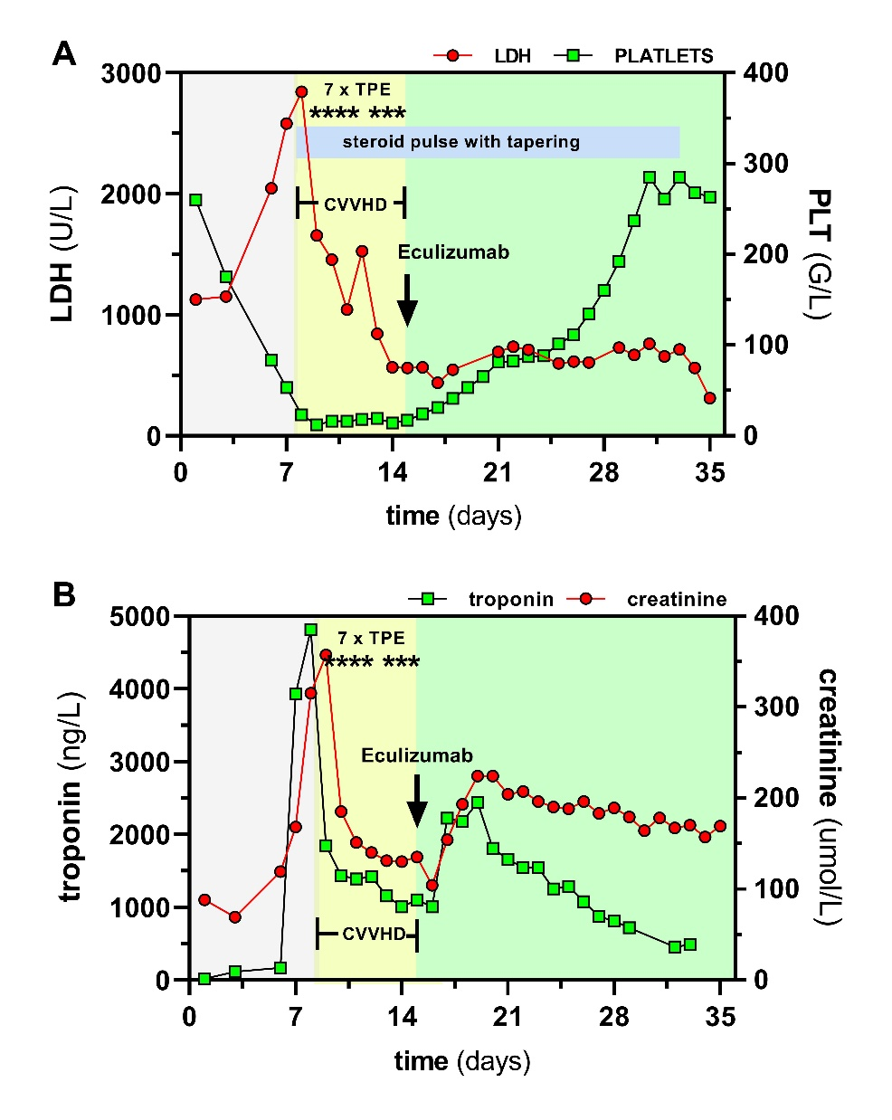
Case Presentation
Biochemical course
Take into account that TPE simply removes any circulating biomarke without a true pathophysiological meaning for the disease course. In other words the drop in biomarker levels during the 7 TPEs performed, does not indicate a disease improment. The only valubale parameter during TPE is thromocyt count (that obviously did not recovery during TPE epidoses – but immediatelty after Eculizumab treatment).

Slide 7
Follow-Up
After a single Eculizumab dose
→ continous rise in thrombocyte counts and decrease in LDH and troponin levels
→ discontinuation of RRT
→ schistocytes disappeared and Hb levels normalized
→ Inotropics were weaned and LVEF improved to 41%
The patient was discharged into rehabilitation after 36 days

Slide 8
Discussion
Etiology of cardiogenic shock observed in this patient cannot simply be explained by his focal and chronic coronary findings
Rising troponin but normal CK and myoglobin suggested a pathology on the microvascular level.
Thrombocytopenia, Coombs-negative hemolytic anemia with schistocytes, renal failure and neurological symptoms suggests a diagnosis of thrombotic microangiopathy

Slide 9
Discussion
In the absence of toxins and ADAMTS13 reduction suggestive for complement mediated TMA (former known as «atypical HUS»)
Complement activation seems to play a general role in the endotheliopathy of COVID-19⁴
Rapid resolution after pharmacological complement inhibition with Eculizumab⁵ suggests a SARS-CoV2-driven complement mediated microangiopathic origin of heart failure

Slide 10

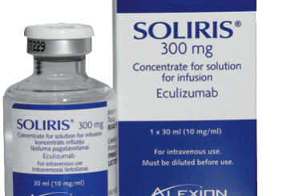

Learning Points
Myocardial injury related to COVID-19 can be a consequence of either direct viral myocarditis or indirect injury via endotheliopathy
TMA in the absence of toxins and with normal ADAMTS13 is suggestive for a complement-mediated pathology (cTMA)
Eculizumab is a monoclonal antibody, that blocks the formation of the terminal complement complex (C5b-9) that can cause endothelial injury and microvascular damage

Slide 11
References
Ge XY, Li JL, Yang XL, Chmura AA, Zhu G, Epstein JH, et al. Isolation and characterization of a bat SARS-like coronavirus that uses the ACE2 receptor. Nature 2013; 503(7477):535-8.
Varga Z, Flammer AJ, Steiger P, Haberecker M, Andermatt R, Zinkernagel AS, et al. Endothelial cell infection and endotheliitis in COVID-19. Lancet 2020; 395(10234):1417-1418.
Shi S, Qin M, Shen B, Cai Y, Liu T, Yang F, et al. Association of Cardiac Injury With Mortality in Hospitalized Patients With COVID-19 in Wuhan, China. JAMA Cardiol. 2020;5(7):802-810.
Magro C, Mulvey JJ, Berlin D, Nuovo G, Salvatore S, Harp J et al. Complement associated microvascular injury and thrombosis in the pathogenesis of severe COVID-19 infection: a report of five cases. Translational Research 2020; 220:1-13.
Diurno F, Numis FG, Porta G, Cirillo F, Maddaluno S, Ragozzino A, et al. Eculizumab treatment in patients with COVID-19: preliminary results from real life ASL Napoli 2 Nord experience. Eur Rev Med Pharmacol Sci. 2020;24(7):4040-4047

