Slide 1
Figure 1

Slide 2
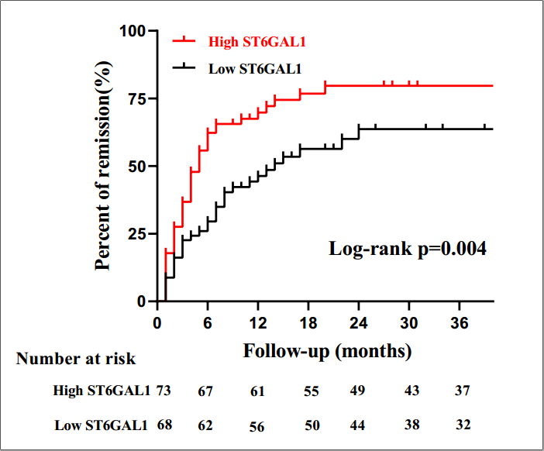
Figure 2

Slide 3
a
b
Figure 3

Slide 4
Figure 4

Slide 5
a
b
Figure 5

Slide 6
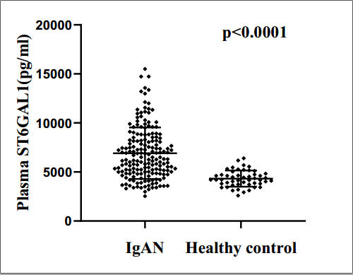
Supplement Figure 1

