Slide 1
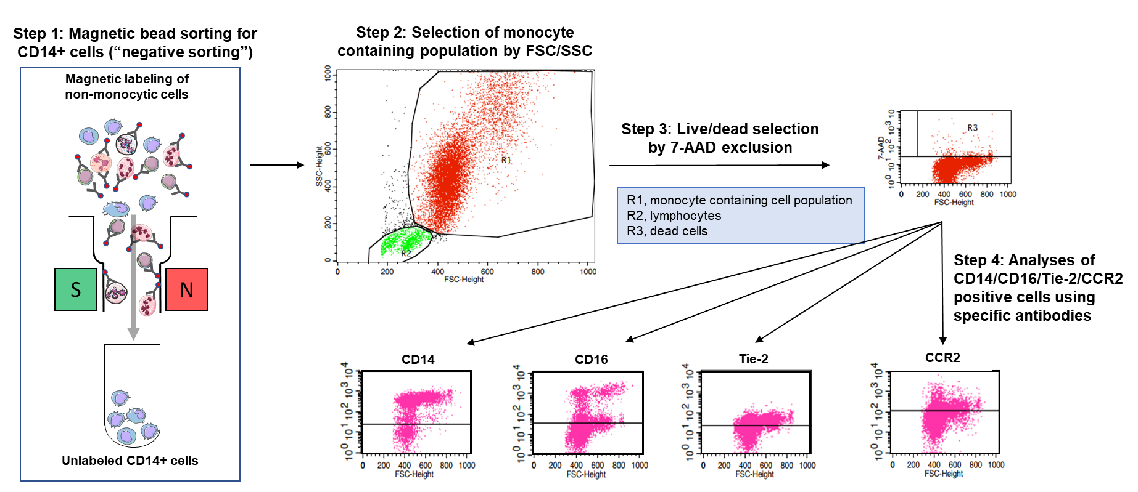
Supplemental Figure 1: Gating strategy employed in the study.

