Slide 1
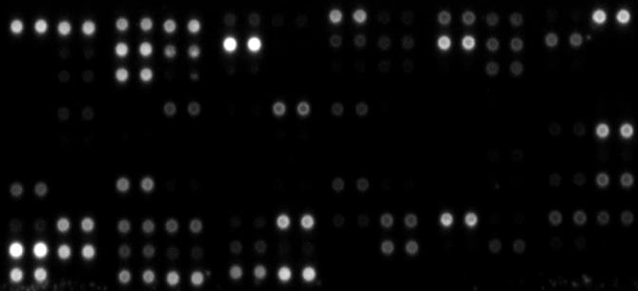

 | 1 | 2 | 3 | 4 | 5 | 6 | 7 | 8 | 9 | 10 | 11 | 12
A | Ref. spot | Adiponect. | Apo-AI | Angiogenin | Angiop. 1 | Angiop. 2 | BAFF | BDNF | C5/C5a | CD14 | CD30 | Ref. spot
B | --- | CD40 lig. | CHI3L1 | Adipsin | CRP | Cripto-1 | Cystatin C | Dkk-1 | DPPIV | EGF | Emmprin | ---
C | --- | CXCL5 | Endoglin | Fas Ligand | FGF basic | FGF-7 | FGF-19 | FLT-3-Lig | G-CSF | MIC-1 | GM-CSF | ---
D | CXCL1 | GH | HGF | ICAM-1 | IFN-γ | IGFBP-2 | IGFBP-3 | IL-1α | IL-1β | IL-ra | IL-2 | IL-3
E | IL-4 | IL-5 | IL-6 | IL-8 | IL-10 | IL-11 | IL-12 p70 | IL-13 | IL-15 | IL-16 | IL-17A | IL-18
F | IL-19 | IL-22 | IL-23 | IL-24 | IL-27 | IL-31 | IL-32 | IL-33 | IL-34 | CXCL10 | CXCL-11 | PSA
G | Leptin | LIF | Lipocalin-2 | MCP-1 | MCP-3 | M-CSF | MIF | CXCL9 | MIP-1α/β | CCL20 | MIP-3β | MMP-9
H | MPO | Osteopon. | PDGF-AA | PDGF-BB | Pentraxin3 | CXCL4 | RAGE | CCL5 | RBP-4 | Relaxin-2 | Resistin | CXCL12
I | Serpin E1 | SHBG | IL1RL1 | CCL17 | TFF3 | TfR1 | TGF-α | TSP-1 | TNF-α | uPAR | VEGF | ---
J | Ref. Spot | --- | VitD BP | PECAM-1 | TIM-3 | VCAM-1 | --- | --- | --- | --- | --- | Neg. ctr.
A
ABCDEFGHIJ
1
2
3
4
5
6
7
8
9
10
11
12
Control
1
2
3
4
5
6
7
8
9
10
11
12
RIPC/Control
ABCDEFGHIJ
CXCL5
GH
RIPC
IGFBP-3
MPO
MIF
200
300
0
100
1
2
3
4
5
6
7
8
9
10
11
12
Regulation %
ABCDEFGHIJ
cRIPC/Control
CXCL5
cRIPC
GH
IGFBP-3
MPO
MIF
200
300
0
100
B
Regulation %
C
Supplemental Figure 2: Effects of RIPC/cRIPC on relative levels of plasma cytokines. A, list of cytokines analyzed and their location on the respective array membrane B, photograph of array membranes revealing the signal intensities of all plasma cytokines investigated. C, RIPC and cRIPC mediated regulation of the top 5 cytokines.

