Slide 1
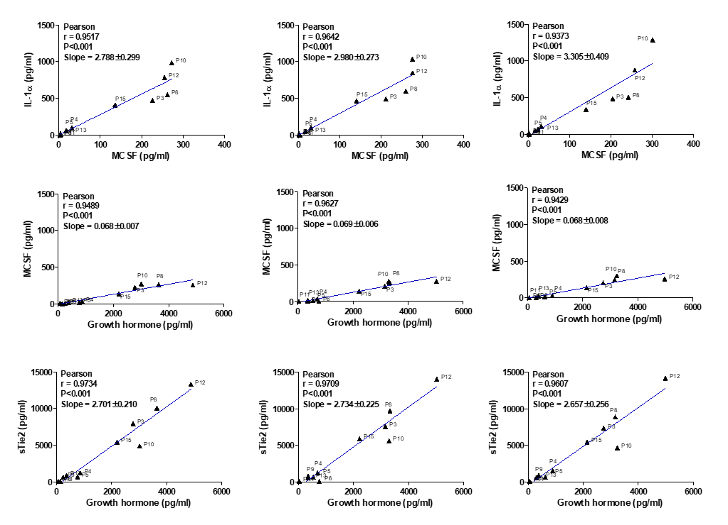
Control
RIPC
cRIPC
A
Control
RIPC
cRIPC
B
Supplemental Figure 4: Correlation analysis of Angiopoietin 2, CXCL5, Growth hormone, IL-1α, IL6, IL8, IGFBP-3, MCSF, PECAM-1, sTie2 and VEGF in Control, RIPC and cRIPC plasma. A, Table: Pearson correlation coefficients (r) based on N=11 samples in each group. B, Graphical presentation of factors showing strong linear correlation under Control, RIPC or cRIPC conditions.

