Slide 1
Supplementary Figures S1. Linkage disequilibrium (LD) analysis in the tested genotypes: heatmap of LD among all significant SNPs located on 1B (a), 2A (b), 7B (c) and 12 Unknown SNPs markers showed highly significant LD (d).

Slide 2
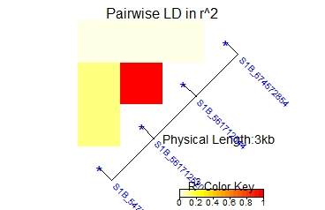
a)

Slide 3
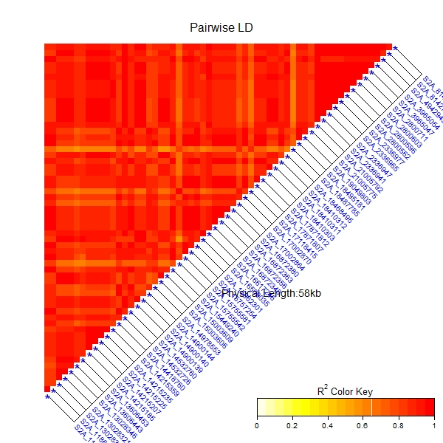
b)

Slide 4
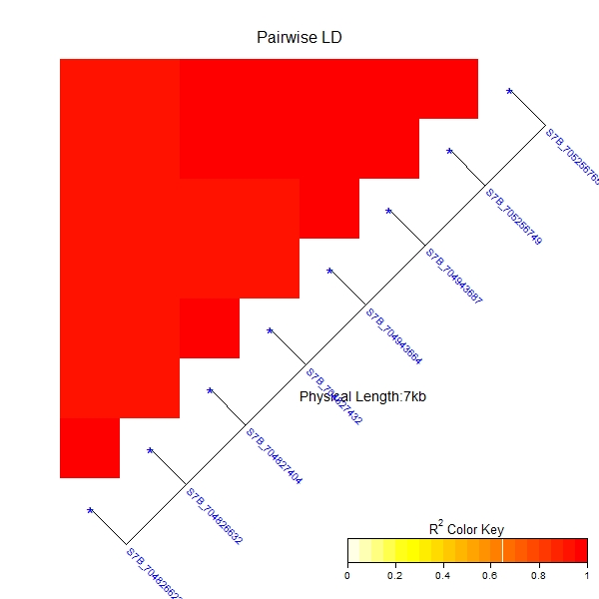
c)

Slide 5
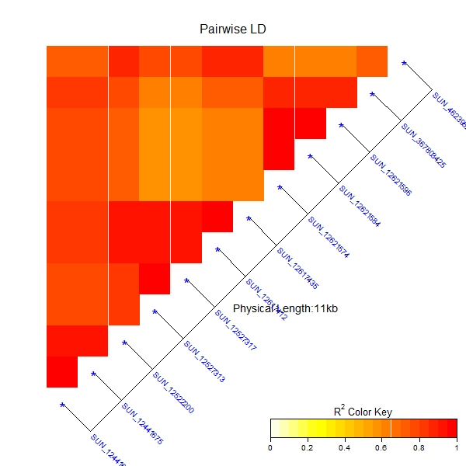
d)

