Slide 1
Research Techniques Made Simple:
CRISPR Genetic Screens
Auke BC Otten¹ and Bryan K Sun¹
¹ Department of Dermatology, University of California–San Diego, La Jolla, California, USA

Slide 2
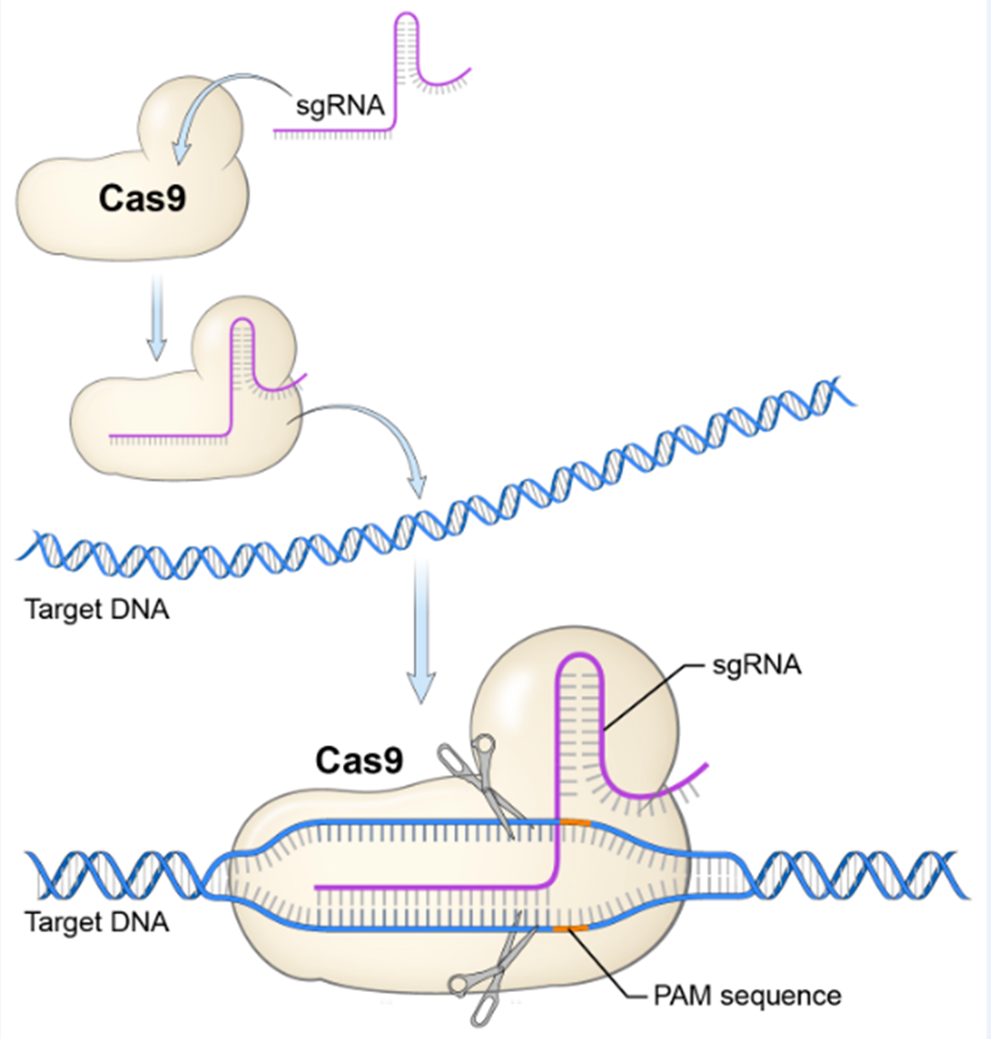
Gene perturbation using CRISPR (1)
Cas enzyme (usually Cas9) is guided to a desired genomic location by a Single Guide RNA (sgRNA)
Cas9 catalyzes a double stranded DNA (dsDNA) break at target location
CRISPR is now preferred over RNA interference
Guitart JR, Jr., Johnson JL, Chien WW. Research Techniques Made Simple: The Application of CRISPR-Cas9 and Genome Editing in Investigative Dermatology. J Invest Dermatol 2016;136(9):e87-e93.

Slide 3
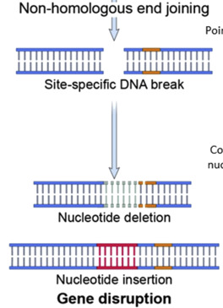
Gene perturbation using CRISPR (2)
dsDNA break most commonly repaired by non-homologous end joining (NHEJ):
  Error-prone
  Random insertion/deletion of nucleotides leads to frameshifts
  Frameshifts can result in loss-of function
  Referred to as CRISPR-knockout (CRISPR-ko)
Guitart JR, Jr., Johnson JL, Chien WW. Research Techniques Made Simple: The Application of CRISPR-Cas9 and Genome Editing in Investigative Dermatology. J Invest Dermatol 2016;136(9):e87-e93.

Slide 4
CRISPR in high throughput screens (1)
One sgRNA → CRISPR-ko of a single target
Multiple sgRNAs → CRISPR-ko of multiple targets
  Collection of sgRNAs = sgRNA library
  Each sgRNA in library inflicts a different knockout
A
B
C
D
E
….
Guitart JR, Jr., Johnson JL, Chien WW. Research Techniques Made Simple: The Application of CRISPR-Cas9 and Genome Editing in Investigative Dermatology. J Invest Dermatol 2016;136(9):e87-e93.

Slide 5
CRISPR in high throughput screens (2)
sgRNA library delivered to pool of cells
  One sgRNA per cells = One knockout event per cell
Pool of cells undergoes positive or negative selection
  Effect of each knockout responds different to phenotype of interest
  Effect of each knockout inferred by its enrichment/depletion
A
B
C
….
Guitart JR, Jr., Johnson JL, Chien WW. Research Techniques Made Simple: The Application of CRISPR-Cas9 and Genome Editing in Investigative Dermatology. J Invest Dermatol 2016;136(9):e87-e93.

Slide 6
CRISPR screen overview

Slide 7
CRISPR screen: key steps

Slide 8
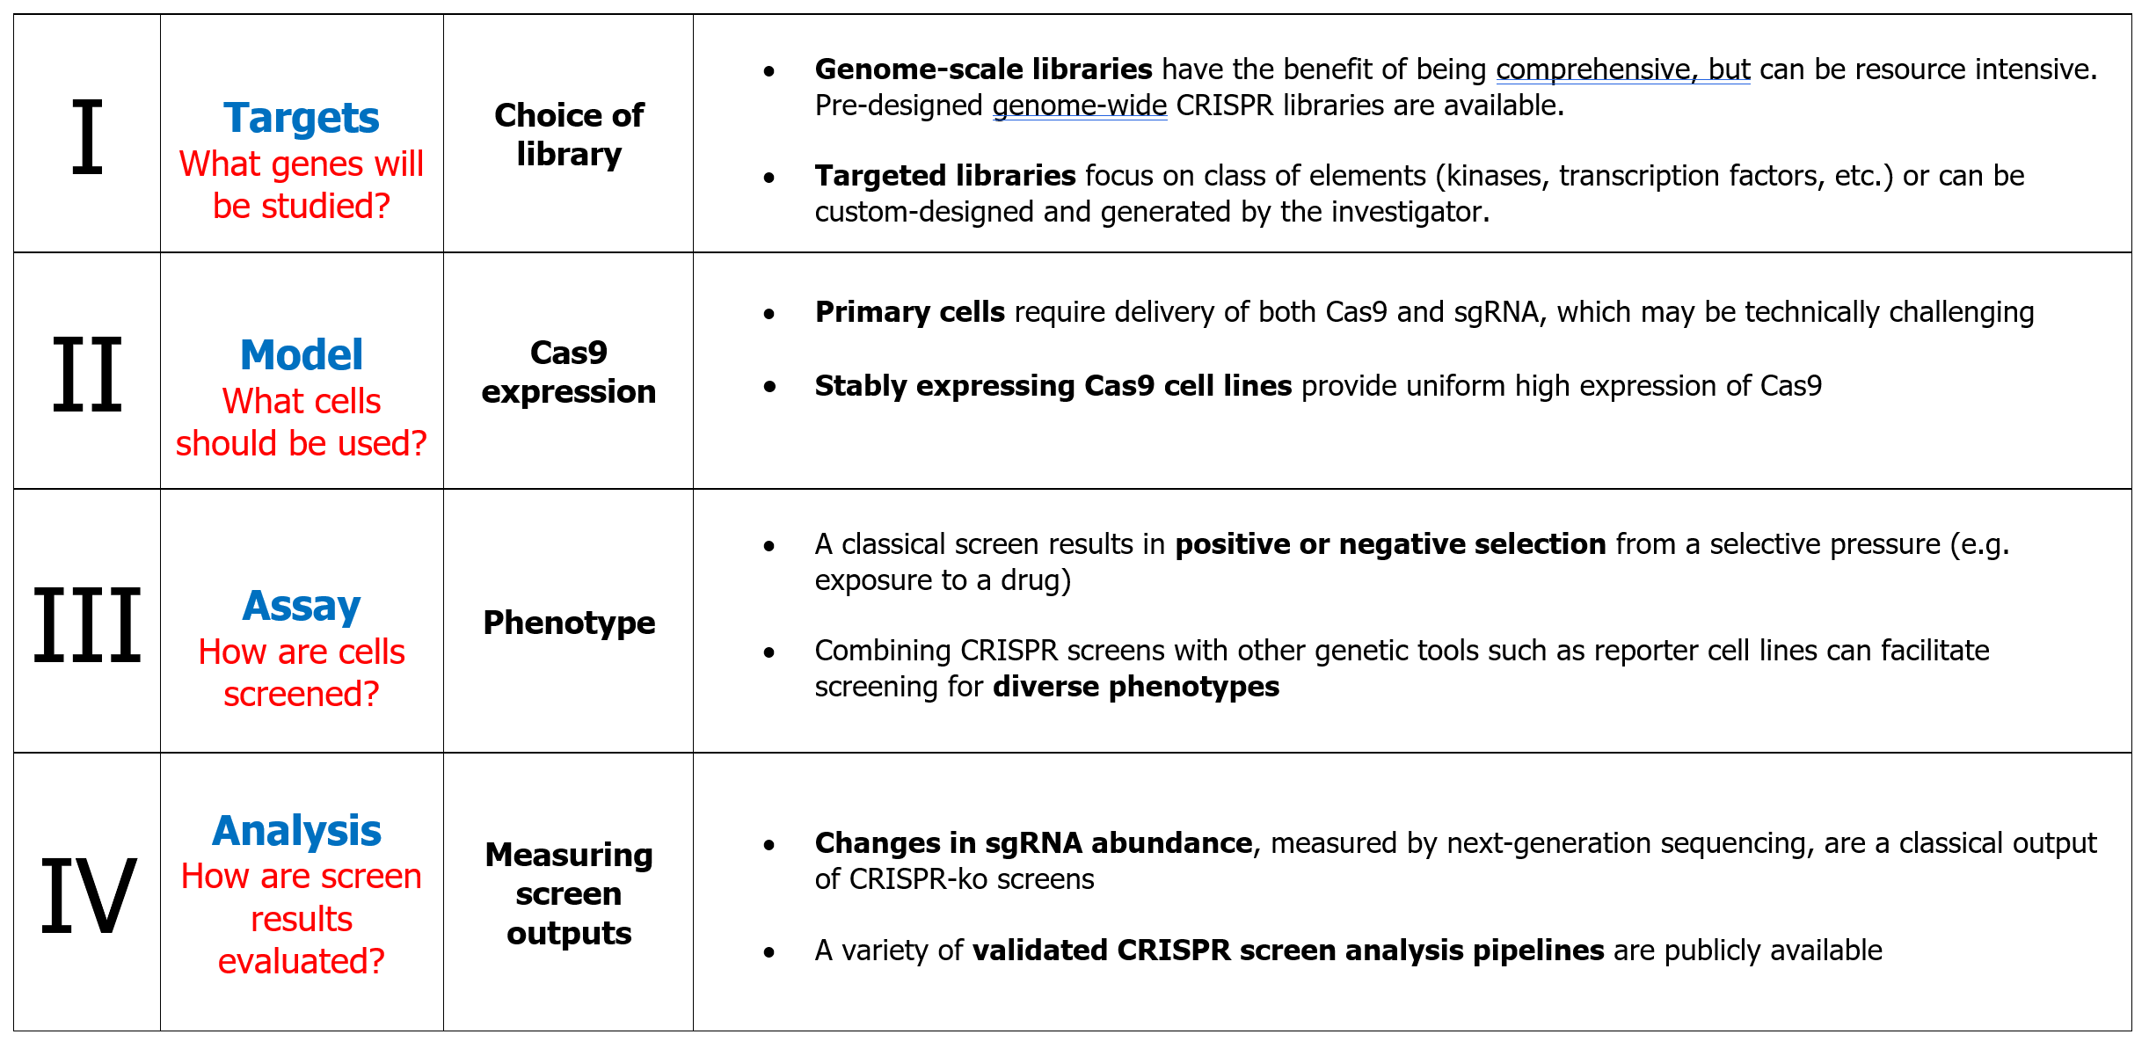
CRISPR screen: considerations

Slide 9
CRISPR screen advantages
The versatility and programmability of CRISPR-Cas genome editing enables high throughput genetic screens.
CRISPR genetic screens enable an systematic evaluation of many genetic elements in a single experiment.
The availability of pre-designed CRISPR libraries provides opportunities to “quick-start” a CRISPR screen using pre-validated sgRNAs.
The wide variety of CRISPR toolsets enables to study of many classes of genetic elements (proteins, miRNAs, non-coding genes, enhancers).

Slide 10
CRISPR screen limitations
CRISPR screens can be both labor- and resource-intensive.
Screen readouts might require the development of an assay that allows selection for a phenotype of interest.
CRISPR screen hits need to be validated by complementary, independent functional techniques.

