Slide 1

Baboon envelope pseudotyped “Nanoblades” loaded with Cas9/gRNAs complexes allow efficient genome editing in human T, B cells and HSCs and donor DNA knock-in provided by AAV-6 in HSCs
Alejandra Gutierrez-Guerrero^{1,9}, Maria Jimena Abrey Recalde^{1,2,9}, Philippe E. Mangeot¹, Caroline Costa¹, Ornellie Bernadin¹, Séverine Périan¹, Floriane Fusil¹, Gisèle Froment¹, Adriana Martinez-Turtos³, Adrien Krug³, Francisco Martin⁴, Karim Benabdellah⁴, Emiliano P. Ricci^{1,5}, Simone Giovannozzi^{6,7}, Rik Gijsbers⁶, Eduard Ayuso⁸, François-Loïc Cosset¹, Els Verhoeyen^{1,2,*}.
¹CIRI – International Center for Infectiology Research, Inserm, U1111, Université Claude Bernard Lyon 1, CNRS, UMR5308, Ecole Normale Supérieure de Lyon, Université Lyon, F-69007, Lyon, France
²Laboratory of Lentiviral Vectors and Gene Therapy, University Institute of Italian Hospital, National Scientific and Technical Research Council (CONICET), Buenos Aires, Argentina.
³Université Côte d’Azur, INSERM, C3M, 06204 Nice, France
⁴Centre for Genomics and Oncological Research (GENYO), Pfizer/University of Granada/Andalusian Regional Government, Genomic Medicine Department, Granada, Spain
⁵Laboratory of Biology and Modeling of the Cell (LBMC), Université de Lyon, Ecole Normale Supérieure de Lyon (ENS de Lyon), Université Claude Bernard, Inserm, U1210, CNRS, UMR5239, 46 Allée d’Italie, 69007 Lyon, France
⁶Laboratory for Viral Vector Technology & Gene Therapy, Department of Pharmaceutical and Pharmacological Sciences, Faculty of Medicine, Katholieke Universiteit Leuven, Leuven, Belgium
⁷KU Leuven, Department of Microbiology, Immunology and Transplantation, Allergy and Clinical Immunology Research Group, Leuven, Belgium
⁸INSERM UMR1089, University of Nantes, Centre Hospitalier Universitaire, Nantes, France
⁹Equal contribution
*Correspondence:
Els Verhoeyen: CIRI, Université de Lyon; INSERM U1111; ENS de Lyon; Université Lyon1; CNRS, UMR 5308, 69007 Lyon, France/Université Côte d’Azur, INSERM, C3M, 06204 Nice, France.
els.verhoeyen@ens-lyon.fr/els.verhoeyen@unice.fr

Slide 2
293
K562
A
NT
NB1
NB2
NT
NB1
NB2
+C
800
Day 3
600
800
600
Day 10
B
C
% Cell survival
Cell nubmer
% Cell survival
Cell nubmer
Supplementary Figure 1: BaEV/VSV-G gp pseudotyped nanoblades mediated long term gene editing in cell lines. (A) Representative electrophoresis gel of the PCR products on genomic DNA from 293T cells and K562 cells transduced with MLV nanoblades (gRNA301+gRNA305) co-pseudotyped with BaEV+VSV-G gps. Gene editing is is shown for day 3 and 10 post-nanoblade incubation. Cell survival (B) and proliferation (C) for 293T and K562 is shown for the indicated time-points post-nanoblade incubation. (B) Cell survival was determined by DAPI staining and is shown for the NB treated cells relative to the not treated cells (NT) for which cell survival was set to 100%. NT: not transduced, NB: nanoblade incubation.

Slide 3
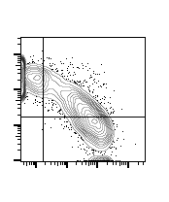
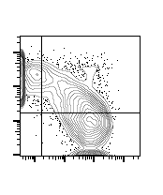
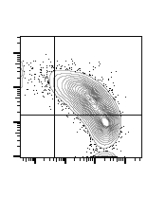
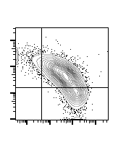
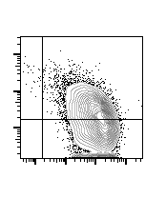
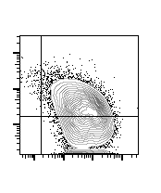
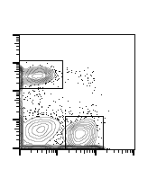
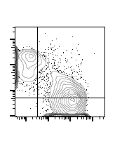
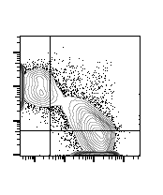
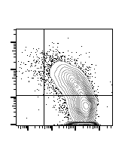
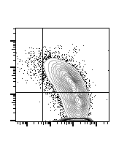
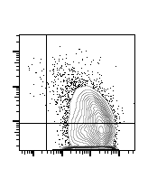
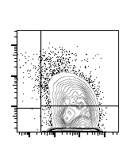
A
NT d3 d10
800
600
B
T cells CD3/CD28
% T cell survival
Cell numbers (x1E4)
C
T cells IL-7
D
Cell numbers (x1E4)
% CD4/CD8 T cells
CD4
CD8
-
Day3
-
Day 6
-
Day 10
CD45RA
NB
NB
NB
E
41
34
6
68
47
1
29
29
60
4
0.4
51
CD8
30
37
35
27
52
48
CD4
19
24
23
27
2
39
2
46
0.3
39
0.1
40
56
50
59
51
60
52
CD45RO
Supplementary Figure 2: BaEV/VSV-G gp pseudotyped nanoblades mediated long term gene editing in T cells without affecting their survival, proliferation and phenotypes. (A) Representative electrophoresis gel of the PCR products on genomic DNA from T cells transduced with MLV nanoblades (gRNA301+gRNA305) co-pseudotyped with BaEV+VSV-G gps (NB) or not (NT) followed by culture with CD3/CD28 beads (TCR stimulation). Gene editing is shown for day 3 and 10 post-nanoblade incubation or not transduced (NT). Cell survival and proliferation (B) and % CD4+ and CD8+ T cells (D) and naïve (CD45RA) and memory (CD45RO) cell phenotype is shown in (E) for the indicated time points post-nanoblade incubation cultured in the the presence of CD3/CD28 beads. (C) Proliferation of T cells is shown for the indicated time points post-nanoblade incubation cultured in the the presence of IL-7. (A) and (E) representative of n=3. (B,C and D) (means+/- SD; NT n=3; NB n=3).

Slide 4
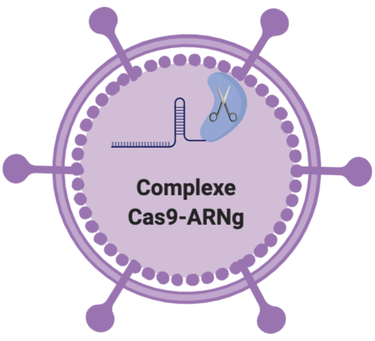

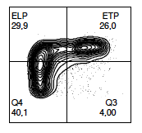
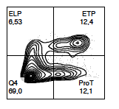
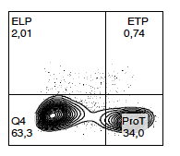
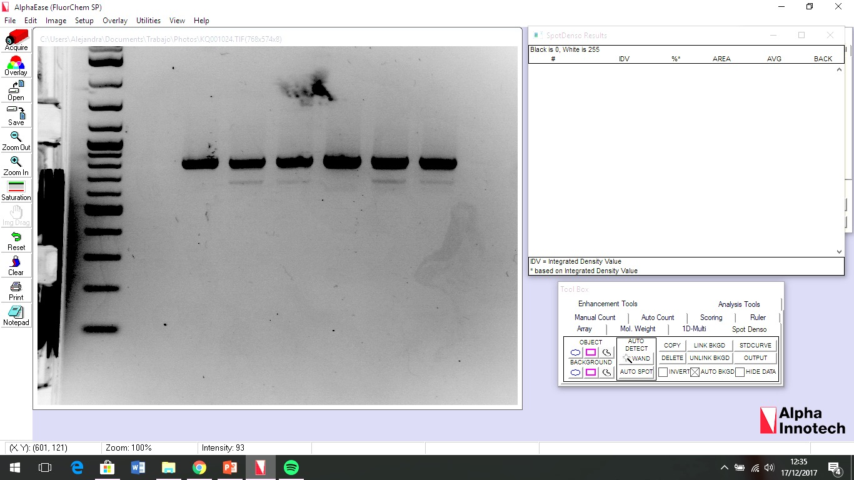
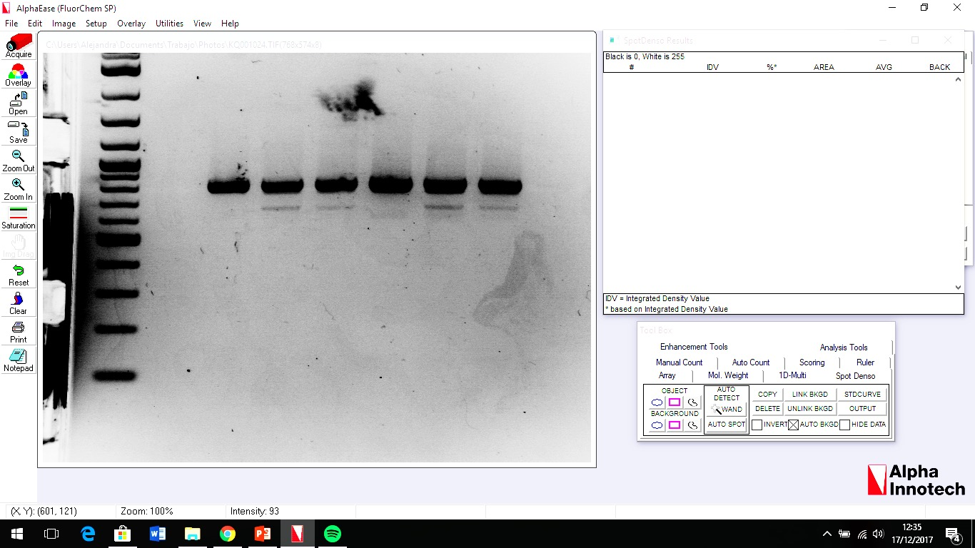
A
day 5
differentiation
24h
gDNA
Extraction
T cell
Progenitors
CD34+ cells
DL-4 Fc/Ig protein culture
SCF/TPO/Flt-3L/IL7
B
Day 3
Day 5
Day 14
CD34+
CD7+
C
NT
MLV
B+V
HIVB+V
811
647
12%
8%
Supplementary Figure 3. Nanoblades allow efficient gene editing in human T cell progenitors. A. Schematic presentation of the protocol for the differentiation of CD34⁺ into progenitor T cells (pro T) and nanoblade addition. Cells were defrosted and plated in DL-4 coated plates with a cytokine cocktail for 5 days and then transduced with MLV or HIV nanoblades in the presence of Vectofusin. B Representative plots showing differentiation at different time points. C. Representative electrophoresis gel of the PCR amplification of the WAS gene on pro-T cells transduced with MLV or HIV nanoblades co-pseudotyped with BaEV- and VSVG-gps (B+V) at day 5 of differentiation with percentage of deletion under each line (means+/- SD MLV B+V n=3, HIV B+V n=3)

Slide 5
Supplementary Table 1. Potential off-target sites for CRISPR/Cas9_gRNA 301
Locus | Off- target sequence | Primers 5’ → 3’
Intronic sequence Chromosome 1 | CAAGAAATTCAAAGAGTCGCCAG | Off-1 Fw | GTAAATGTTCAATAACTATT
 |  | Off-1 Rev | TTATTTAGAGACAGGGTCTC
FGF14 Chromosome 13 | CAAGCATCCCAAAGAGTGGCTGG | Off-2 Fw | CATTTACTTTAGAAGAGTTC
 |  | Off-2 Rev | CCTTGACATATACAGTCCTC
Intronic sequence Chromosome 12 | AAAGCATCCCAAAGAGTCTCAAG | Off-3 Fw | ATTAGCCAGGCATGGTAGCG
 |  | Off-3 Rev | AAGTAGGTCAGTGGGAAGCT
Notes:
Suplementary tables 1 and 2. Potential off-target sites.

Slide 6
Supplementary Table 2. Potential off-target sites for CRISPR/Cas9_gRNA 305
Locus | Off- target sequence | Primers 5’ → 3’
LINC00607 Chromosome 2 | CACGCTTAGACGAAAATGCTGGG | Off-4 Fw | TGCAGTTACTCATTCTCAGA
 |  | Off-4 Rev | GGTATGGAGGCAAGTGTGGA
Intronic sequence Chromosome 2 | GATGCCTGGAGGAAAATGCTGAG | Off-5 Fw | TAGAACTTGATTATTATGGG
 |  | Off-5 Rev | TCTACAAGCCAACGAGAATA
Intronic sequence Chromosome 9 | AATGCTTAGAAGAAAATGCTCAG | Off-6 Fw | GCTGACACATCAATCTCCTA
 |  | Off-6 Rev | AGTCTGCTTTCCAGCACACC
Intronic sequence Chromosome 8 | TCTGCTTGGAAGAAAATGCTAAG | Off-7 Fw | TTACCTCTGACTTTACTTTG
 |  | Off-7 Rev | CTGCCTCACACAGAAAGAAA
CNTNAP4 Chromosome 16 | GAAGCTTCTACGAAAATGCTGAG | Off-8 Fw | GATTCCATGCAATTCAAATG
 |  | Off-8 Rev | TTTAGGACCTAATGCTAATC
Intronic sequence Chromosome 18 | AATGGTTGGACCAAAATGCTGAG | Off-9 Fw | TGTGGCAGTGAGAGAATGGA
 |  | Off-9 Rev | TTGCTGATTAGGAATTTCTT
KIAA1217 Chromosome 10 | AATGCTTGGAAGAAAATGCAGGG | Off-10 Fw | TTCAACAACAGTGCCAAGAT
 |  | Off-10 Rev | TCCCTTATCAGGTGTACGAT
Intronic sequence Chromosome 3 | GATACTGGGACCAAAATGCTCAG | Off-11 Fw | CTCATCATTGAATGTATAGT
 |  | Off-11 Rev | AATTACACATTATTACTGAA
Intronic sequence Chromosome 4 | CATGCTTGCACGAAAATGATGGG | Off-12 Fw | TAGAGGTTATTGCTGCCCTT
 |  | Off-12 Rev | ACCACAACCATCCAATTACC
CPNE8 Chromosome 12 | GATGCTTTGATGAAAAGGCTGAG | Off-13 Fw | GCCTTGTGCTGGTTGAAA
 |  | Off-13 Rev | ATATTATCTTCTAAGGTAAC
Intronic sequence Chromosome 2 | GATGCTTGGGAGAAAAAGCTTGG | Off-14 Fw | CCTATGTATATTTGAAATT
 |  | Off-14 Rev | GTGTTATATCTGTTATGTGC

Slide 7
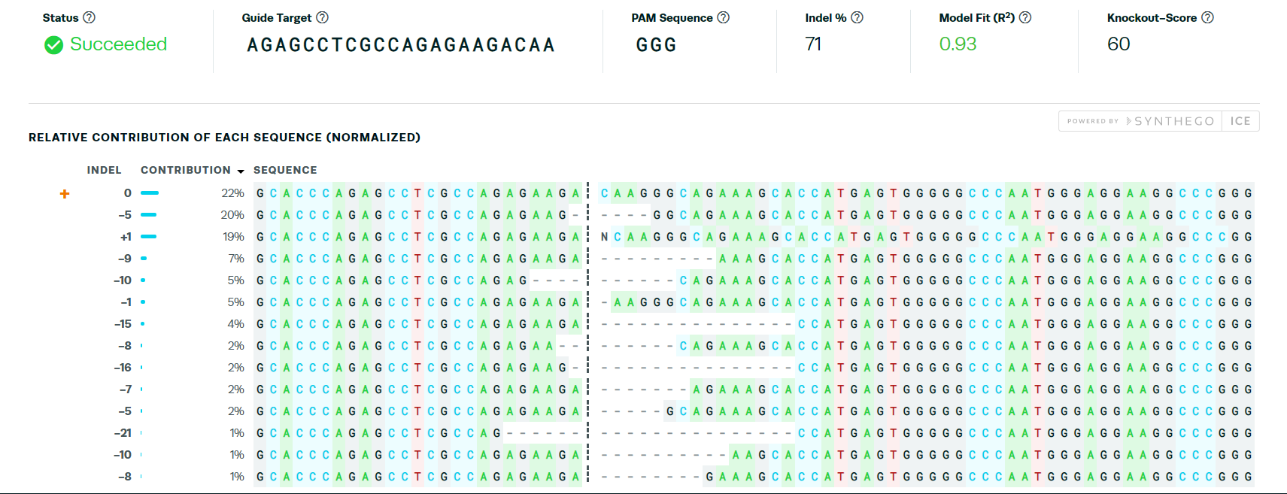
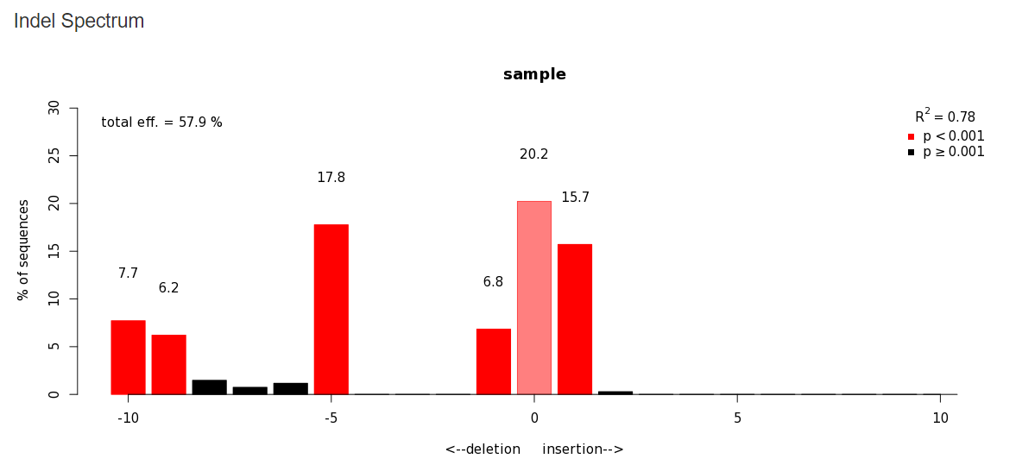
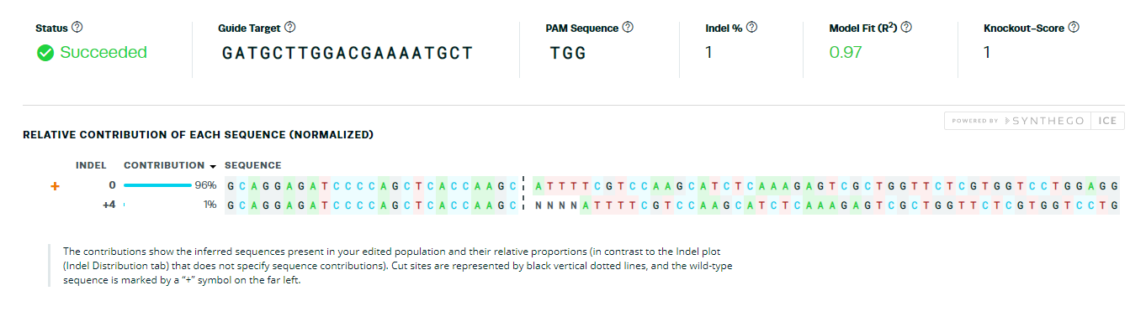
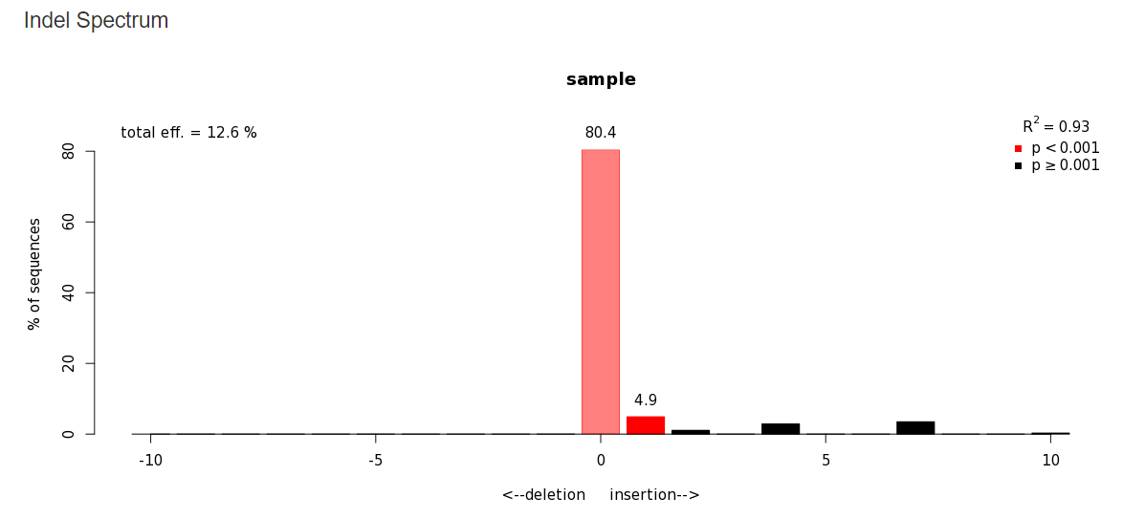
A On-target gene editing 293T for WAS gRNA-301
ICE analysis
TIDE analysis
B. On-target gene editing 293T for WAS gRNA-305
ICE analysis
TIDE analysis
Supplementary Figure 4: Residual gene editing in either target site WAS gRNA 1 or WAS gRNA 2 after incubation of 293T cells with nanoblades. To evaluate gene editing PCR was performed using WASFw/WASRv Primer pair. Gel electrophoresis reveals a 811bp and 647 bp (double cut with the 2 guides). The 811 bp PCR band was isolated separately and subjected to Sanger sequencing to evaluate single cutting by either WAS-301 gRNA 1 (A) or WAS-305 gRNA2. The INDELs were revealed by ICE and TIDE analysis for both on-target sequences. (p< 0.001= significant, Dark red bars; p>0.001 = non-significant, black bars; light red bars= no gene editing)

Slide 8
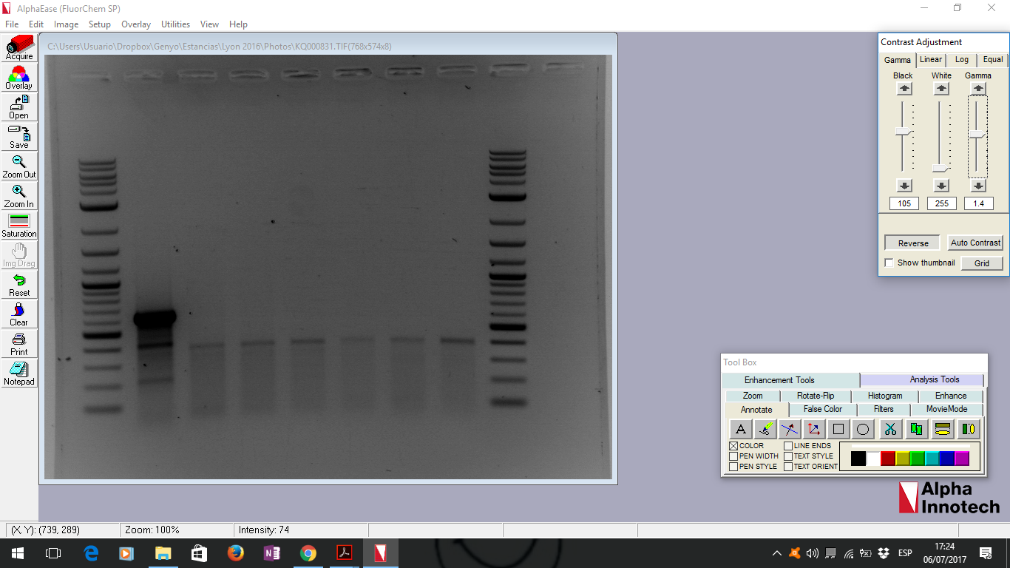
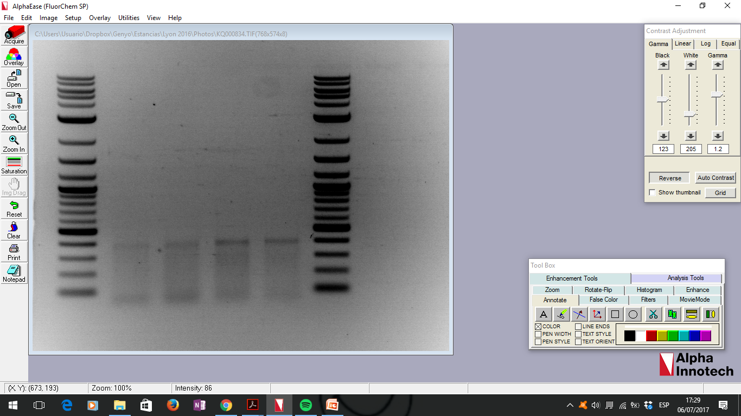
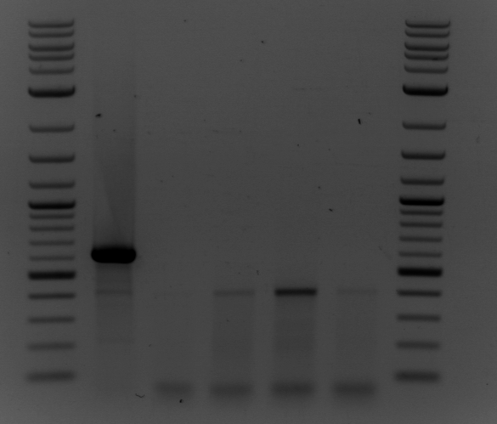
A
Name | Related gRNA | Off-target Sequence | size of PCR amplicon (bp) | Size after T7 treatment (bp)
off-2 | TPEM_301 | CAAGCATCCCAAAGAGTGGCTGG | 391 | 173/154
off-10 | TPEM_305 | AATGCTTGGAAGAAAATGCAGGG | 395 | 176/156
off-12 | TPEM_305 | CATGCTTGCACGAAAATGATGGG | 408 | 176/168
off-14 | TPEM_305 | GATGCTTGGGAGAAAAAGCTTGG | 400 | 181/153
B
Off-target 2
Off-target 10
C+
NT
MLV
HIV
NT
MLV
HIV
173
154
Off-target 12
Off-target 14
NT
MLV
HIV
NT
MLV
HIV
Supplementary figure 5. Off target editing evaluated by surveyor assay. (A) Table showing the different off target site for the different gRNAs tested by the surveyor essay; size of the PCR product and expected bands after the T7 treatment are indicated. The sequence shows in red the mismatches in comparison with the original gRNA target sequence. (B) Representative electrophoresis gel 4 off-target sites after PCR amplification and T7 treatment. C+ = positive control showing the T7 enzyme works accurately.
Notes:
Figure 7. Off target effects.

Slide 9
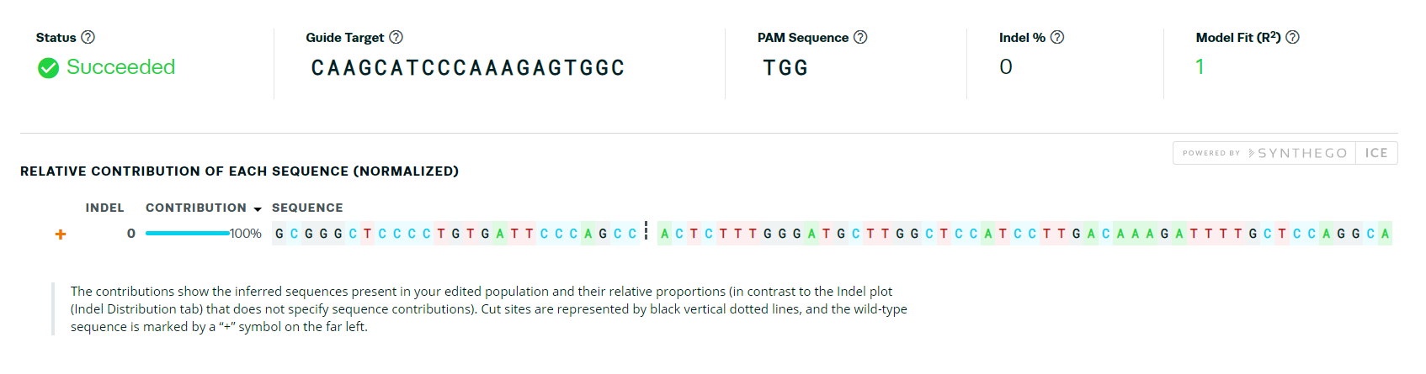
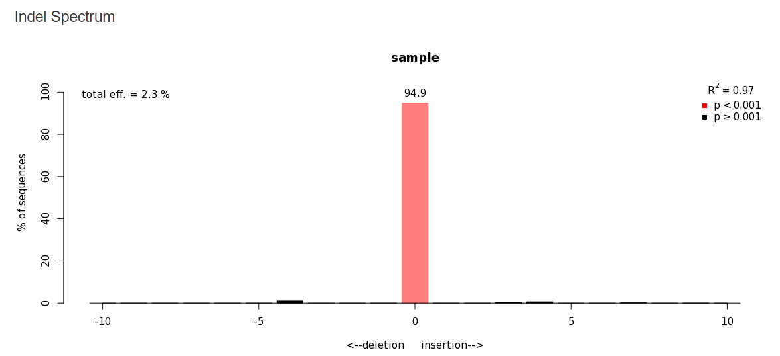
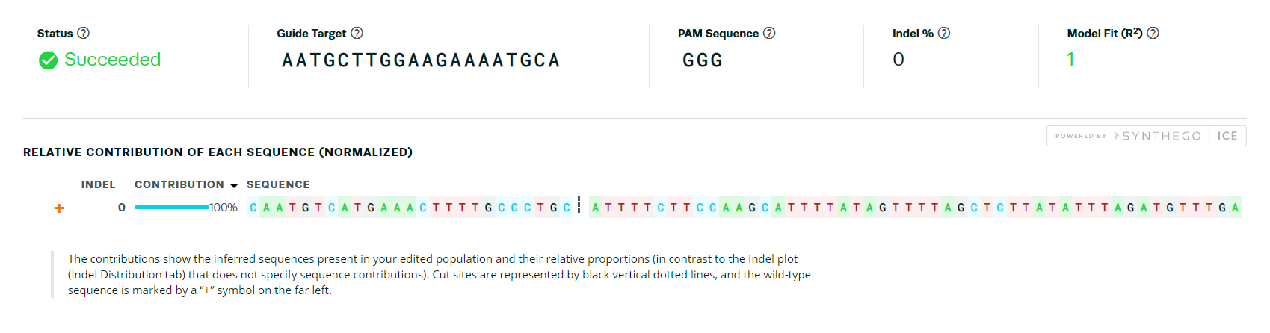
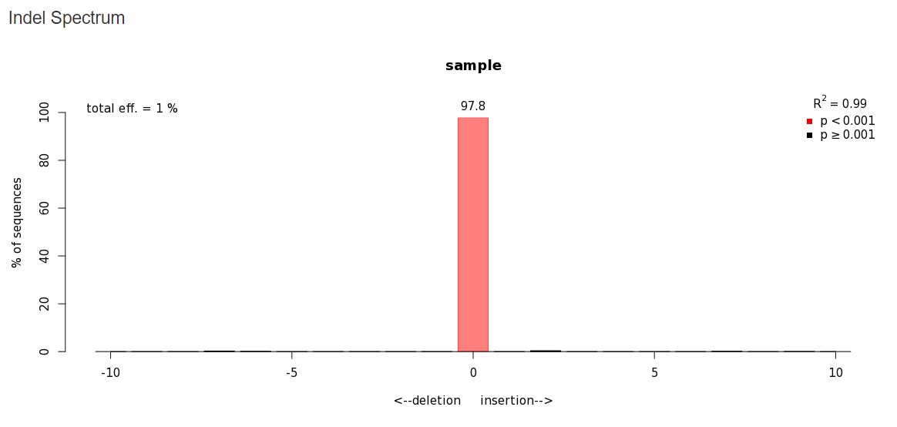
A. Off-target 2
ICE analysis
TIDE analysis
B. Off-target 10
ICE analysis
TIDE analysis

Slide 10
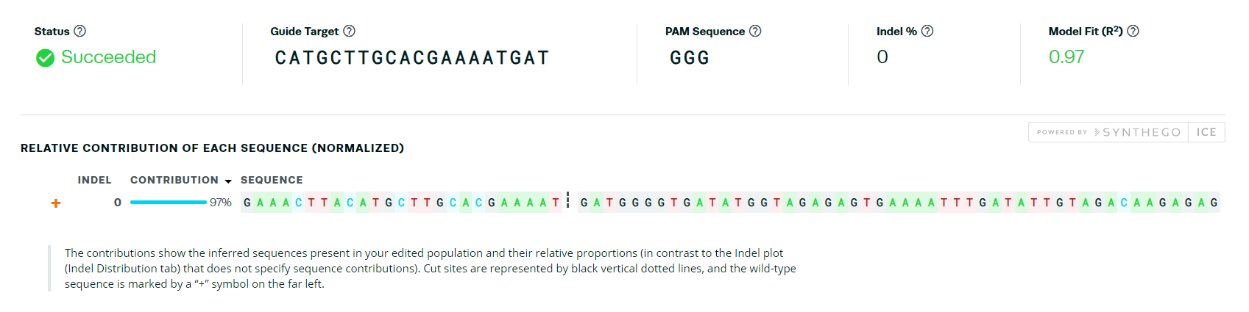
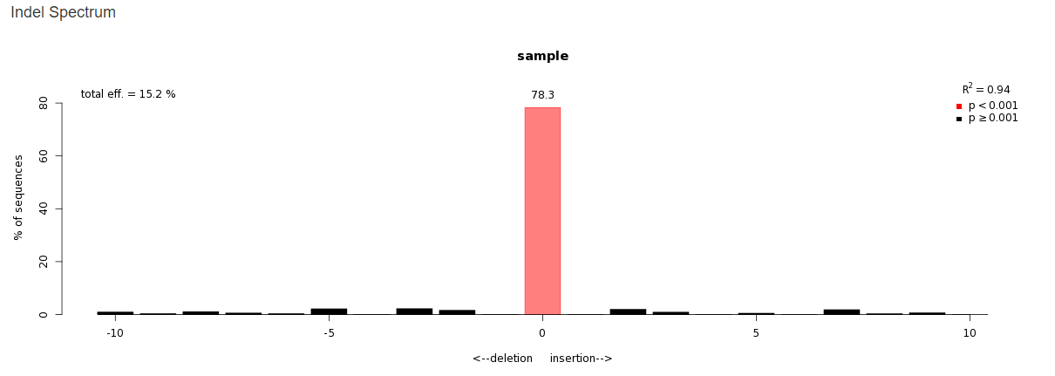
C. Off-target 12
ICE analysis
TIDE analysis
Supplementary Figure 6: Evaluation of off-target gene editing by nanoblades by ICE and TIDE analysis.
Off-target sites for gRNA-301 and gRNA-305 were identified and are listed in supplementary Table 1 and 2. The off-target positions 2, 10 and 12, panel A, B and C, respectively, were PCR amplified with the primers indicated in Supplementary Table 1 and 2. The resulting PCR product was purified and subjected to Sanger sequencing. Sequencing data were analyzed by ICE and TIDE analysis to evaluate the presence of off-target INDELs. For TIDE analysis p< 0.001= significant, Dark red bars; p>0.001 = non-significant, black bars; light red bars= no gene editing)

