Slide 1
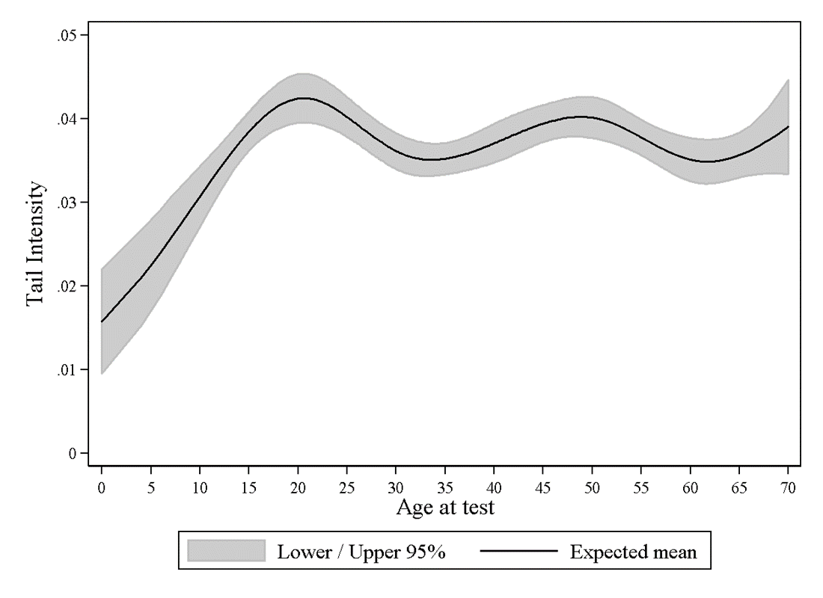
Supplementary Figure 1. Relationship between tail intensity and age estimated through the restricted cubic spline technique. Sex, exposure to genotoxic agents, smoking habit, and laboratory/study effects were included in the regression model.

