Slide 1
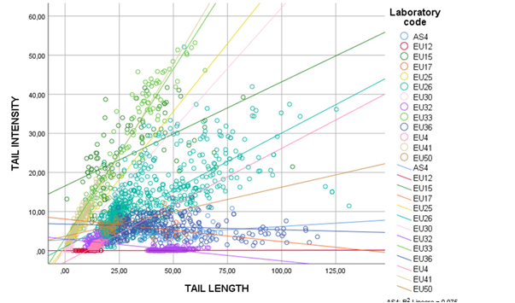
Supplementary Figure 2. Correlation between DNA damage measured with Tail intensity and Tail length by laboratory.

