Slide 1
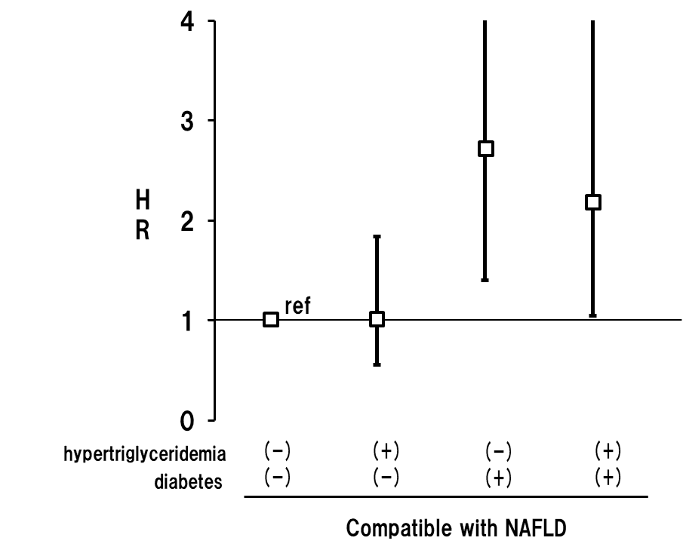
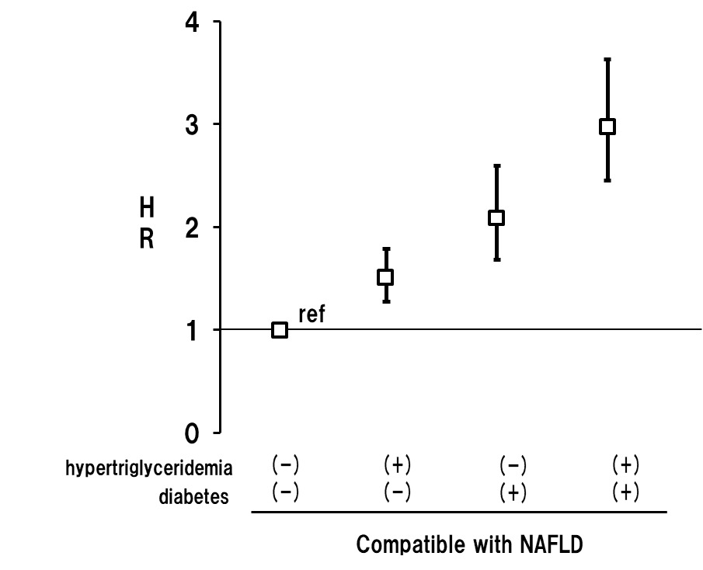
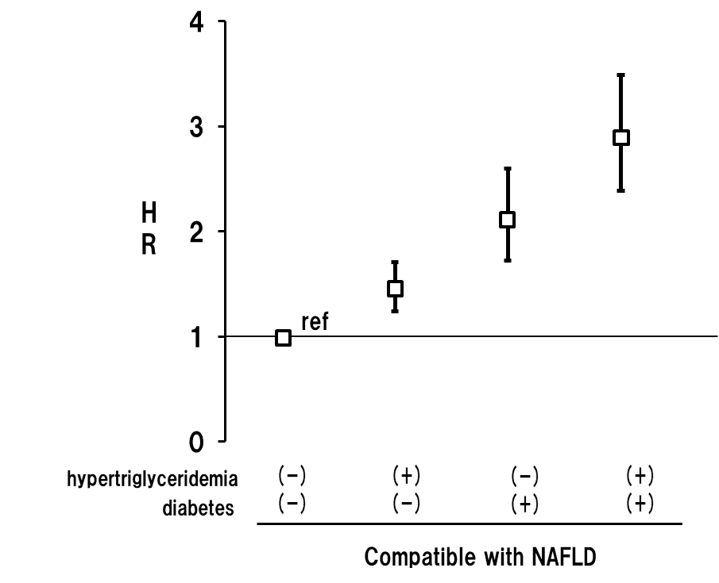
Supplementary Figure 3. Hazard ratios of primary outcomes in compatible with NAFLD (Liver test abnormalities) with or without diabetes and/or hypertriglyceridemia
(a) cerebral infarction
(b) coronary artery event
© cardiovascular event
Primary outcomes were adjusted by age, sex, smoking habit, BMI, LDL-C hypertension, and statin use. Bars indicates 95% confidence intervals. HR：hazard ratio

