Slide 1
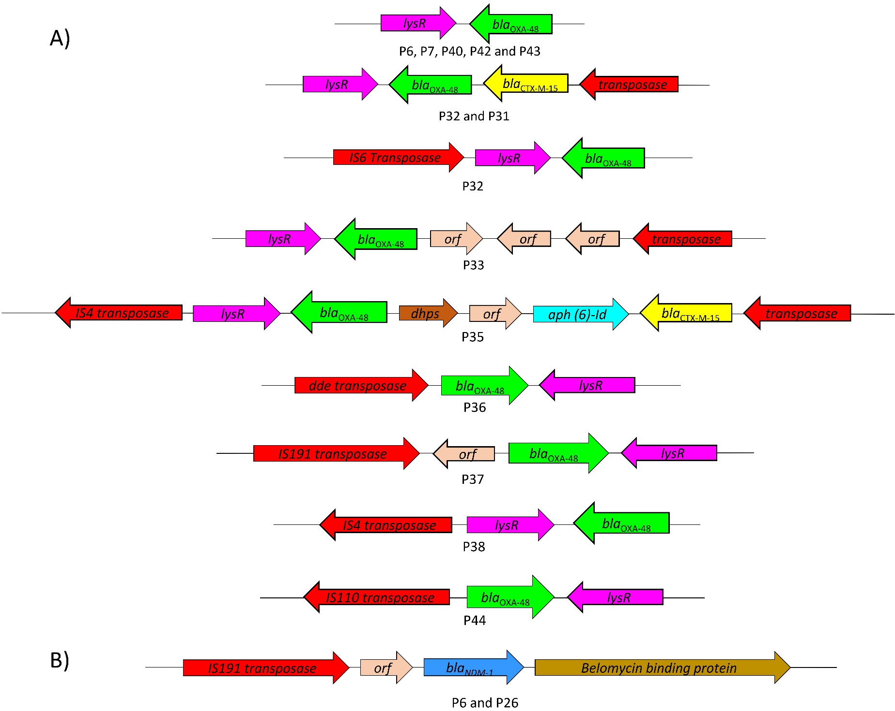
Figure S1. A) The genetic environment of bla_{OXA-48} and bla_{NDM-1} in 14 colistin-resistant OXA-48-producing K. pneumoniae strains. bla_{OXA-48} was identified in all strains except for P26. lysR and bla_{OXA-48} complex was found in all strains. No transposase element was detected surrounding lysR and bla_{OXA-48} complex in P6, P7, P40, P42 and P43. Two bla_{OXA-48} with different genetic arrangement were found on P32 plasmid. In P36, P37, P38 and P44; lysR and bla_{OXA-48} complex was flanked upstream by DDE, IS91, IS4 and IS110 family transposase genes, respectively. B) bla_{NDM-1} was detected only in P6 and P26 strains. bla_{NDM-1} was flanked upsteram by bleomycin binding protein and trpF genes and downstream by IS91 family transposase.

