Slide 1
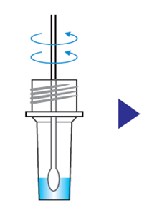
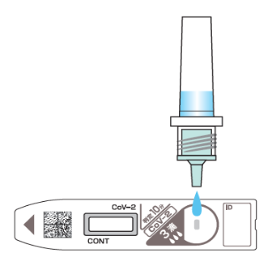
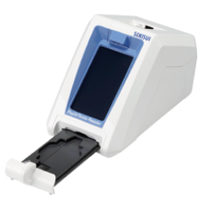
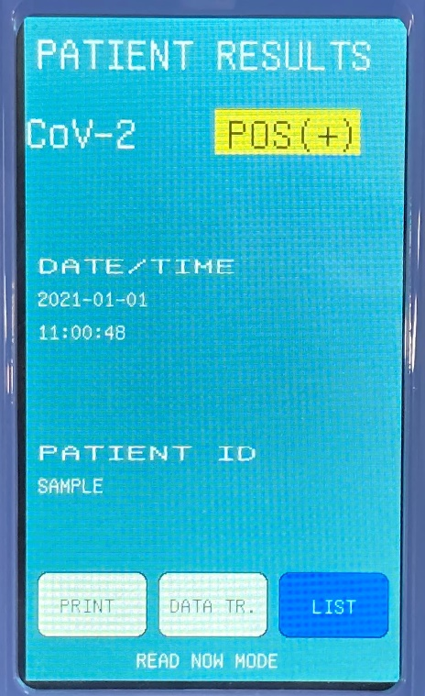
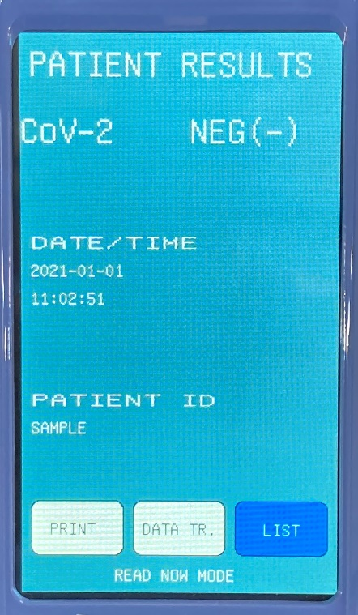

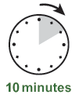

Positive result
Negative result
Extract swab sample into extraction buffer
Add 3 drops of extracted sample onto the test cassette
Judge the result by using a digital immunoassay device
*Figures were edited from the Instruction for Use of RapidTesta Reader

