Slide 1
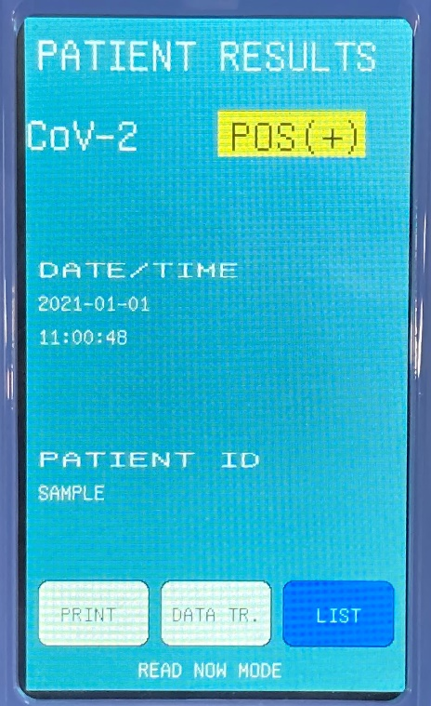
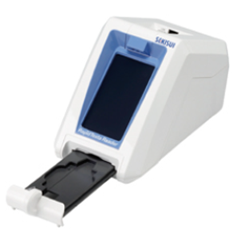


Positive by digital immunoassay device
Judge positive
Suspect false-positive
RT-PCT

