Slide 1
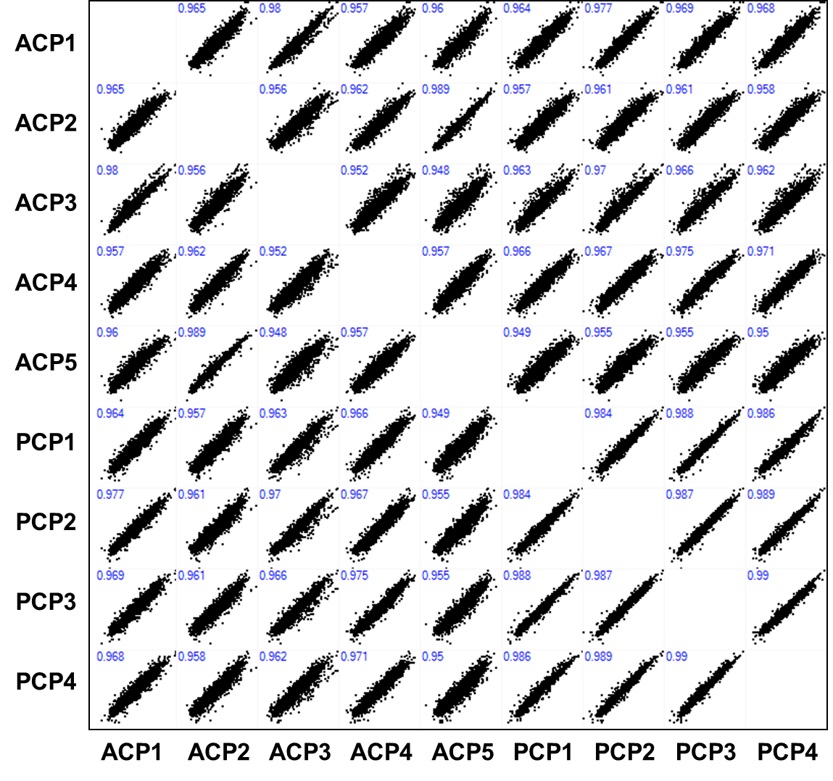
Title: In-depth Proteomic Profiling Captures Subtype-specific Features of Craniopharyngiomas
Authors: Jung Hee Kim, Hyeyoon Kim, Kisoon Dan, Seong-Ik Kim, Sung- Hye Park, Dohyun Han, Yong Hwy Kim
Supplementary Figure 2. Correlation between ACP and PCP in TMT quantification set

