Slide 1
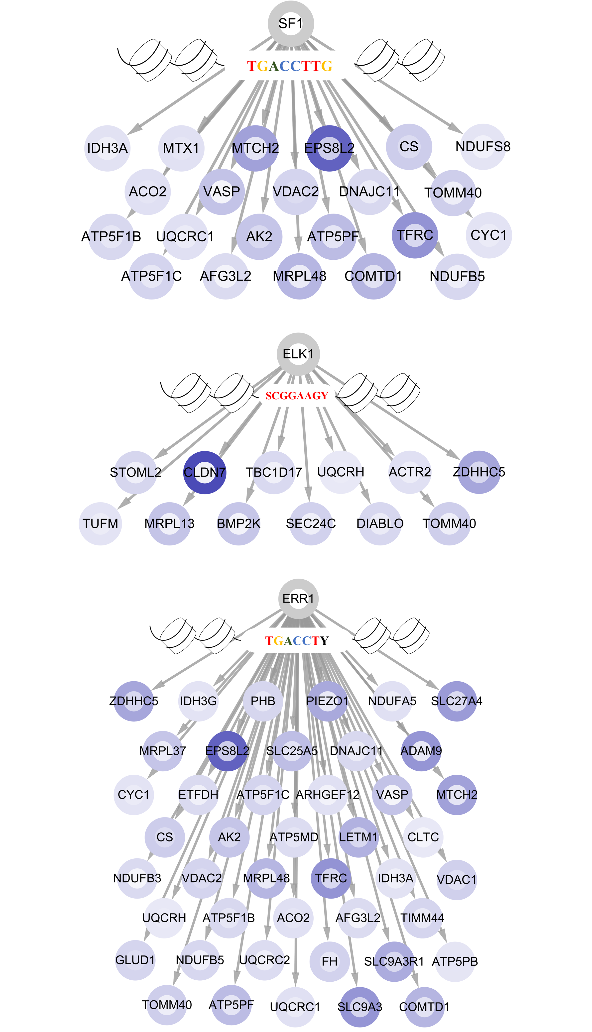
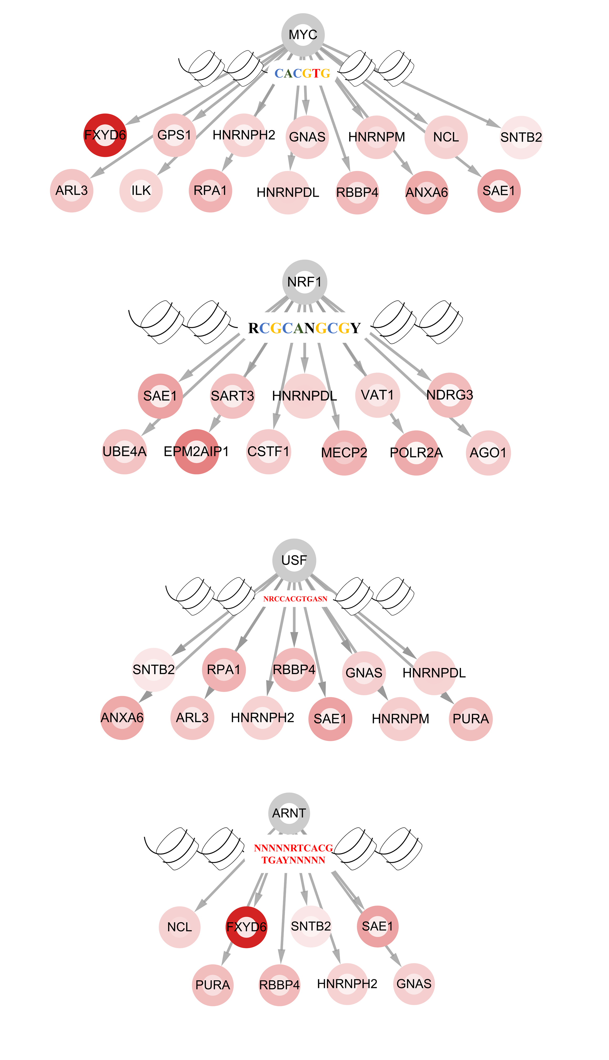
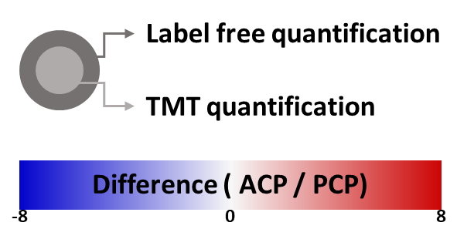
Title: In-depth Proteomic Profiling Captures Subtype-specific Features of Craniopharyngiomas
Authors: Jung Hee Kim, Hyeyoon Kim, Kisoon Dan, Seong-Ik Kim, Sung- Hye Park, Dohyun Han, Yong Hwy Kim
a
b
Supplementary Figure 4. TFBS prediction and network between TFs and downstream target proteins

