Slide 1
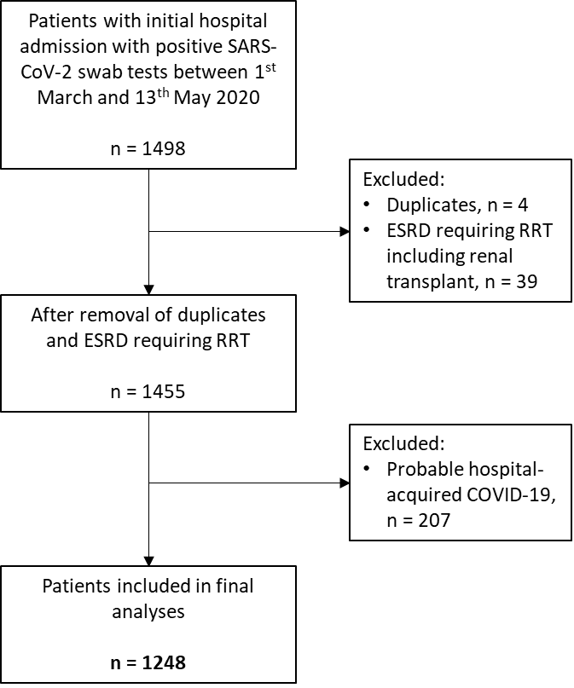
ESRD: end stage renal disease
RRT: renal replacement therapy
*RRT includes haemodialysis, peritoneal dialysis and functioning renal transplants

