Slide 1
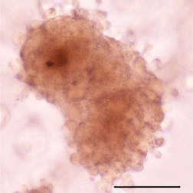
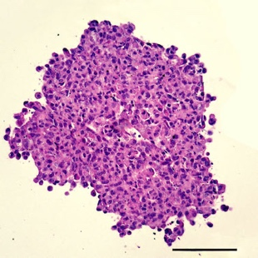
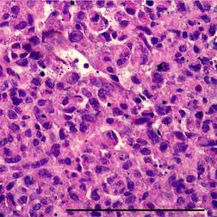
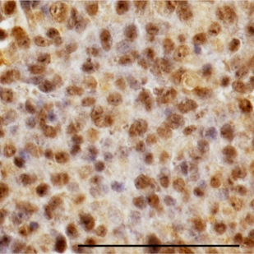
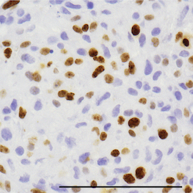
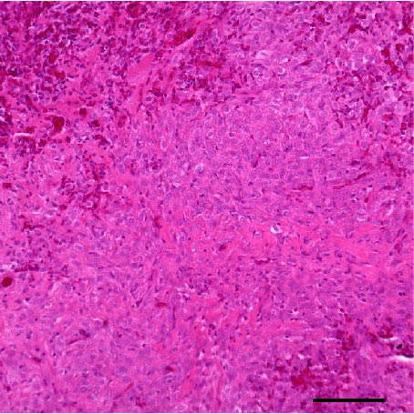
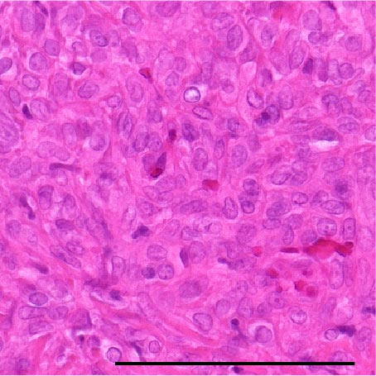
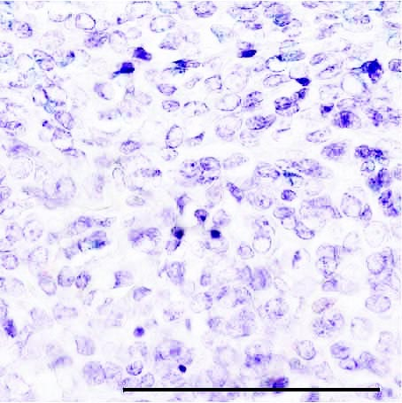
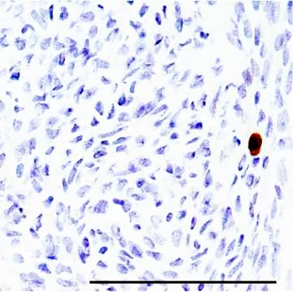
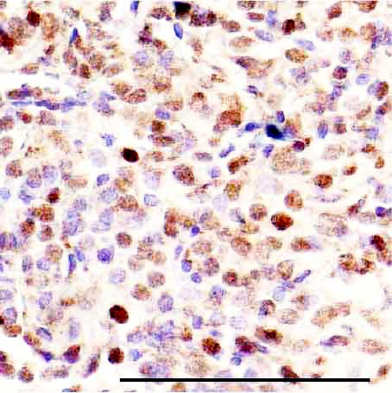
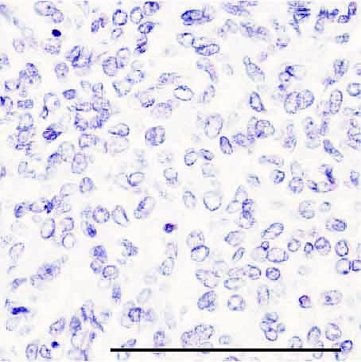
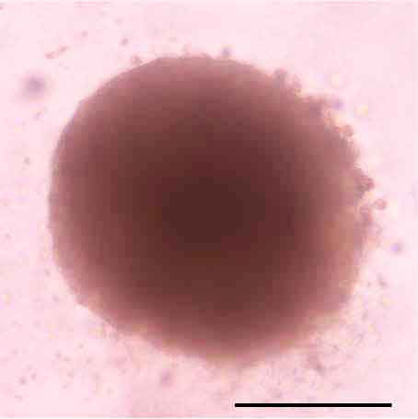
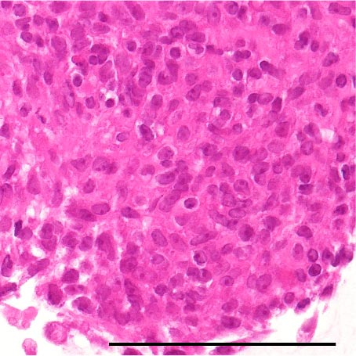
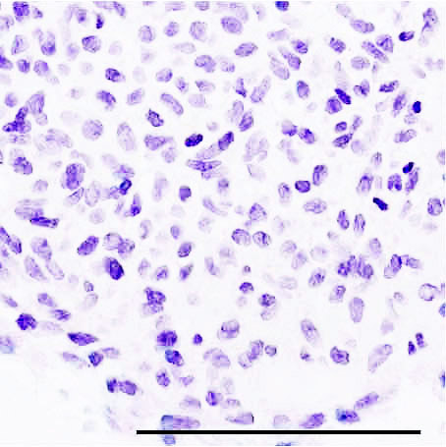
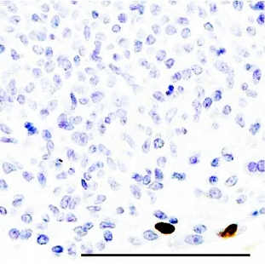
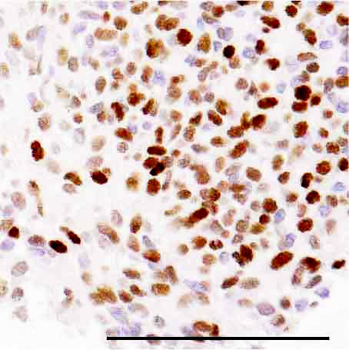
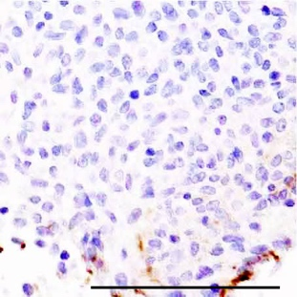
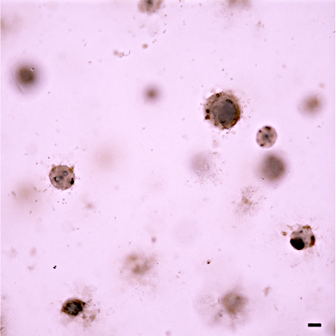
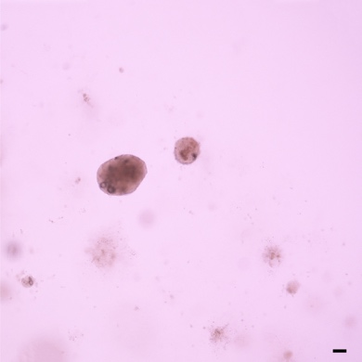
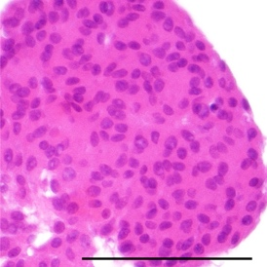
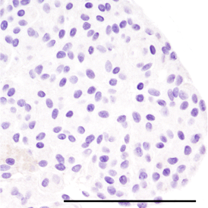
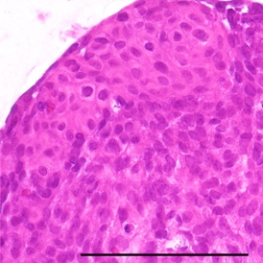
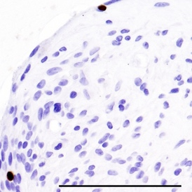
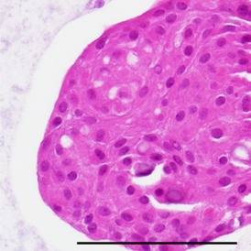
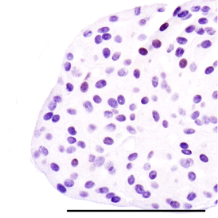
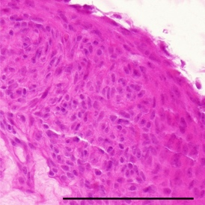
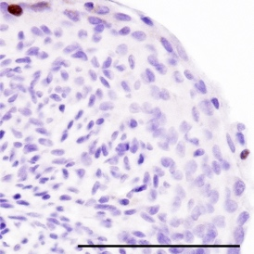
Supplementary Figure 1
A
Bright field
image
HE
HE
SSTR2A
Ki-67
HKBMM
B
HE/
Bright field
image
HE
SSTR2A
Ki-67
STAT6
FOXM1
P
SFT2
O
C
Grade I (M10)
Organoid size
Number of organoids
DMEM+10%FBS
Serum-free
600
15
400
10
size (μm)
number
200
5
0
0
DMEM
+10%FBS
Serum
-free
DMEM
+10%FBS
Serum
-free
D
Grade I (M9)
Grade II (M6)
Ki-67
HE
Ki-67
HE
Ki-67
8
6
Pre
Ki-67⁺ index (%)
4
2
Post
0
M9
M10
M6
M7
Pre-cryopreservation
Post-cryopreservation

Slide 2
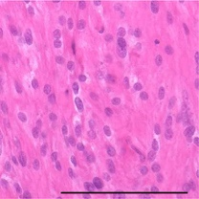
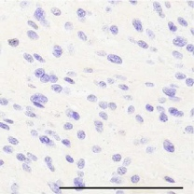
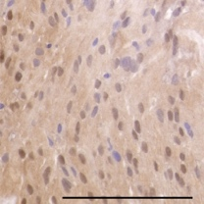
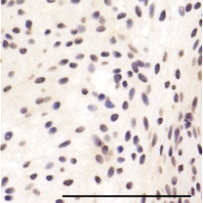
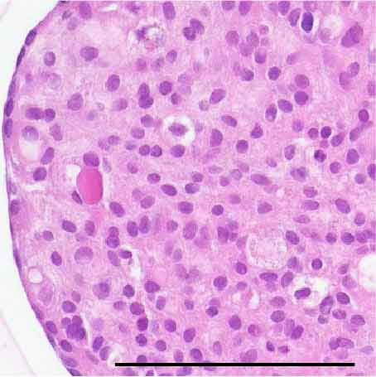
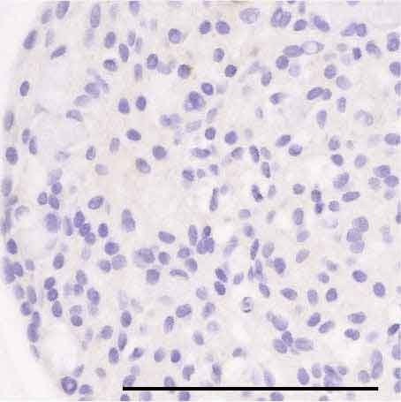
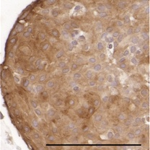
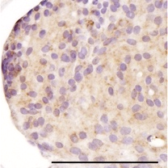
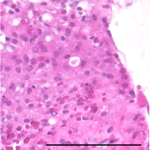
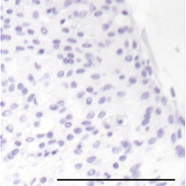
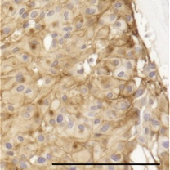
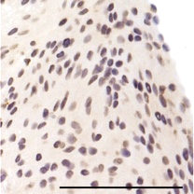
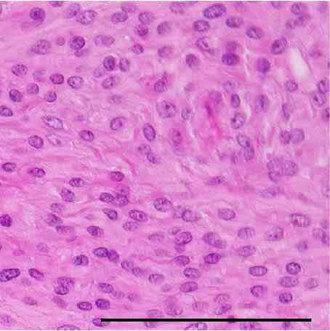
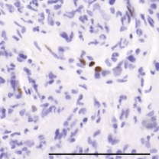
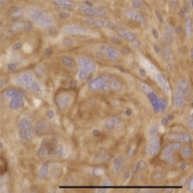
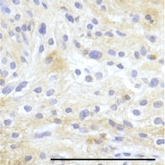
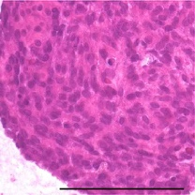
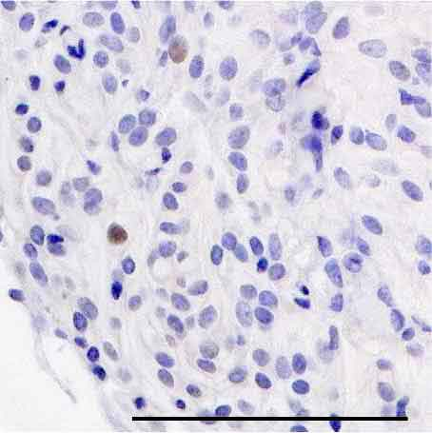
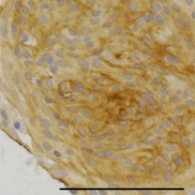
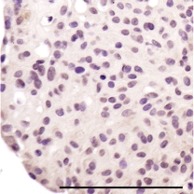
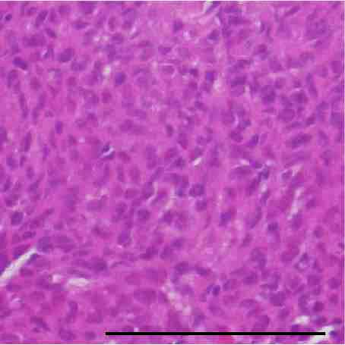
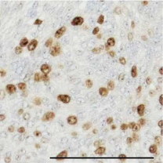
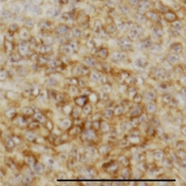

























Supplementary Figure 2
HE
Ki-67
SSTR2A
STAT6
P
Grade I (M5)
O
Passage 1
Late
-O
Passage 8
P
Grade II (M7)
O
Passage 3
P
Ki-67
Grade III (M8)
50
O
Passage 8
40
Late
-O
30
Passage 16
Ki-67⁺ index
20
10
0
P
Grade:
M5
M7
M8
M4
M3
I
II
III
I
I
Grade I (M4)
Parental tumor
O
Passage 14
Organoid
Late-Organoid
P
Grade I (M3)
O
Passage 15

Slide 3
Supplementary Figure 3
A
1
2
3
4
5
Chromosome number
Log₂
copy ratio
6
7
8
9
10
11
12
13
14
15
16
17
18
19
20
21
M1
P
22
-1
0
1
O
M2
P
O
M3
P
O
B
Breakpoint
Chr12: 57,485,581
Chr12: 57,492,807
NAB2
STAT6
GGAAAGTGTGGAGAGGATCT
CCGTGGAAAGGTGAGTGTGGA
P
GGAAAGTGTGGAGAGGATCT
CCGTGGAAAGGTGAGTGTGGA
O

Slide 4





















Supplementary Figure 4
A
Grade II (M14)
Grade I (M9)
Control
si-FOXM1
Control
pcDNA
-FOXM1
-1
-2
FOXM1
FOXM1
β-actin
β-actin
B
Grade I (M9)
Grade I (M12)
Control
pcDNA-FOXM1
Control
pcDNA-FOXM1
HE
HE
Ki-67
Ki-67
FOXM1
FOXM1

Slide 5








Supplementary Figure 5
A
Radiation
B
Thiostrepton
1.2
1.4
1.0
1.2
0.8
1.0
Relative luminescence
Relative luminescence
0.6
0.8
0.4
0.6
0.2
0.4
0.2
0
4Gy
0
Control
8Gy
12Gy
16Gy
Control
1μM
2μM
4μM
8μM
C
Control
4μM
4Gy
4μM+4Gy
IOMM-Lee
HKBMM
Organoid size
Number of Organoids
2.0
1.2
IOMM-Lee
1.5
1.0
HKBMM
0.8
Relative size
Relative number
1.0
0.6
0.5
0.4
0.2
0
Control
4μM
4Gy
4μM+4Gy
0
Control
4μM
4Gy
4μM+4Gy
D
Thiostrepton (4μM) with or without radiation (4Gy)
1.2
IOMM-Lee
1.0
HKBMM
0.8
Relative luminescence
0.6
0.4
0.2
0
Control
4μM
4Gy
4μM+4Gy

